Slide 1
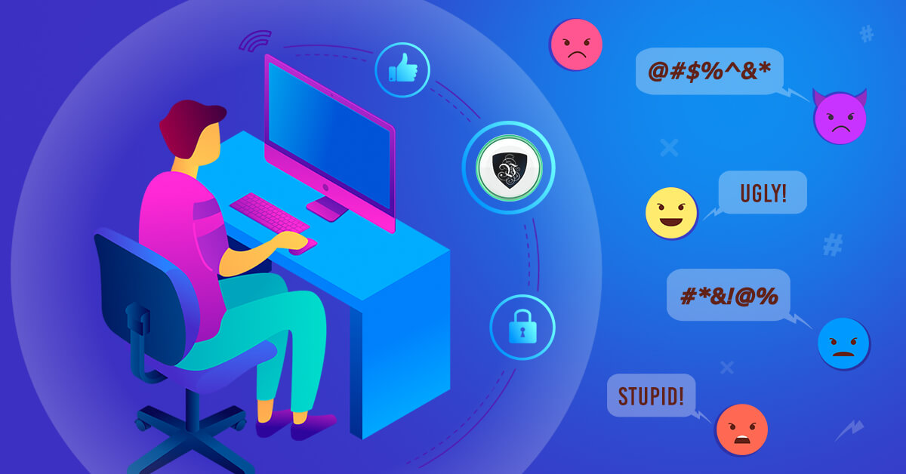
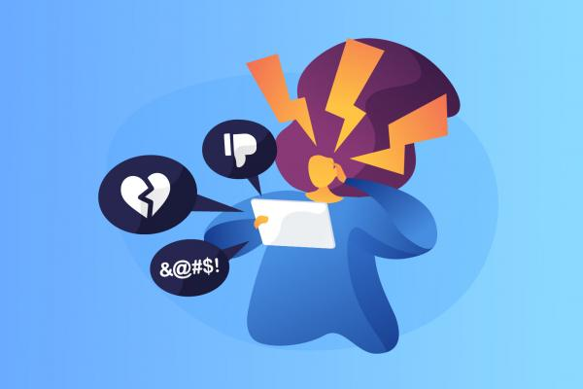
WHAT’S CYBERBULLYING
It’s a type of bullying that happens online, and in devices, like phone, computer and etc.
Cyber-bullying can occur via SMS, texts, emails or photos; it also occurs when someone shares a person’s personal infos to others.

Slide 2
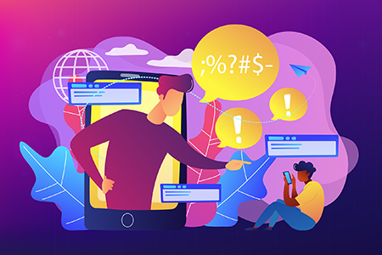
A person’s personal infos, if shared online, can be
seen by strangers. If the infos are negative, this
will create a wrong reputation of the individual,
and will be exposed to negative comments, views
and behaviors.

Slide 3


The consequences of it cause:
-Humiliation (because online bullying lasts longer, and
it may cause embarrassment, overwhelming and
exposion)
-Isolation (it creates a sense of being excluded or ostricized, and
it can worsen because at this age friends are important, so not
having them is crucial)
-anger ( it creates a non-ending cycle if repeated on other
people)

Slide 4

Also it can affect a person’s mental health and
emotions.
It can generate:
-humiliation ( the peraon is too embarrassed to talk
about it and feels overwhelmed)
-anger ( they’ll try to respond back with the same way
the bully did)
-isolation ( they feel excluted or ostracized at school)
-depression and anxiety (it increases feelings of worry and isolation and
erodes self-confidence)
-self-esteem (they doubt their woth and value)

Slide 5

HOW TO PREVENT IT
1)Educate yourself of how it happens and where happens, how it shows
and what causes it
3) protect your password so strangers and other peers won’t be able to
enter in your account
3) think about when you want to send a photo of yourself and think
what would happen after
4) pause before posting something that may com-
promise your reputation
5)Raise awareness about the topic
6) Don’t be a cyberbully

