Slide 1
Cyberbullying
Diego Di Modica
Adriana Karola Scalzo
Elena Floridia 2bl

Slide 2
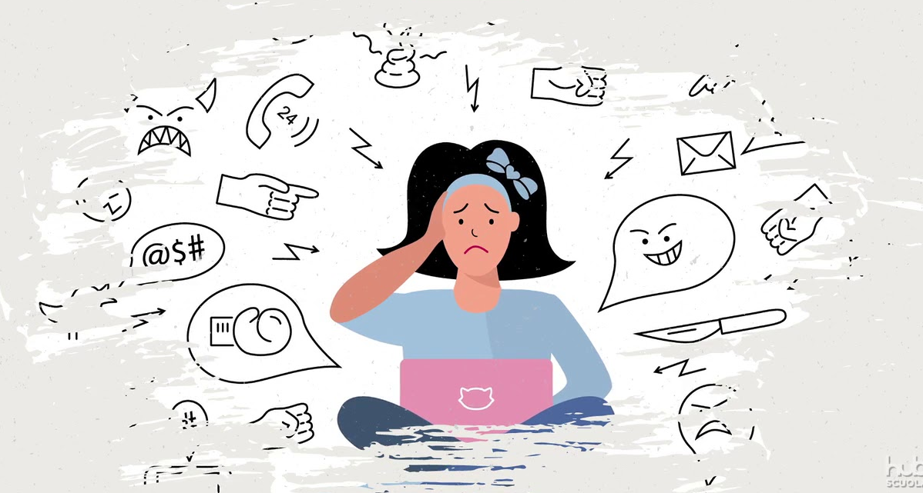
Cyberbullying is a fenomenon which occurs specially among teenagers through technological devices .

Slide 3
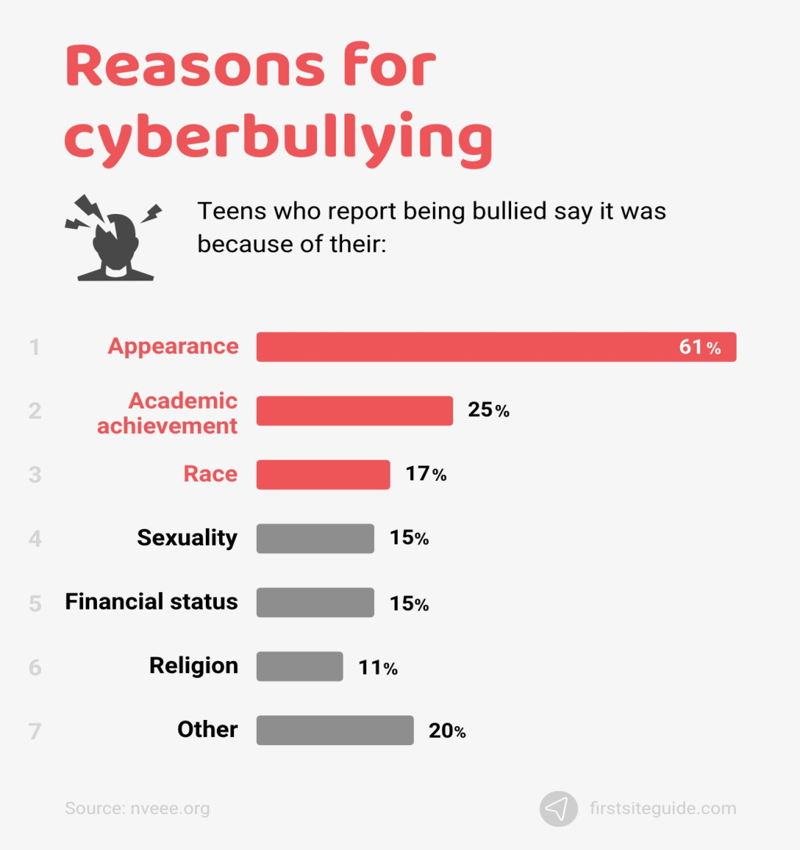
Cyberbullying’s episodes happen constantly all over the world for different causes.

Slide 4
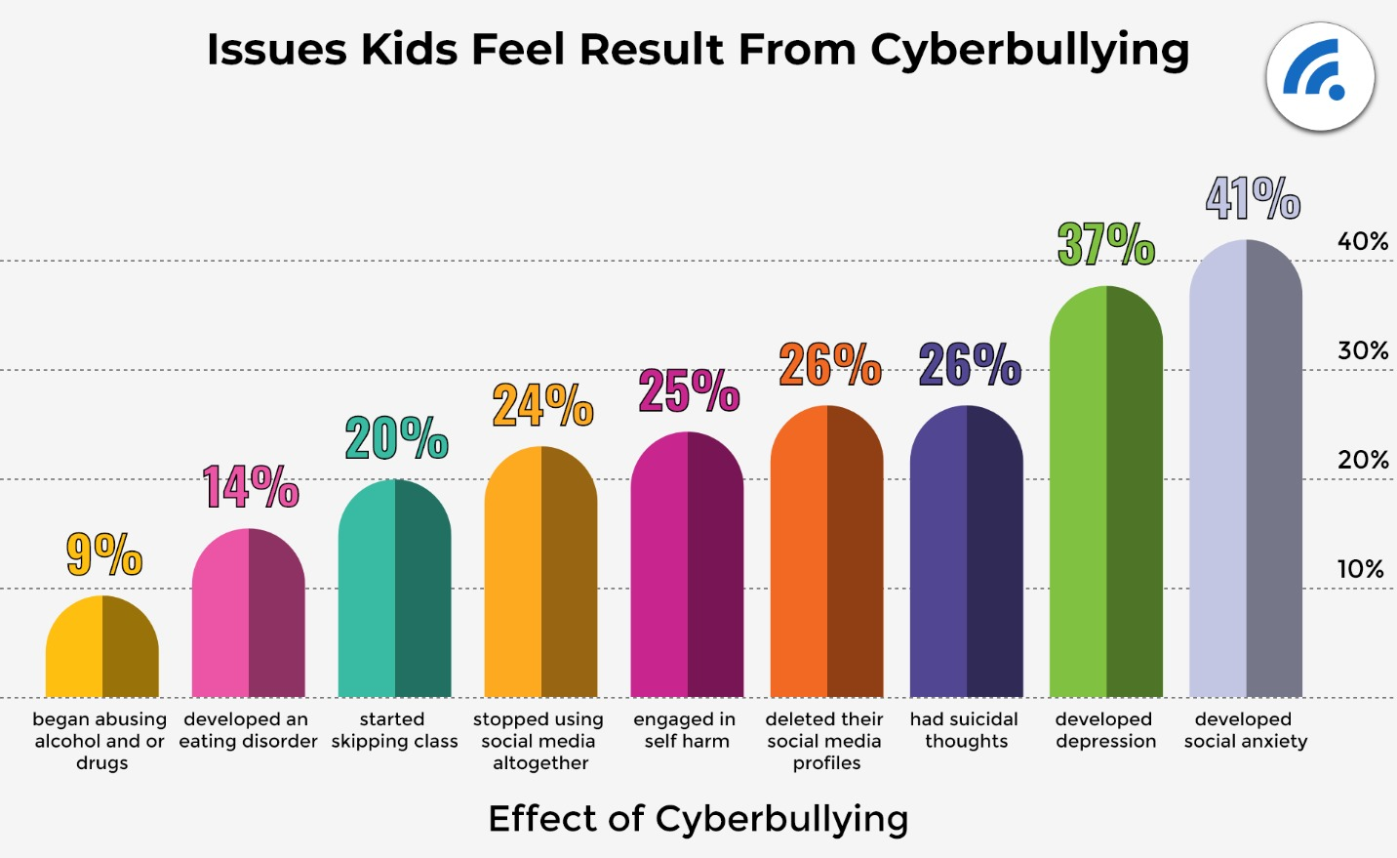
Who is a bully and a cyber-bully?
A bully is a person who often has a low self-esteem. For this he finds his strength addressing threats, insults, harassments and physical violence towards weak targets. A cyber-bully hits his victims by social media. A victim can react in different ways:

Slide 5
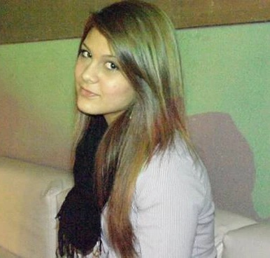
In that 26 % re-enters the example of an italian girl: Carolina Picchio.
She was a fourteen-year old from Novara who took her own life. The cause was the diffusion of some of her intimate videos and photos. Everything started with the anger of his ex boyfriend, who was the first to send a compromising video.

Slide 6
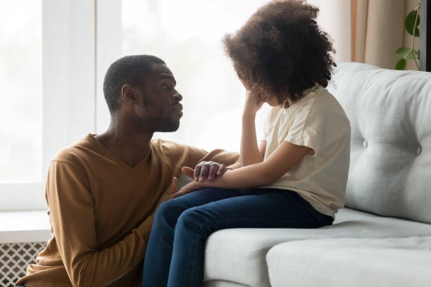
When you feel bothered by someone, the first step to get out from this situation is acquiring awareness, then talking about it with anyone you trust and believe in your strenghts. Instead if you understand that you are a possible attacker don’t aim to a target, but prove that you worth standing up for who is in difficulty.

