Slide 1
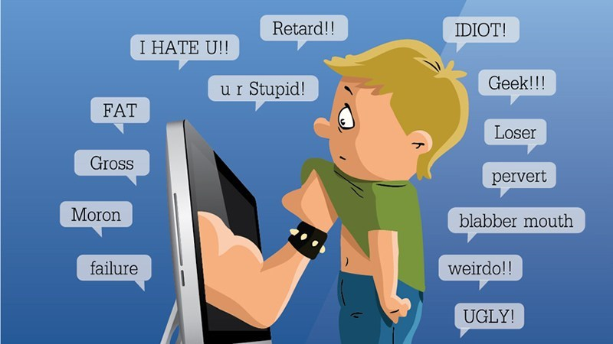

Cyberbullying
Cyberbullying is a form of bullying that takes place through telematic tools, such as the internet.

Slide 2
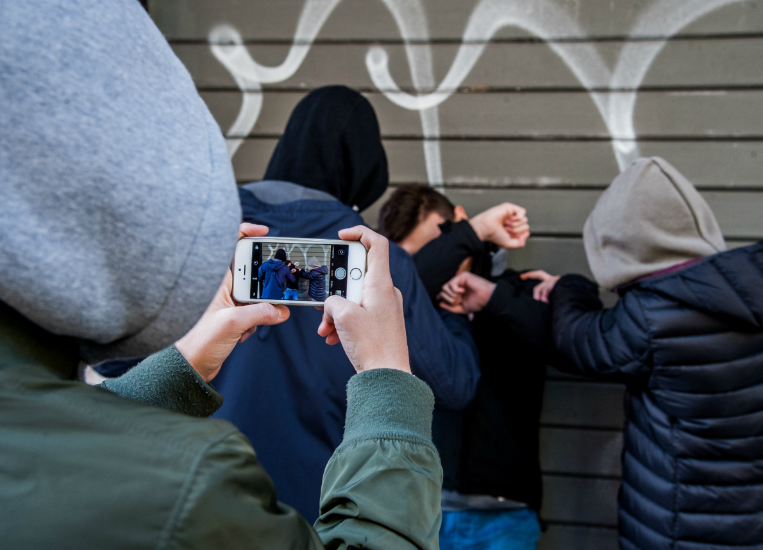
Cyberbullying can take place via SMS, email or social networks such as Instagram, Facebook.
In general, young people or children who have a different sexual or political orientation, or because of their physical appearance, who have a reserved nature or attack public figures are attacked. They are secretly filmed from phones and then the videos are posted on social media to mock the victim.

Slide 3


The law of 2017 provides that the minor victim of cyberbullying can request the website or the operator of the social network or the owner to hide, delete or block the contents disseminated on the internet.

