Slide 1
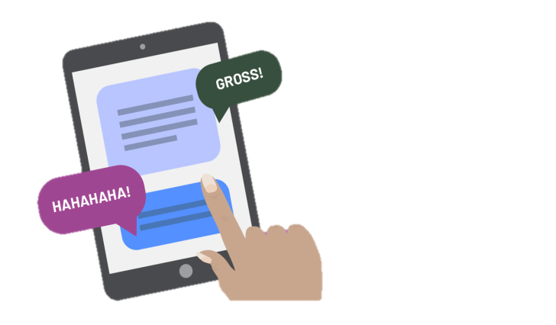
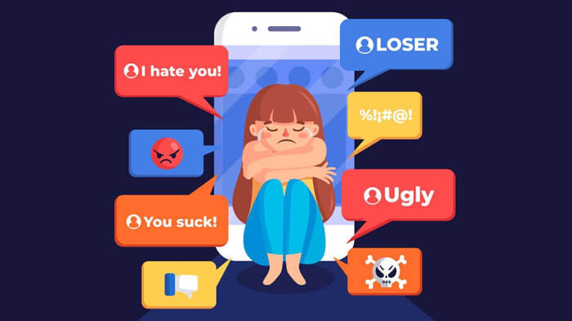
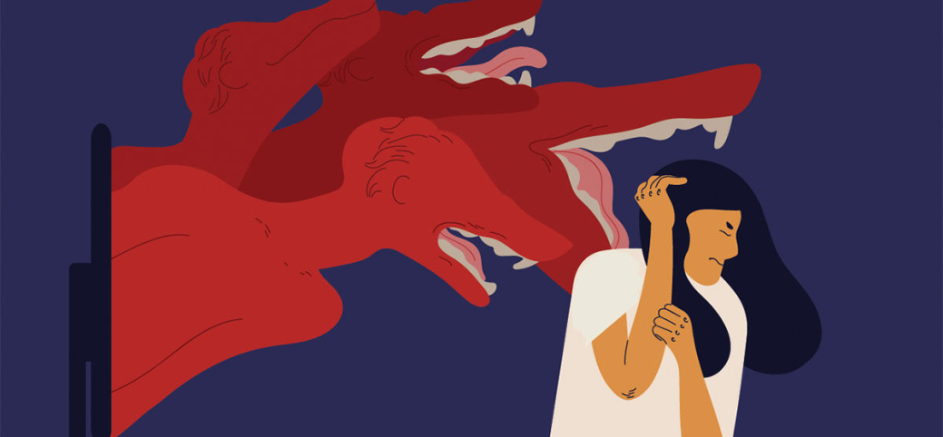
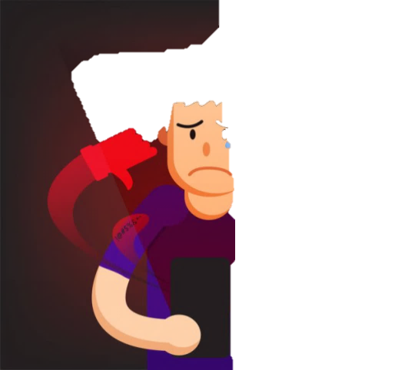
Cyberbullying
Cyberbullying is a type of bullyng by internet
This term refers to offenses, harassment, blackmail or forms of pressure. by a person or group of people against another person or group, using digital technologies .

Slide 2
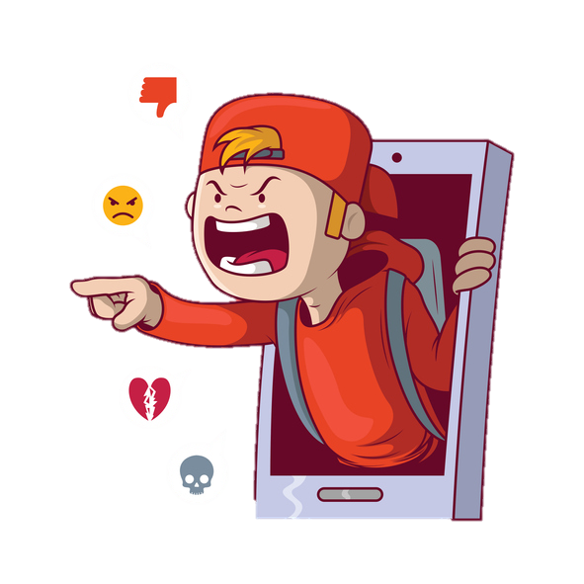

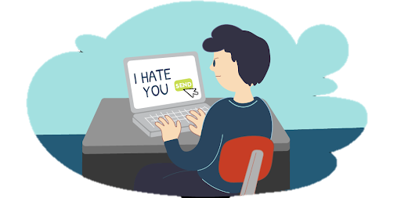
Why is ciberbullyins so prevalent?
The technology has peculiarities because "it allows bullies to infiltrate the homes of victims, to materialize in every moment of their life, persecuting them.
the bully can hide his/herself behind a fake profile or an anonymity

Slide 3
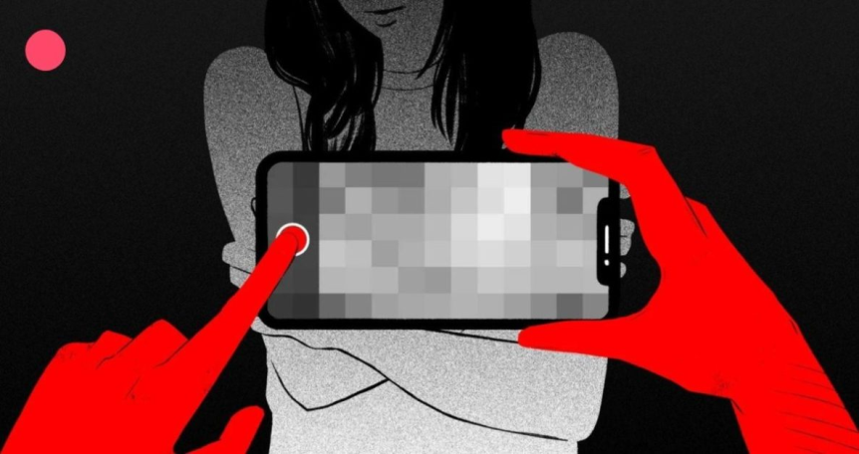
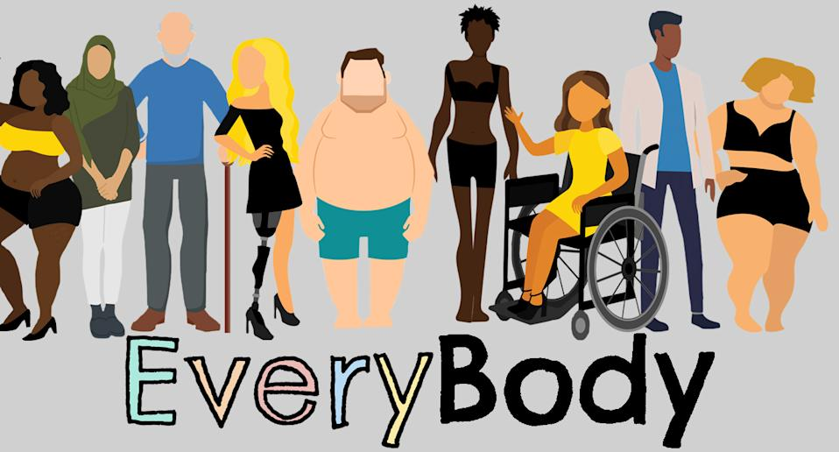


Different form of Cyberbullying
Revenge porn
Body shaming
Doxing
Hate speech

Slide 4
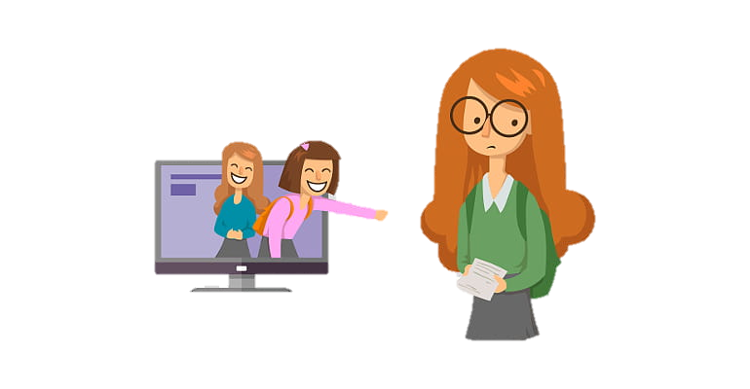
Cyberbullying today
in Italy
Today, because of the coronavirus, the use of the internet is even more frequent and this has led to an explosion of the phenomenon of cyberbullying in all virtual classrooms in Italy.
According to the Carolina Foundation
there have been 121 cases in the last month, with victims among children and 89 with victims among teachers, 9 cases of "sexting" and 4 cases of "revenge porn"

Slide 5
Cyberbullying
2 BL
Spinelli Miriana, Genovesi Gloria

