Slide 1
cyberbullying
Marika Giampapa
Giada Santoro

Slide 2

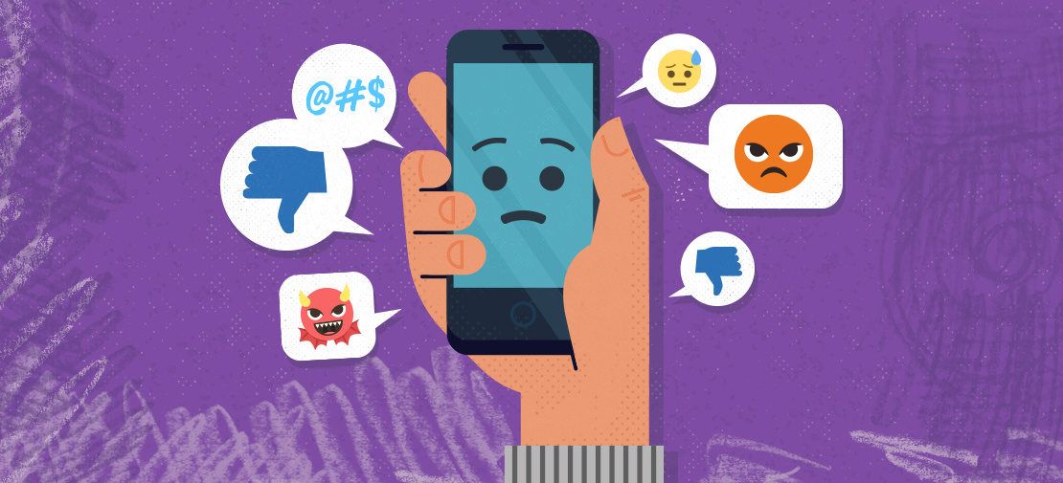
What is it?
Cyberbullyng is bullyng that takes place using electronic technology that includes devices such as cell phones, computers including social media, websites. Posting embarrassing pictures or videos with fake profiles.

Slide 3
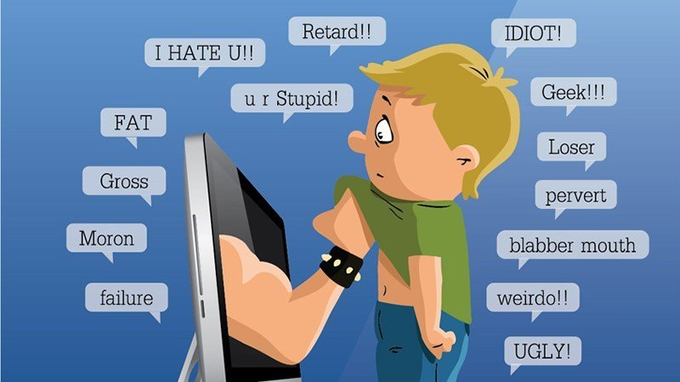
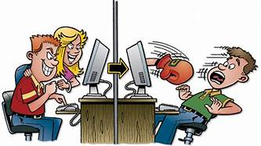
types of cyberbullying
Flaming: violent and vulgar online messages.
Harassment: Repeated sending of messages aimed at hurting someone.
Denigration: gossiping about someone to damage their reputation through social media.
Person substitution: pretending to be another person to send inappropriate photos or messages.
Exclusion: Excluding a person from an online group to cause them to feel marginalized.
Cyberpersecution: Harassment aimed at instilling fear.
Doxing: public disclosure of personal data

Slide 4
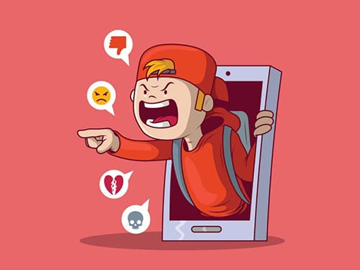
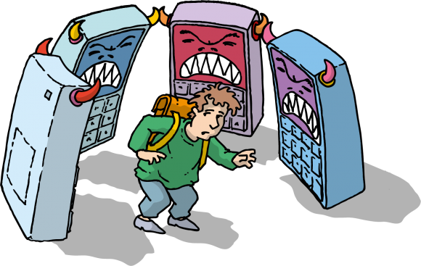
The purpose of cyberbullying is to embarrass, harass or intimidate someone.
Studies have shown the effects of cyberbullying it has on victims such as self-harm or even suicide.
To fight cyberbullying you have to talk about it with your parents, teachers or the authorities.

