Slide 1


Slide 2
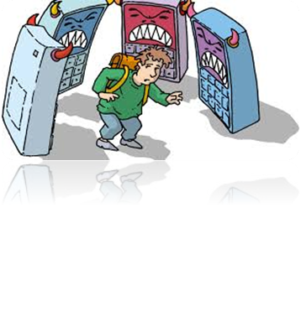
DEFINITION:
Cyberbullying is an aggressive action made by one or a group of people, using electronic means, against a person which cannot defend itself or fails to do so

Slide 3


BULLYING AND CYBERBULLYING:
Cyberbullying has elements in common with traditional bullying, but it has other elements that specifically characterize this phenomenon and that derive from the modalities interactive mediated by new technologies.

