Slide 1
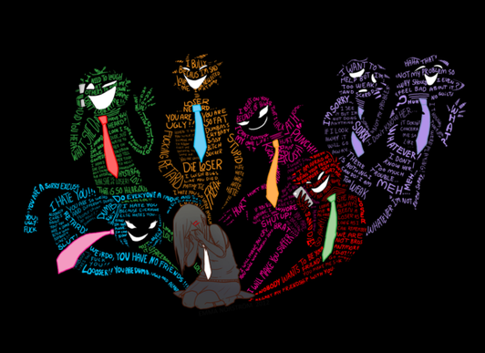
What Is Bullying
Bullying is unwanted, aggressive behavior that involves a real or perceived power imbalance. The behavior is repeated, or has the potential to be repeated, over time. Both kids who are bullied and who bully others may have serious, lasting problems.
Repetition: Bullying behaviors happen more than once or have the potential to happen more than once.

Slide 2
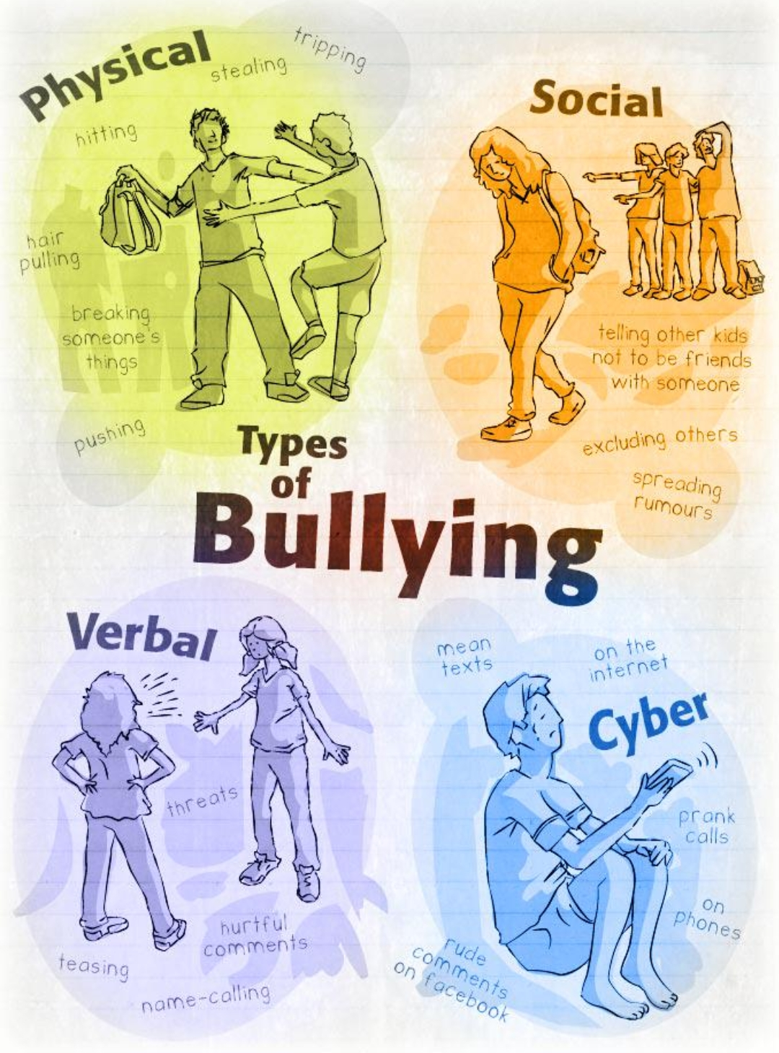
Types of Bullying
There are three types of bullying:
Verbal bullying is saying or writing mean things. Verbal bullying includes:
- Teasing
- Name-calling
- Inappropriate sexual comments
- Taunting
- Threatening to cause harm
Social bullying, sometimes referred to as relational bullying, involves hurting someone’s reputation or relationships. Social bullying includes:
- Leaving someone out on purpose
- Telling other children not to be friends with someone
- Spreading rumors about someone
- Embarrassing someone in public
Physical bullying involves hurting a person’s body or possessions. Physical bullying includes:
- Hitting/kicking/pinching
- Spitting
- Tripping/pushing
- Taking or breaking someone’s things
- Making mean or rude hand gestures
Cyber bullying is bullying that takes place over digital devices like cell phones, computers, and tablets. Cyberbullying includes:
- Exclusion: is the deliberate act of excluding someone from an online group.
- Gossip: Posting or sending cruel gossip to intentionally damage a person’s reputation and/or relationship with family friends, and coworkers.
- Fraping: Logging into someone else’s social networking account or email and impersonating that person by sending or posting inappropriate content in their name.
- Harassment: The constant and intentional posting or sending of offensive, cruel, threatening, or insulting messages/content to an individual.
- Cyberstalking: Posting or sending unwanted or intimidating messages to an individual that extends to making real threats on an individual’s physical wellbeing and/or safety.
- Outing and Trickery: The deliberate act of tricking someone into revealing personal or embarrassing information, which is then shared publicly to humiliate the individual.
- Fake profiles: a profile may be created so an individual can hide their real identity with the intention of cyberbullying an individual. This can also lead Catfishing.

Slide 3


A bullying situation:
Assistant:
Is a person who laugh at and encourages bullying behaviour but is not the actual bully.
Bully:
A bully is a person who repetely bothers someone else verbally, socially and/or physically.
Victim:
The victim (or target) is a person who is bullied by someone.
Upstander:
An upstander is a person who watches bullying take place and does something about it
Bystander:
A person or group of people who witness injustice but do nothing to try and stop it.

Slide 4

How to solve it
If you are directly involved If you aren’t involved
- Speak to someone - be an upstander
-Be aware that is not your fault - try isolate the bully

