Slide 1

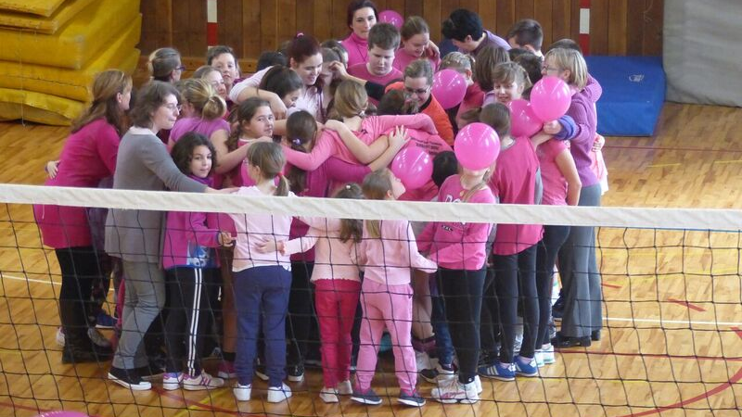

Cyberbullying
Alunne: Garilli Lucreazia , Paci Roberta
Classe : 2bl

Slide 2
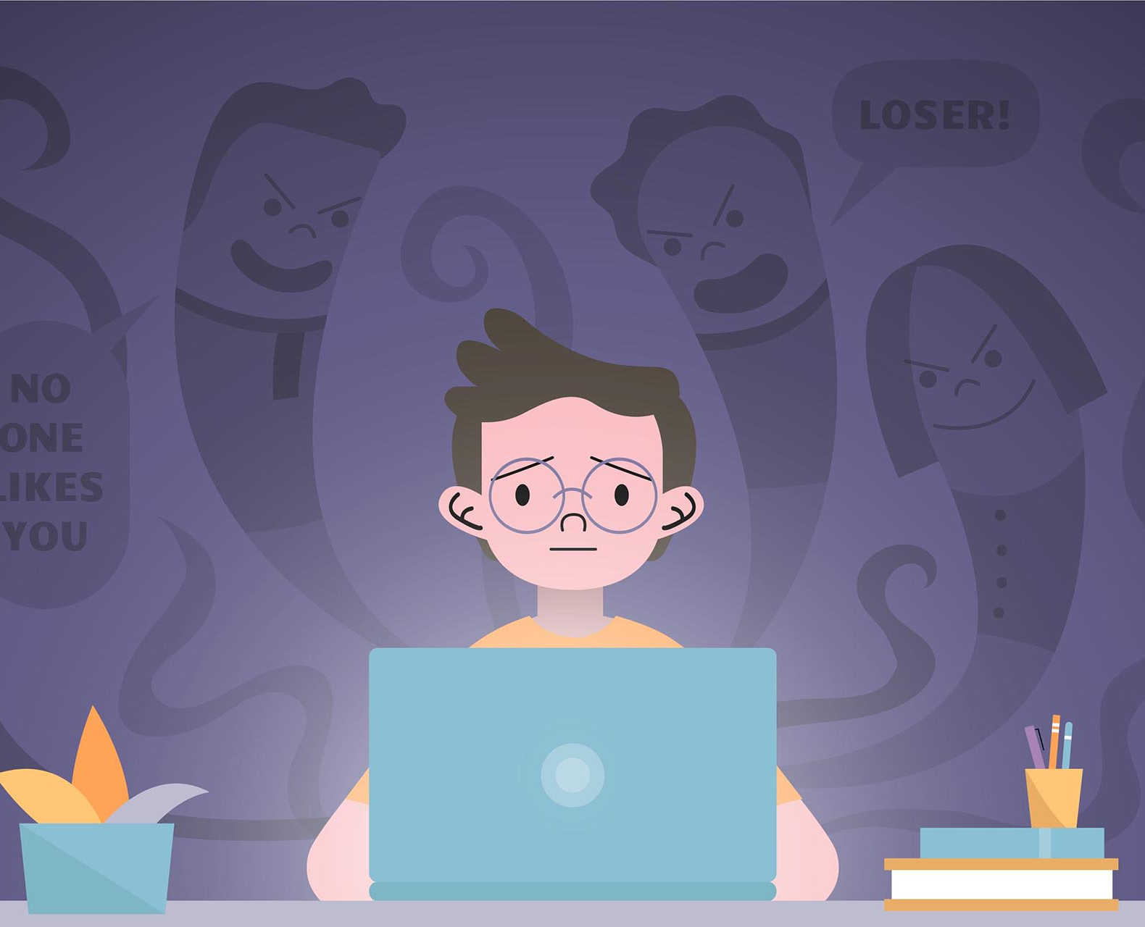
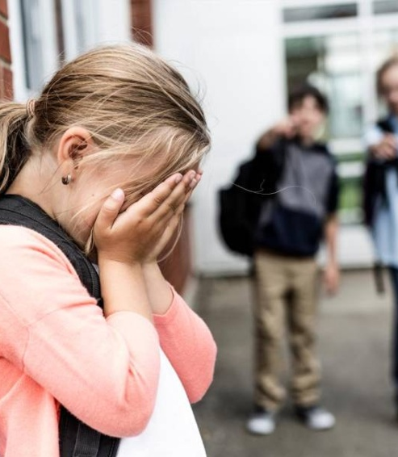
Bullying
Bullying is very often in school. Victims can be targeted for their race, gender, or religious beliefs.
Bullies torment their victims hitting, humiliating them inventing gossip.

Slide 3
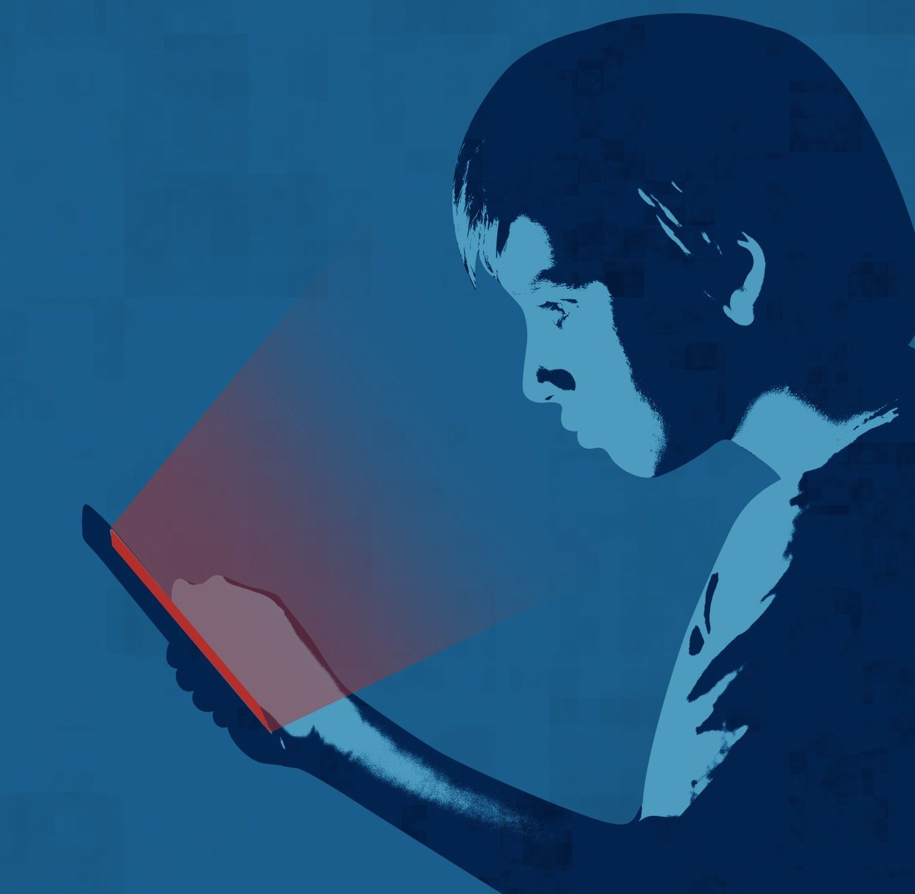
Cyberbullying
Social media allows bullies to torment their victims easily. Online, bullies can't hurt physically but they hurt the victims psychologically. Victims suffer self-esteem problems, anxiety and depression and could commit suicide.

Slide 4

In Social network bullies can use a fake name to torment their victims anonymously.
Bullies torment their victims
-spreading lies about or posting embarrassing photos of someone on social media
-sending hurtful messages or threats via messaging platforms

Slide 5
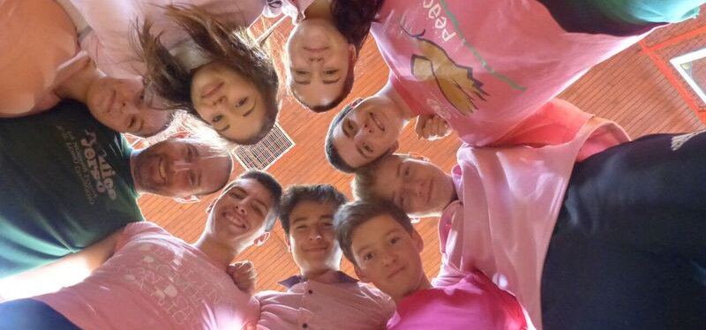

In case of bullying the best thing to do is talk with an adult about it. Also exist some campaigns to prevent. In Canada a boy was being bullied for wearing a pink shirt. By that an event known as “Anti- bullying Day”started where boys and girls wear pink shirts.

