Slide 1

CYBERBULLYING
-Giorgia Sciacca
-Nicole Tringali
VBL

Slide 2
INTRODUCTION
Cyberbullying is a form of bullying
or harassment using electronic means.
Cyberbullying is the use
of digital-communication tools
to make another person feel angry, sad,
or scared, usually again and again.

Slide 3

CATEGORIES OF CYBERBULLYING
How many are there?

Slide 4
There’s a total of seven...
HARASSMENT
DENIGRATION
CYBERSTALKING
IMPERSONATION
TRICY AND TRICKERY
EXCLUSION
HAPPY SLAPPING
Offensive and violent messages
Fake news and rumor
Terrorize and persecute the victims
Identity theft
Publication and dissemination of private informations
Exclude the victim from a group
The activity of attacking someone and filming the attack

Slide 5
WHAT ARE THE “ACTORS”
OF BULLYING?
SPECTATORS
BULLY
VICTIM
People that are aware of the actions of the bully, but ignore them.
Desire for control and power over the other and his actions, as well as a pleasure in causing discomfort.
WINGMAN
"Passive bully", flank the bully and support him.
Usually insecure and anxious, quietly undergoes the torment of the bully.

Slide 6
Why is the bully targeting others?
POPULARITY
POWER
PREJUDICES
Because people want try to climb the social ladder or gain some social power humiliating others.
Because people want to be in control when things do not go their way.
Race, religion, sexual orientation, physical.

Slide 7
The effects of cyberbullying
Anxiety
Depression
Reduction in educational attainment
Feelings of isolation
Changes in eating and sleeping habits
Lowering of self-esteem
Increase in school absences
Loss of interest in hobbies and other activities
Using alcohol and drugs to cope
Retreat from family and friends

Slide 8
IS CYBERBULLYING WORSE THAN
TRADITIONAL BULLYING?
Yes, it is, because cyberbullying can have more devastating effects...
Cyberbullying is a very difficult form of bullying to prevent and to police;
The bully is often anonymous and not easy to identify;
Digital images, cell phones, and other electronic means can greatly increase the speed in which the bully's messages can spread;
Cyberbullying continues even when you are at home, in your own "safe zone".

Slide 9
➥Tips on to prevent cyberbullying
Stand up for others who are being cyberbullied.
Remember that everything you post is permanent and public.
A
B
Raise awareness.
Speak to an authority figure if the need arises.
C
D
Check your privacy settings.
E
Avoid taking compromising photos.
F

Slide 10
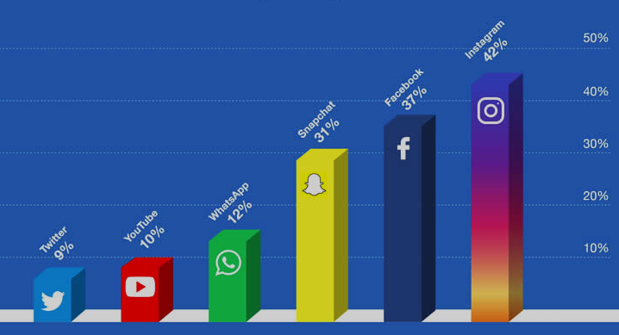
WHERE ARE PEOPLE CYBERBULLIED?

Slide 11
The actions by social networks
FACEBOOK
INSTAGRAM
GOOGLE
Instagram introduced a filter that detects and obscures bullies.
Facebook developed a platform to help children and parents that are looking for support about bullying issues.
Google with an app filters words and searches on the internet and checks on the apps that your child can download.

Slide 12
THE LAW OF CYBERBULLYING
Although bullying is not a specific criminal offence law in many states like UK;
in some countries this law was issued.
In Italy it was issued on 29th May 2017 ("prevention and contrast of early school leaving, all forms of discrimination and bullying, including computer")

Slide 13

—Anna Maria Chavez
“Unless and until our society recognizes cyberbullying for what it is, the suffering of thousand of silent victims will continue.”

