Slide 1
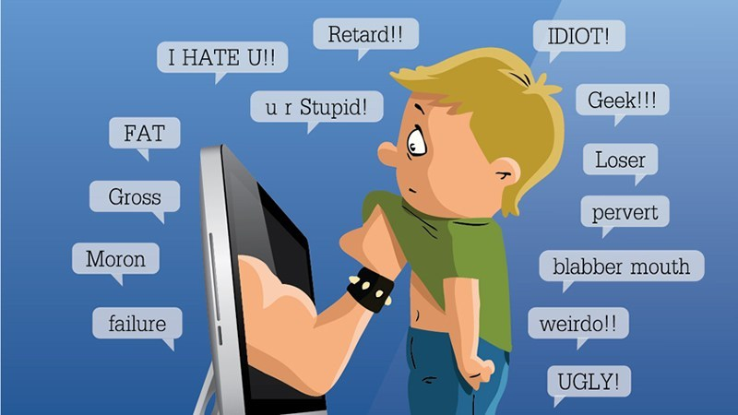
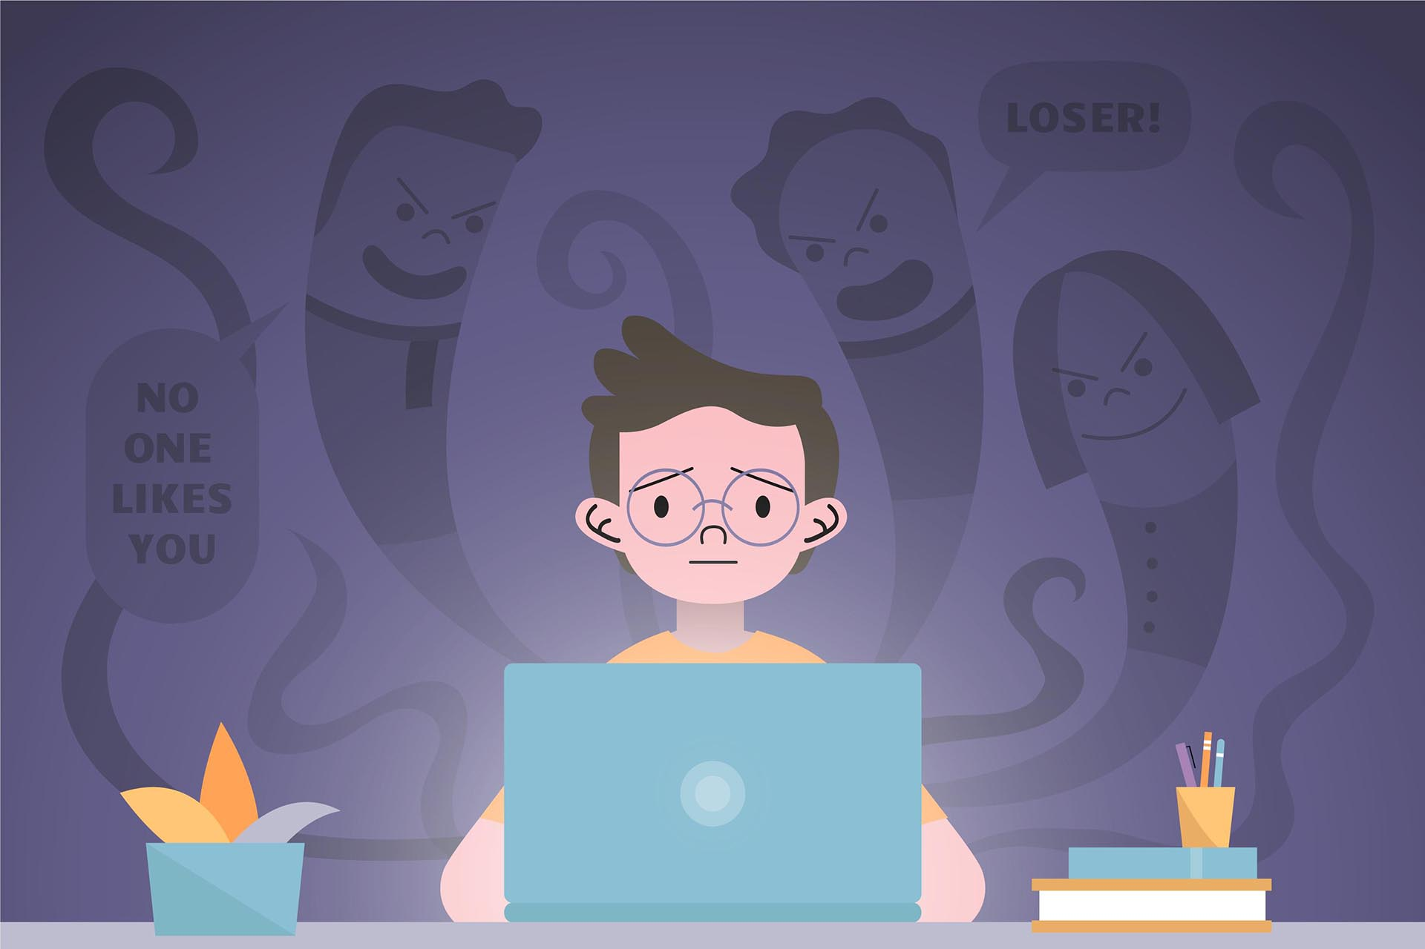
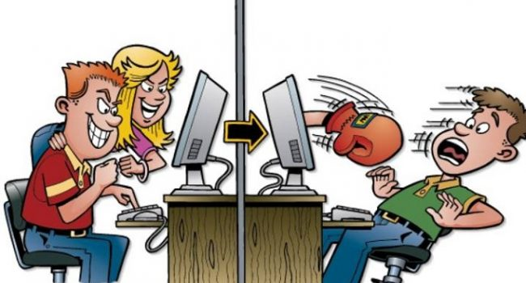
CYBERBULLYING
ALESSIA
FARERI
What is cyberbullying for you? Now we tell you about it.
FRANCESCO PITARI

Slide 2
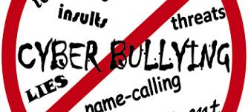
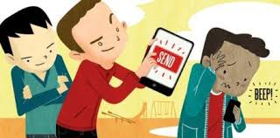
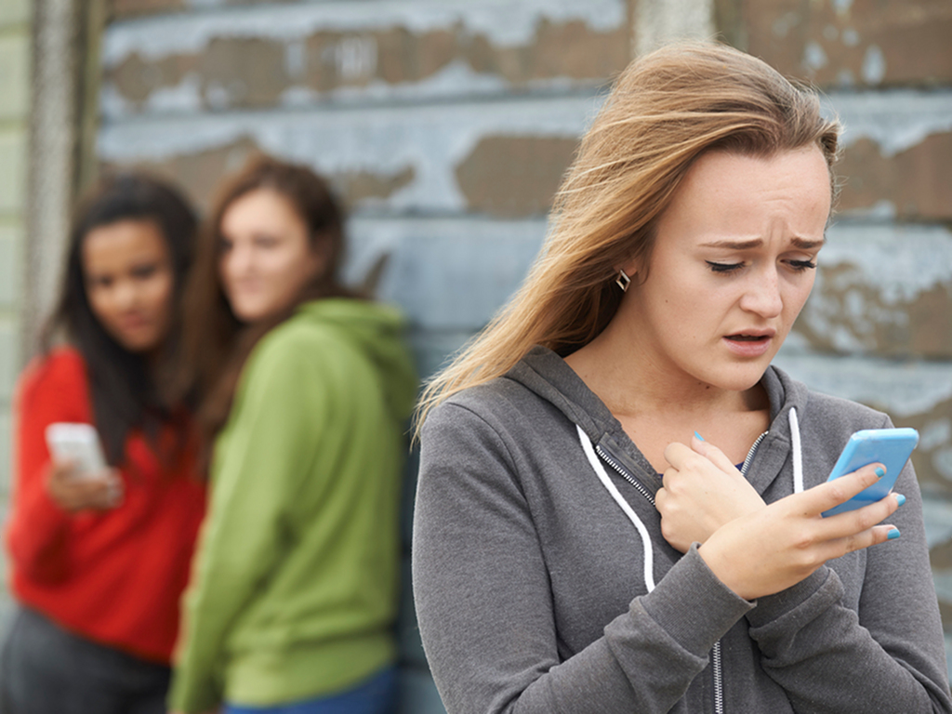

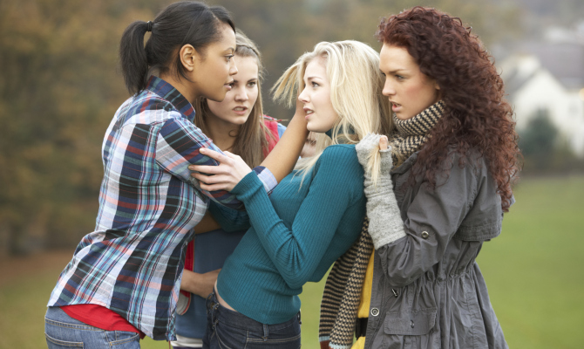
What’s about bullying?
Pysical bullying
Verbal bullying
Cyberbullying
Racist bullying
They are very dangerous

Slide 3
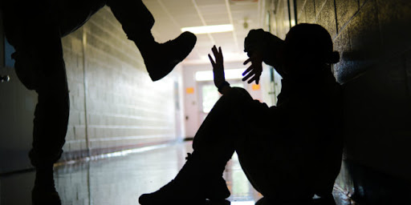
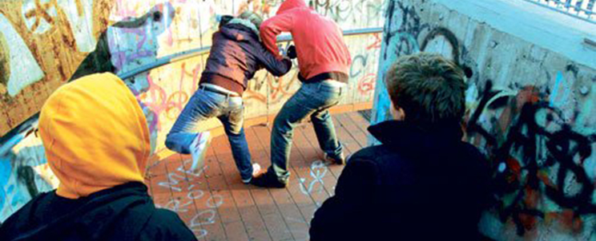
Pysical bullying and Verbal bullying
  Pysical bullying
It is very dangerous for the victim, because the bullies attack usually victim’s body and so they can ruin it.
Verbal bullying
Includes teasing, name calling, racial slurs, gossip. Verbal bullying is a form of violence that is carried out by a boy / girl, within a restricted territory, where the victim is targeted without being able to defend himself.

Slide 4
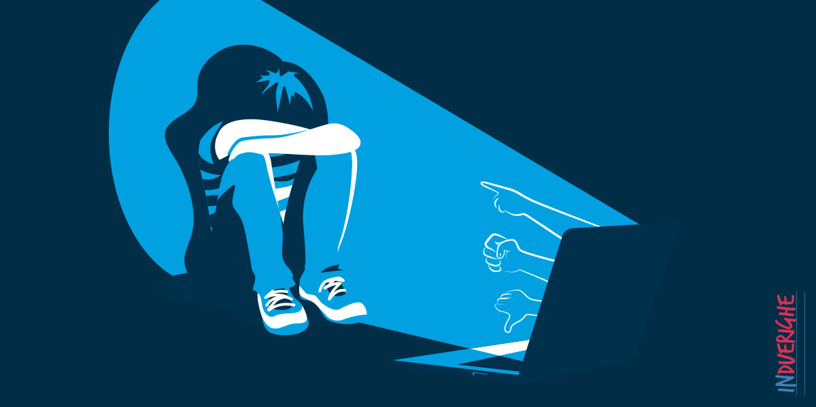
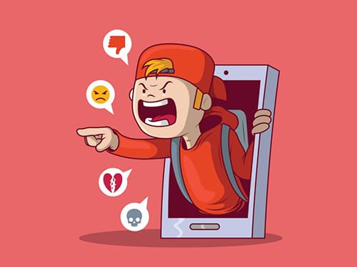
CYBERBULLYING
It is a serious problem
Cyber-bullies use the internet and mobile phone. They can send threatening or offensive emails and text messages. Sometimes they harass people on social media sites. Social media sites have got positive and negative aspects.
                Victims of bullying usually feel isolated

Slide 5

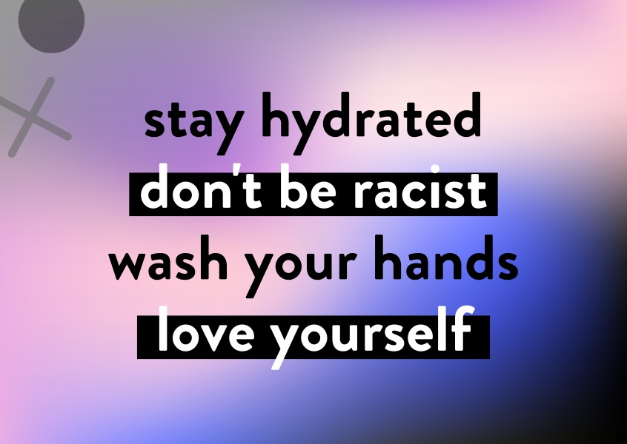
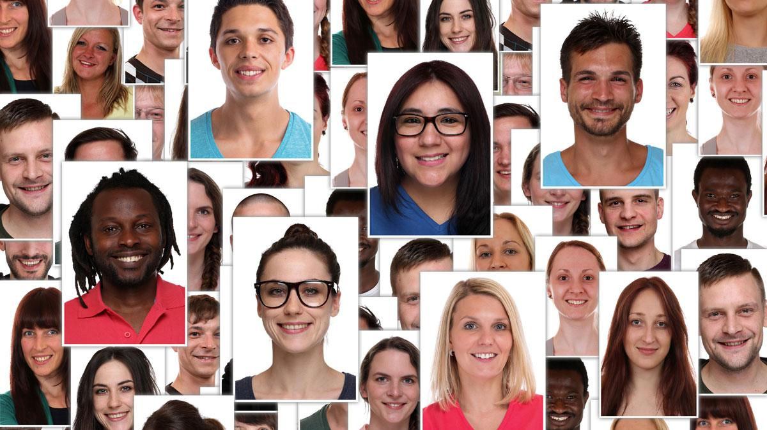
Racist bullying
Racism is the belief that groups of humans possess different behavioral traits corresponding to physical appearance and can be divided based on the superiority of one race over another. It may also mean prejudice, discrimination, or antagonism directed against other people because they are of a different race or ethnicity.
STOP RACISM

