Slide 1

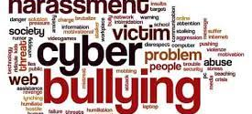

Cyberbullying
Giorgia Randazzo
Alessandra Serra
3AL

Slide 2

What is cyberbullying?
Cyberbullying is bullying with the use of digital technologies. It can take place on social media, messaging platforms, gaming platforms and mobile phones. It is repeated behaviour, aimed at scaring, angering or shaming those who are targeted. Examples include:
spreading lies about or posting embarrassing photos of someone on social media
sending hurtful messages or threats via messaging platforms
impersonating someone and sending mean messages to others on their behalf.

Slide 3

The difference between a joke and bullying
All friends joke around with each other, but sometimes it’s hard to tell if someone is just having fun or trying to hurt you, especially online. Sometimes they’ll laugh it off with a “just kidding,” or “don’t take it so seriously.”
But if you feel hurt or think others are laughing at you instead of with you, then the joke has gone too far. If it continues even after you’ve asked the person to stop and you are still feeling upset about it, then this could be bullying.
Stopping cyberbullying is not just about calling out bullies, it’s also about recognizing that everyone deserves respect – online and in real life

Slide 4
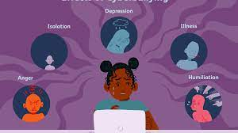
The effects of cyberbullying
When bullying happens online it can feel as if you’re being attacked everywhere, even inside your own home. It can seem like there’s no escape. The effects can last a long time and affect a person in many ways:
Mentally — feeling upset, embarrassed, stupid, even angry
Emotionally — feeling ashamed or losing interest in the things you love
Physically — tired (loss of sleep), or experiencing symptoms like stomach aches and headaches
The feeling of being laughed at or harassed by others, can prevent people from speaking up or trying to deal with the problem. In extreme cases, cyberbullying can even lead to people taking their own lives.

Slide 5
What should I do if someone is bullying me online?
If you think you’re being bullied, the first step is to seek help from someone you trust such as your parents, a close family member or another trusted adult.
In your school you can reach out to a counsellor, the sports coach or your favourite teacher.
And if you are not comfortable talking to someone you know, search for a helpline in your country to talk to a professional counsellor.

Slide 6

If the bullying is happening on a social platform, consider blocking the bully and formally reporting their behaviour on the platform itself. Social media companies are obligated to keep their users safe.
We also make it easy to report any bullying directly within Facebook or Instagram. You can always send our team an anonymous report from a post, comment or story on Facebook or Instagram.
We have a guide on Facebook that can help lead you through the process of dealing with bullying, On Instagram, there is also a Parent’s Guide that provides recommendations for parents, and a central hub where you can learn about our safety tools.

Slide 7

How do we stop cyberbullying without giving up access to the Internet?
Being online has so many benefits. However, like many things in life, it comes with risks. If you experience cyberbullying, you may want to delete certain apps or stay offline for a while to give yourself time to recover but you did nothing wrong, so why should you be disadvantaged?
We all want cyberbullying to stop so we need to be thoughtful about what we share or say that may hurt others and we need to be kind to one another online and in real life.
Think twice before posting or sharing anything online – it may stay online forever and could be used to harm you later. Don’t give out personal details such as your address, telephone number or the name of your school.

Slide 8

Punishments for cyberbullying
Most schools take bullying seriously and will take action against it. If you are being cyberbullied by other students, report it to your school. In countries that have specific laws on cyberbullying, online behaviour that deliberately causes serious emotional distress is seen as criminal activity.
However, it is important to remember that punishment is not always the most effective way to change the behaviour of bullies. It is often better to focus on repairing the harm and mending the relationship.

Slide 9
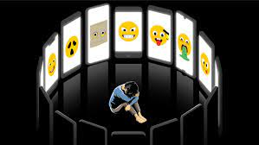
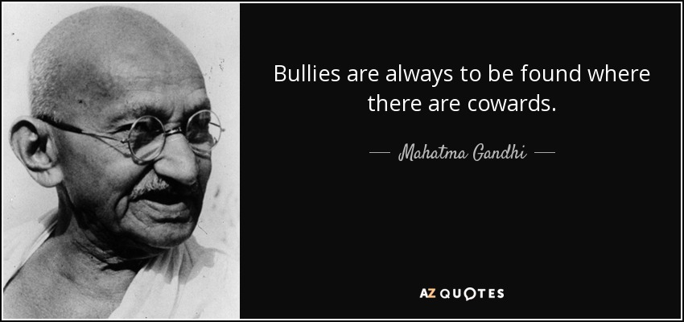
REMINDER

