Slide 1
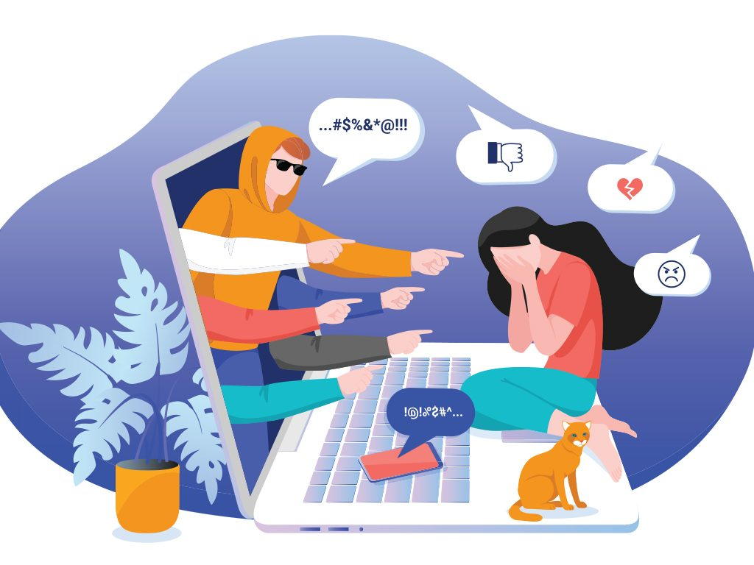
CYBERBULLYING
Serena Riera
Simone Flaminio
IV AL

Slide 2
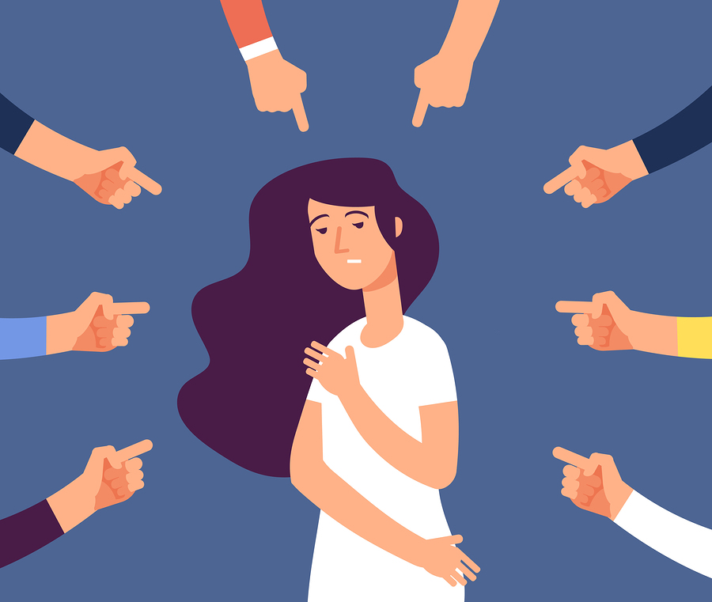
WHAT IS BULLYING?
Bullying is a common phenomenon that always existed, specially at school, but that can anyway occur everywhere else. The word "bully" was first used in the 1530s meaning "sweetheart", applied to either sex, The meaning deteriorated through the 17th century through "fine fellow", "blusterer", to "harasser of the weak". Bullying is an aggressive behavior which mostly involves children and teenagers, that can be repeated over time by using force, coercion, hurting teasing and it can cause serious, lasting problems.

Slide 3
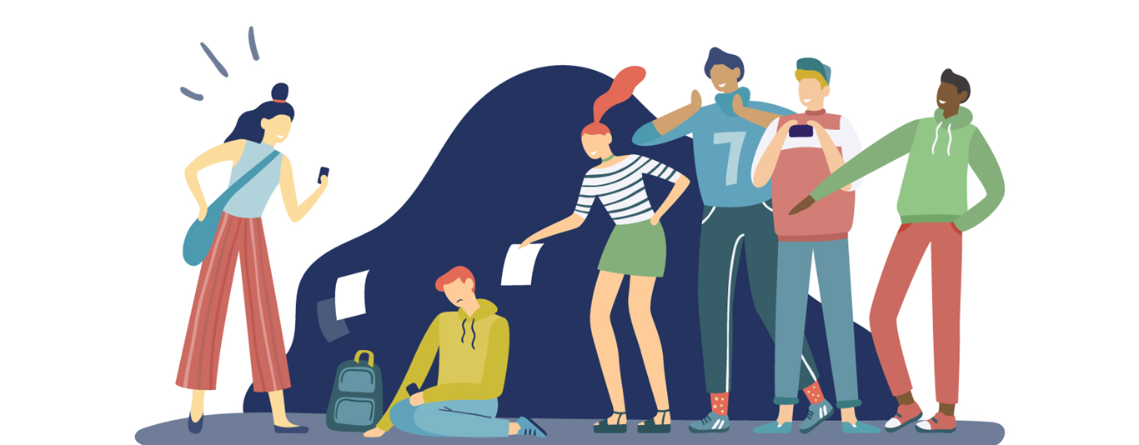
The behavior of the bully is often caused by low self esteem, problems at home with the family, repressed anger. These terrible states are unleashed on the victims who sometimes vent on someone else ,hence they create a chain of bullying that can only be stopped by the help of a friend, a parent or a teacher. A bully usually targets their victims and torments them by being annoying and doing small actions, like shoves or insults, or even worse, like stealing money or hitting.

Slide 4
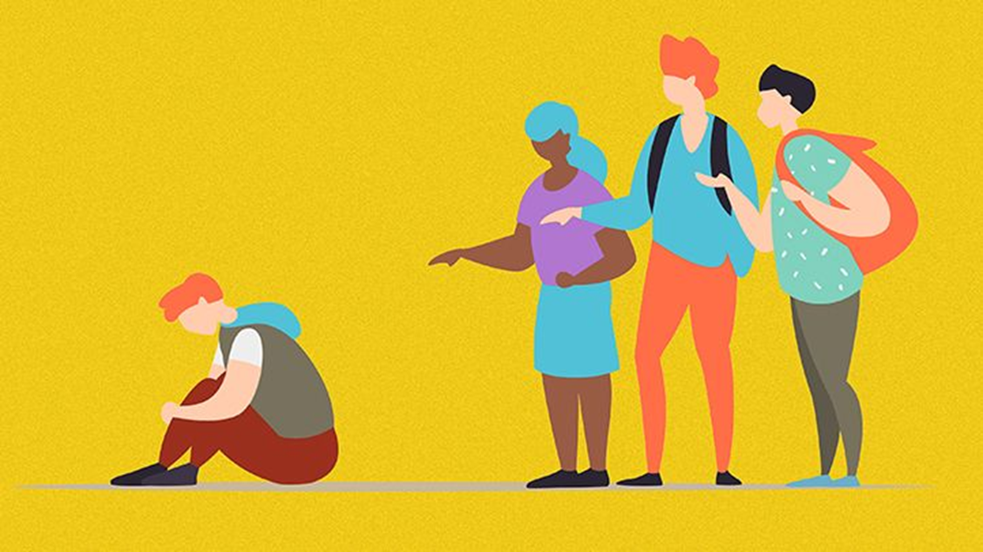
Victims are bullied for different reasons, for example different culture, different religious belief, different sexual orientation, different race, different social class. So sometimes bullying is a synonym for racism, homophobia and xenophobia. There are various types of bullying: physical bullying, social bullying, verbal bullying and cyberbullying.

Slide 5

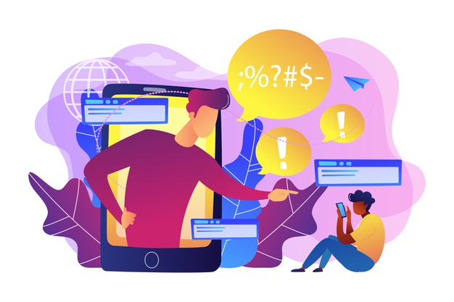
CYBERBULLYING
Harassment might also occur online; a bully torments a victim on social networks in direct messages or in front of others. Molestation can happen in various forms, such as fraud, identity theft, insults, sending porn or unwanted contents, revenge porn.
Nowadays, social media are essential for our lives and people spend most of their time on the Internet. Consequently, everyone could be a victim, but the real problem appears if it is a child or a teenager who does not know how to react. This is the reason school always alerts about this topic and prepares students to respond and fight back against bullying without using violence or unseemly actions.

Slide 6
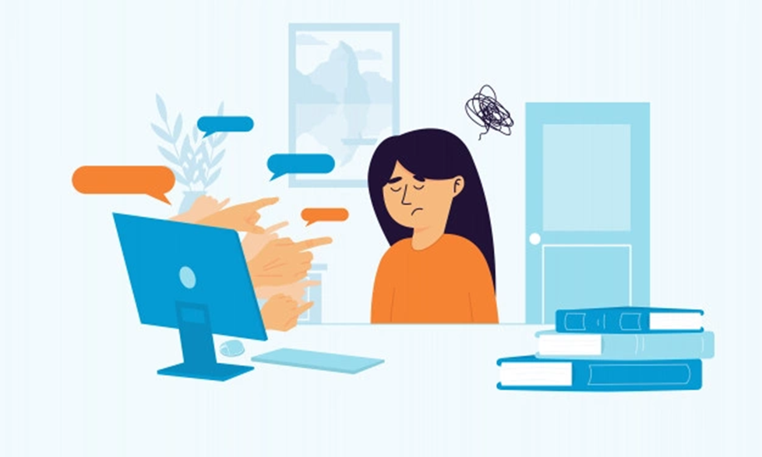
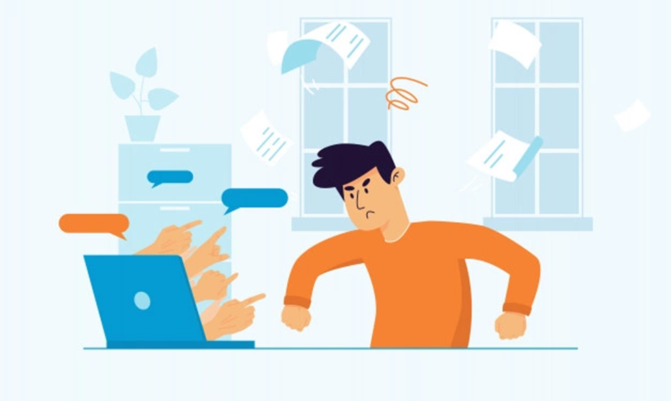
Since cyberbullying can be a danger for everyone, there is a possibility that a friend of ours could get bullied and undergo insults or violence online. It is, therefore, fundamental to understand how we can recognize a victim who is probably not comfortable enough or even scared to talk about it.
They usually try to hide their phone when they get a notification and people are able to see it
They get vigilant about their private lives and they could get mad if you try to “investigate” on their computer;
They suddenly have a shift in attitude or a change of heart as soon as they get on their phone
They may alter, get scared or be distracted if you talk to them while they are on the Internet

