Slide 1

CYBERBULLYING

Slide 2

WHAT IS CYBERBULLYING ?
Cyberbullying is using technology to bully or hurt someone else.

Slide 3
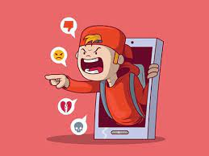
WHO ARE CYBERBULLIES AND WHO HELPS THEM?
In some cases , a cyberbully can also bully in face -to - face encounters . bullying over the computer may be a natural extension of their behavior.

Slide 4

WHO ARE THE VICTIMS ?
Most victims of cyberbullies are children , but there are also adults who are cyberbullying victims.

Slide 5
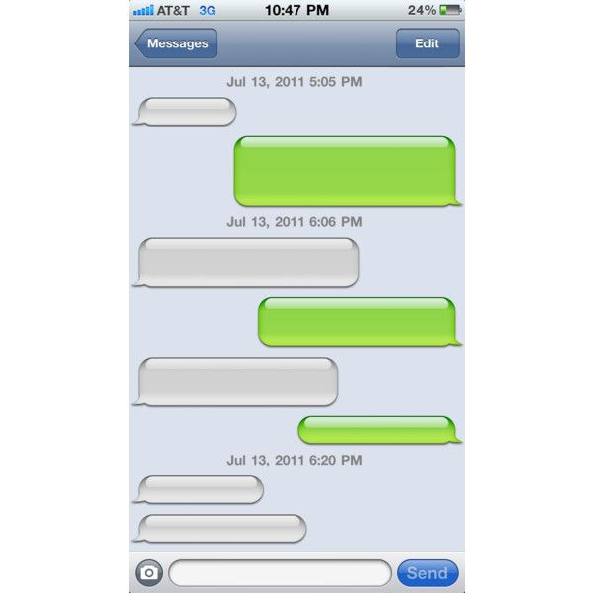
VICTIM
:(
YOU ARE FAT AND UGLY!
SHUT THE F*** UP.
DO YOU THINK YOU’RE STRONG ? F****** IDIOT.
JUST , LEAVE ME ALONE.
Wait for me after school.
c’mon
just stay away from me

Slide 6

HOW TO SOLVE THIS PROBLEM:
The only good news about bullying online or on phones is that it can usually be captured, saved, and shown to someone who can help. You can save that evidence in case things escalate but you mustn't retaliate!

Slide 7


