Slide 1
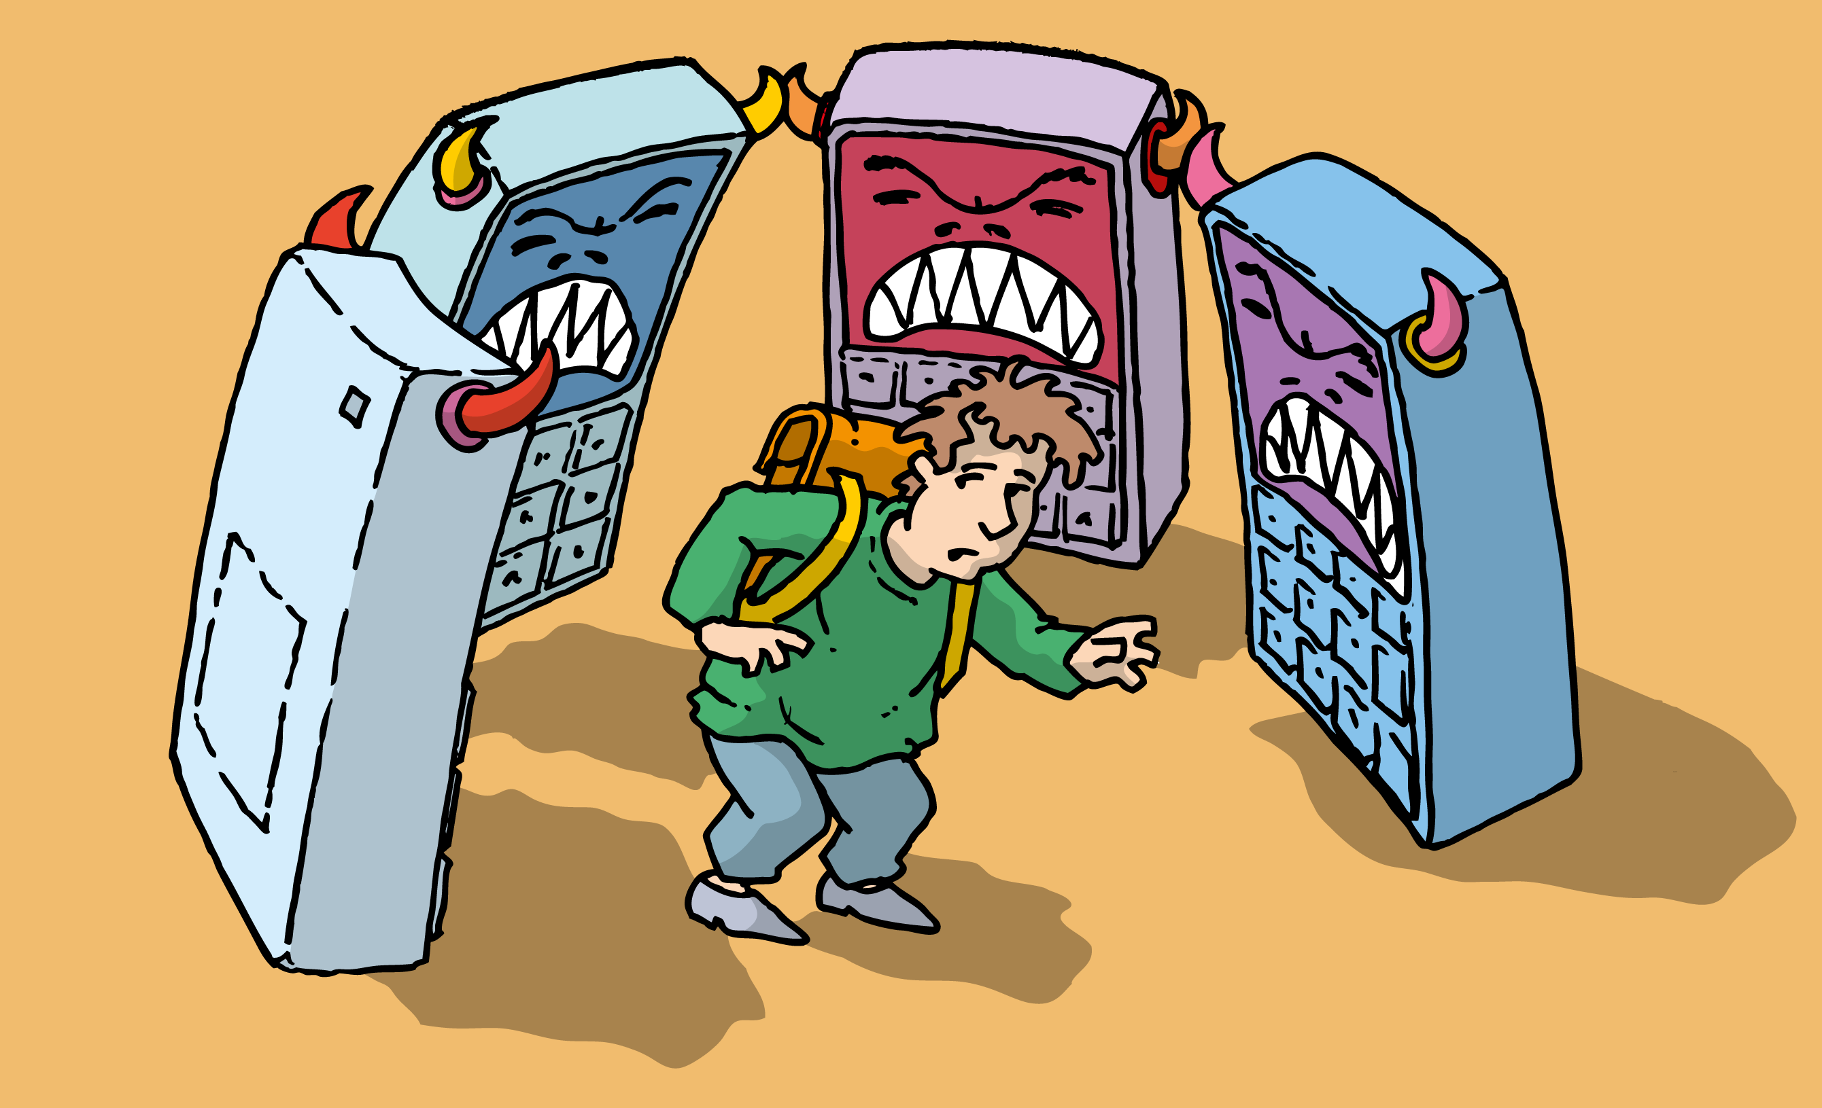
CYBERBULLYING

Slide 2
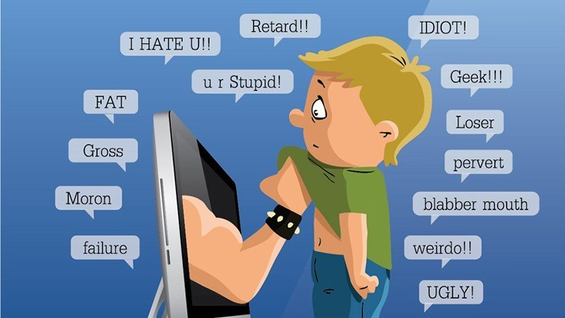

What is it?
Cyberbullying is bullying that takes place over digital devices like cell phones, computers, and tablets. Cyberbullying can occur through text and apps, or online in social media, forums, or gaming where people can view, participate in, or share content. Cyberbullying includes sending, posting, or sharing negative, harmful, false, or mean content about someone else. It can include sharing personal or private information about someone else, causing embarrassment or humiliation. Some cyberbullying crosses the line into unlawful or criminal behavior.

Slide 3
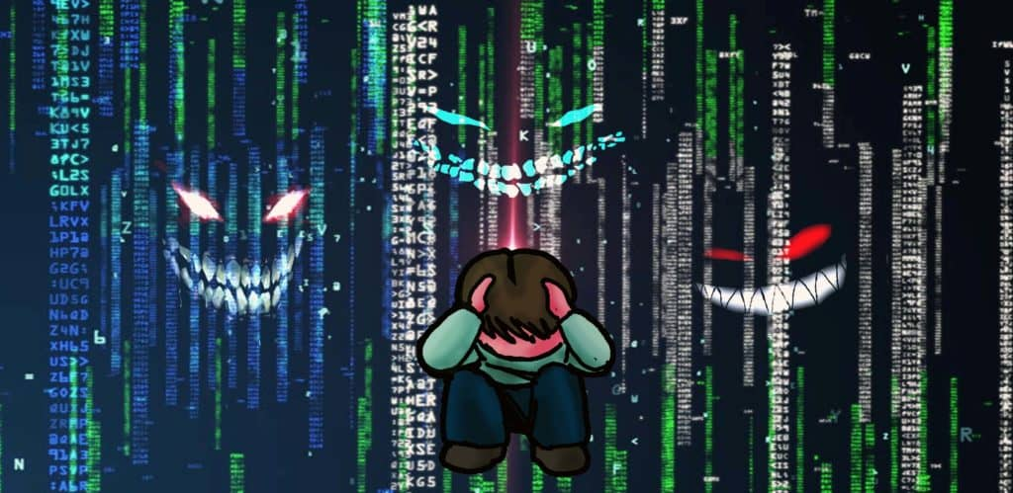

CONSEQUENCES
Abuse alcohol and drugs
Physical and emotional health issues
Lower self-esteem
Poor school grades
Avoiding other kids
Refusing to go to school
Increased thoughts of suicide

Slide 4
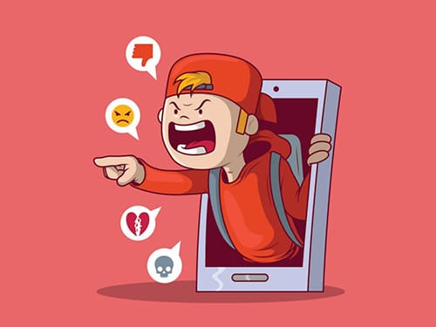

WHO ARE THE CYBERBULLIES?
In general, boys and girls appear to be equally likely to harass others online. In the Youth Internet Safety Survey, boys were more likely than girls to harass others frequently.
In general, harassers are more likely also to report being aggressive and to frequently break rules.
Teens who harass others frequently also report depressed or withdrawn behavior twice as often as teens who don’t harass others online .
Youth who have difficulty with concentration and/or low academic achievement are more likely to perpetuate bullying.

Slide 5
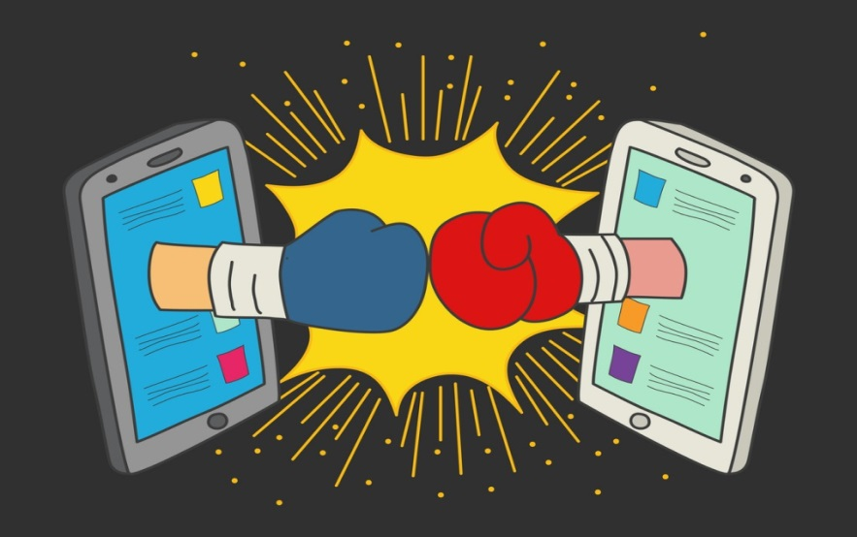
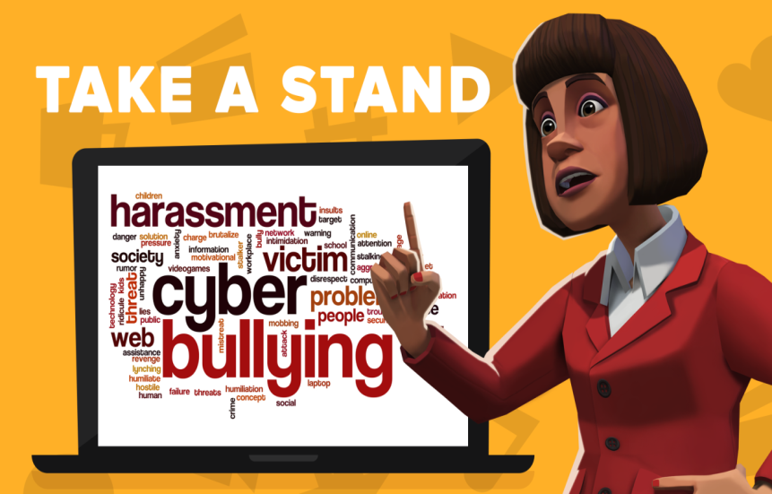
how to fight cyberbullyng?
A cyberbully seeks power and control through intimidation. The best way to fight a cyberbully is to not give them the power - just ignore him
If you receive a hurtful message is recommended you to not only ignore the message but also block the user from your computer, phone or other technological device. Sometimes it takes a long time for Internet Service Providers, websites and mobile service providers to take action, but do not be discouraged, eventually they can help stop the cyberbully from going further.
And if you must, sometimes it is best to delete your account and start over again. Another way to fight cyberbullying is to report the offender to your internet server, website that you are using, or mobile phone provider to stop them from attacking others. It will also help to tell a parent, friend or teacher about the incident.

Slide 6


