Slide 1
Cyberbullying
Alessandro Passanisi-Gregory Morale 2ªB linguistico

Slide 2
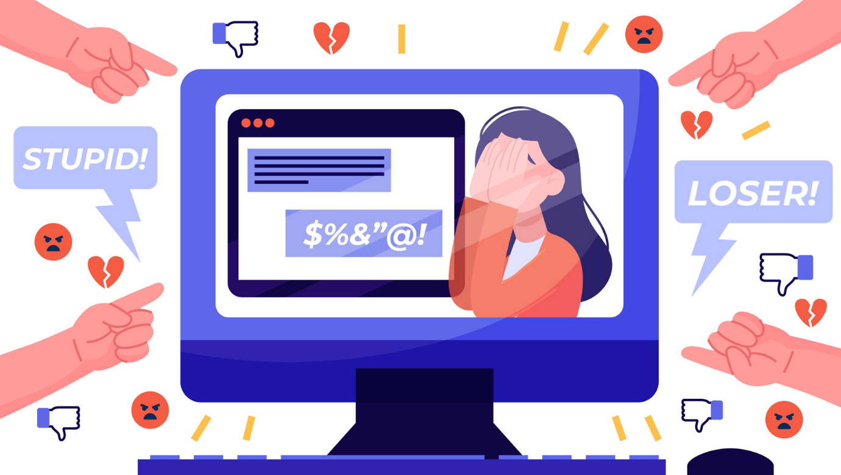

Slide 3
What is Cyberbullying?
The era of the internet and smartphones, social networks and digital forums, has given additional weapons in the hands of bullies, ready to understand the resources of the network, as a virtual, but very concrete place, where to carry out violent acts. For adolescents in technologically advanced societies, the Internet represents an indispensable context of experiences and socialization. However, new technologies hide dark sides, such as the distorted and improper use made of them to intentionally target defenseless people and damage their reputation, facilitated by anonymity and the potential global spread of offenses. In this regard, the term "electronic bullying" or "cyberbullying" (cyberbullying in English-speaking literature) has been coined to define an aggressive, intentional act conducted by an individual or a group of individuals using various forms of electronic contact, repeated over time against a victim. The bully can act, for example, by posting photographs, videos or private information of the victim, by spreading slander through text messages with the mobile phone or by e-mail, or by carrying out repeated threats through the mobile phone or electronic means. Nancy Willard proposed a distinction between various types of cyberbullying:
Flaming: violent and vulgar online messages, often within a forum.
Harassment: repeated sending of insulting messages.
Denigration: "gossiping" about someone through gossip or rumors to damage their reputation.
Person replacement ("impersonation"): pretending to be another person to send messages or publish texts that compromise the victim's reputation or her friendships.
Revelations ("exposure"): publishing private and / or embarrassing information or images about another person.
Deception: ("trickery"); publish or share secret information with others.
Exclusion: Deliberately excluding a person from an online group to hurt them.
"Cyber-persecution" ("cyberstalking"): repeated and threatening harassment and denigration.

Slide 4
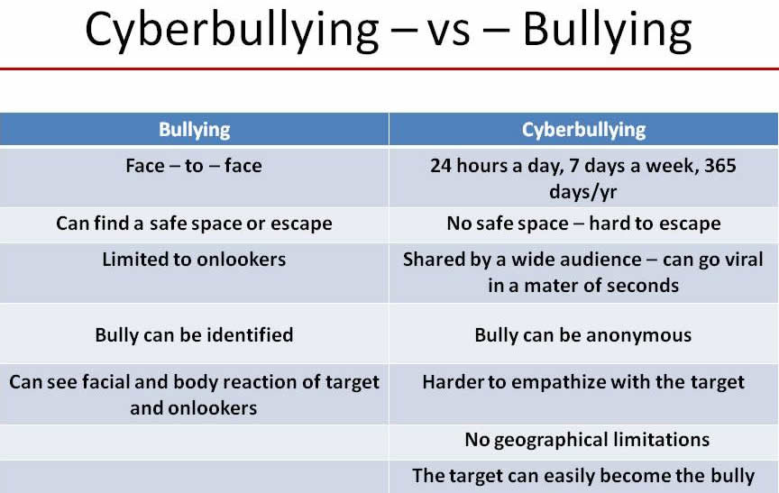

Slide 5
How to fight cyberbullying
Use the internet and social networks consciously.
Report and block cyberbullies.
Avoid potentially dangerous situations.
Talk to your parents and teachers.
Report to the authorities.

