Slide 1




Cyberbullying

Slide 2
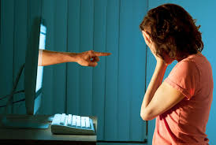
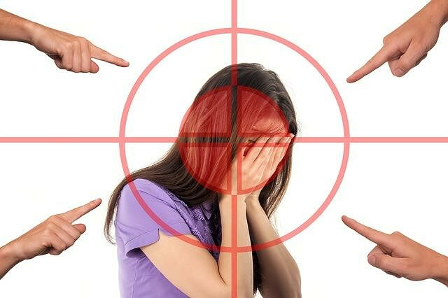
What is Cyberbullying?
Cyberbullying, unlike bullying, can also be practiced by people "masked" or who in social networks do not have their name but an invented account. Unfortunately, this phenomenon is in great expansion and is very frequent, a conversation, a chat can be put online in a very short time, a stolen photo or a confidential can be released in a heartbeat. We could all be the targets and victims of this growing phenomenon. Fear is for the younger ones, those who are more involved and accustomed to using the Internet. There is no longer respect for the different, for the differences that are not always negative, sadly famous are the stories of overweight or gay guys who publicly mock online, on social networks, in group chat with photos, videos, bad phrases.

Slide 3
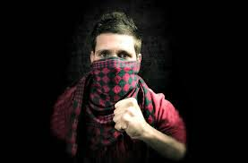
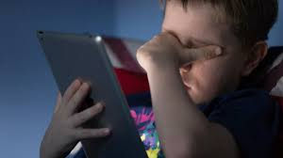
How to define the cyberbully?
The cyberbully can be defined as a subject, normally between the ages of 10 and 16 who use the web, with which he is particularly familiar, to take it out on the weakest, attacking or insulting them.Generally, the cyberbully, compared to the bully, is a subject that in real life may even seem "harmless", but that behind the computer screen loses all its inhibitory brakes and lets go to bullying behaviors that outside of reality telematics does not have the "courage to perform". It is not always easy to trace back to the cyberbully, as he generally uses a fake web profile, thus losing all the inhibitor brakes. In some contexts, the false profile gives way to absolute anonymity. The consequences of cyberbullying on the psychology and social life of the victims can be very serious enough to risk even leading to suicide, in the most desperate cases and when the weakest and most fragile are affected. However, for the cyberbully the behavior held against young people targeted is almost normal: he, most of the time and especially when his age is low, He lives in the absolute unawareness of the gravity of his actions and the weight that his words can have. Which the virtual world only exacerbates.

Slide 4

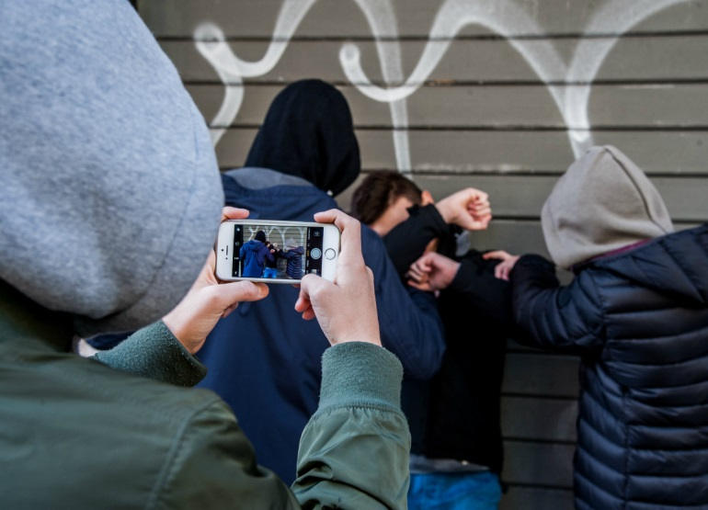
The audience of the cyberbully
Bullying has always required the presence of an audience, which assists the bully’s behavior by supporting and inciting it.The presence of the public is also required by the cyberbully, which, indeed, can "perform" in front of an audience even wider, potentially infinite, which is that of the web.For this reason, the cyberbully feels more and more incited and can enter a vortex in which he gains consensus at the expense of the weakest and from which he hardly manages to get out. The role of families and schools therefore becomes fundamental and the task to be carried out even more difficult, if we consider that in the current world there are models that are based on popularity and approval by social and that risk therefore to make it really difficult to remove the cyberbully from the "fame" which on the net may be derived from his bullying behaviour.

Slide 5

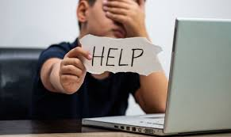
How to fight cyberbullying
Talking to your parents and teachers is very important in combating the phenomenon of online bullying. Do not make the mistake of facing the problem alone, just because you are embarrassed, ashamed or afraid to report the incident to adults you trust. You’ll see that by talking to your parents or teachers about what happened, you’ll be able to resolve the situation: they will certainly be able to provide you with the practical help you need, avoiding that the situation may get worse. Not to be underestimated, moreover, the psychological relief deriving from the awareness that others are aware of the situation and that you are not only facing it. If the acts of cyberbullying perpetrated against you persist or worsen by including threats, intimidation messages and the like
Go, then, to the police station or the nearest police station and provide the officers who will assist you with all the data and information you need to proceed.

