Slide 1
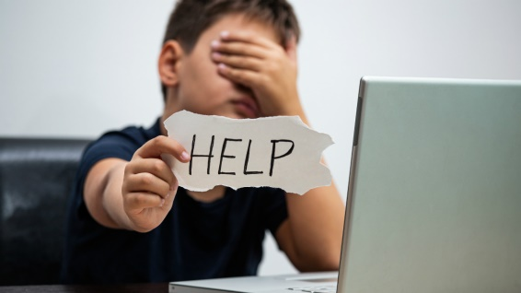
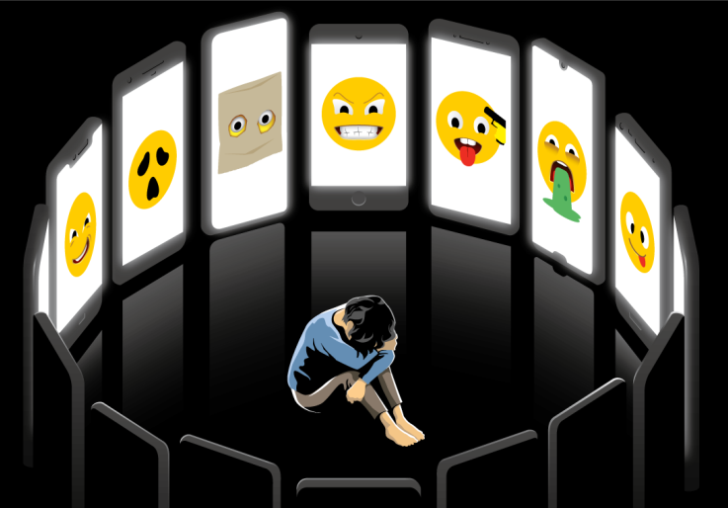
Cyberbullying
Nowadays technology is more and more important and social media becomes more and more useful, but there is also a negative aspect: cyberbullying
In fact young people today have direct access to the Internet from personal computers and mobile devices, whether at home, schools or in public places and it increases the phenomenon of cyberbullyng.

Slide 2
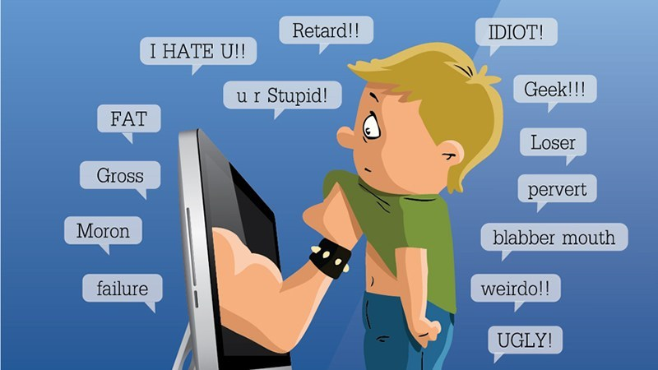
Cyberbullying is bullying with the use of digital technologies.
It is repeated behaviour, aimed at scaring, angering or shaming those who are targeted.
spreading lies about or posting embarrassing photos of someone on social media.
sending hurtful messages or threats via messaging platforms.
impersonating someone and sending mean messages to others on their behalf. .

Slide 3

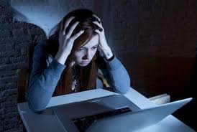
If you are worried about your safety or something that has happened to you online, urgently speak to an adult you trust.
All friends joke around with each other, but sometimes it’s hard to tell if someone is just having fun or trying to hurt you, especially online. Sometimes they’ll laugh it off with a “just kidding,” or “don’t take it so seriously.”

Slide 4
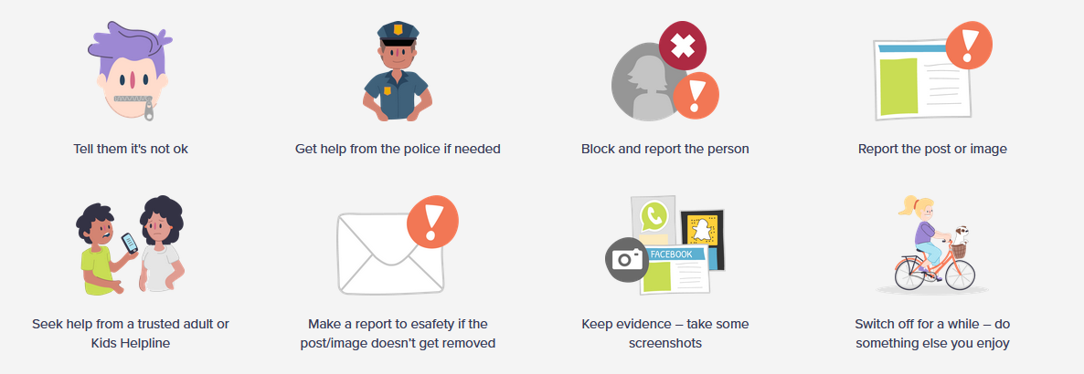
A victim of cyberbullyng can always do something to report the situation. The only important thing is that they must never be silent in front of this type of action.

Slide 5
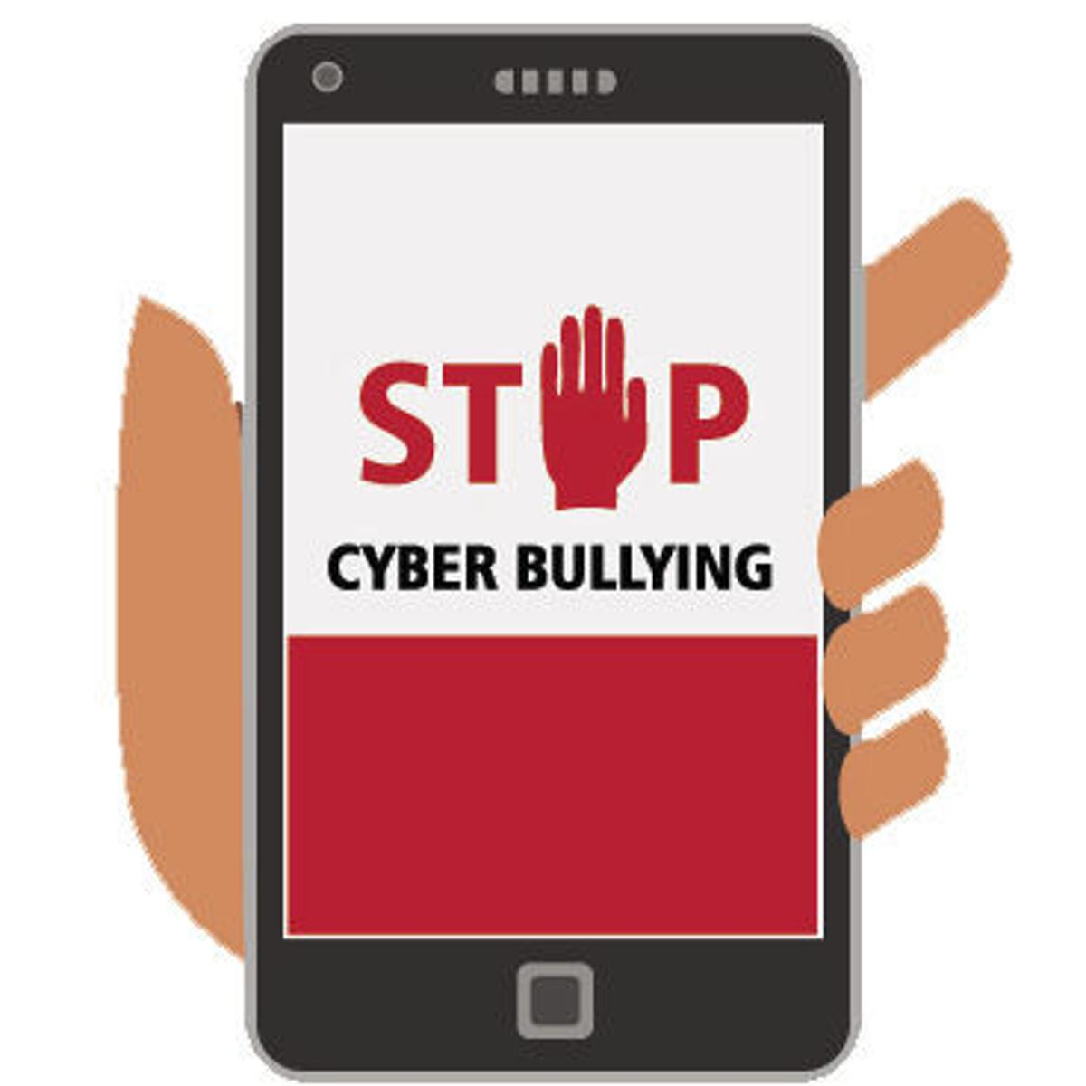
Realized by Giorgia D’Agostino and Alice Caminiti

