Slide 1
cyberbullying

Slide 2
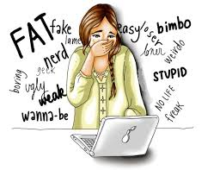
What is the cyberbullying?
The cyberbullying is a form of bullying that happens when the bully sends threat messages to the victim by internet, takes photos or films him when he doesn’t want to be filmed and then publishes his images on the social media.

Slide 3
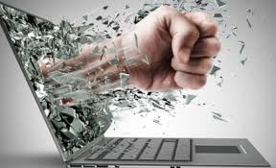
The elements of cyberbullying
The elements that distinguish cyberbullying from traditional bullying are:
Absents of time limits: the cyberbullying can happens at every time of the day and the night.
Absents of space limits: it can happens everywhere, in fact it can invade your own personal places.
The possible anonymity: who offends online can try to stay hidden behind a nickname and hide his identity.
The impact (virality): the diffusion of films and images is uncontrollable and without limits.

Slide 4
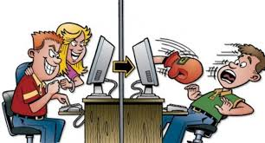
The cyberbully
The cyberbully is someone who commits violence and arrogance against someone else he considers weak. He does what he doesn’t have the courage to do in real life.
THE VICTIM
The victim is someone considered weaker than the bully. He is usually silent and sensitive.

Slide 5
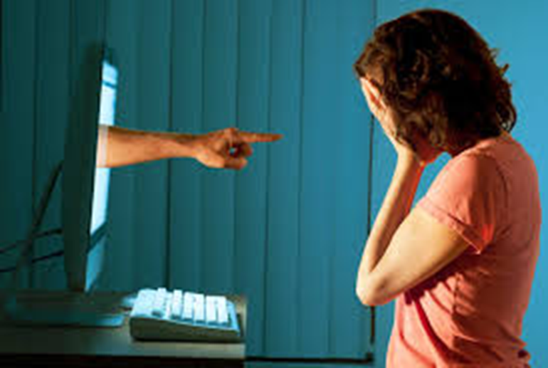
CAUSES AND EFFECTS
The victim is tormented by the bully for his physical appearances, his character or because doesn’t wear fashionable clothes and for his skin colour and religion, too. The bully does it because he has family problems, he attends bad companies or because he has been also a victim of cyberbullying. People suffering cyberbullying tend to close themselves in and they suffer from self-esteem problems, depression, anxiety and they are insecure. In extreme cases victims commit suicide.

Slide 6
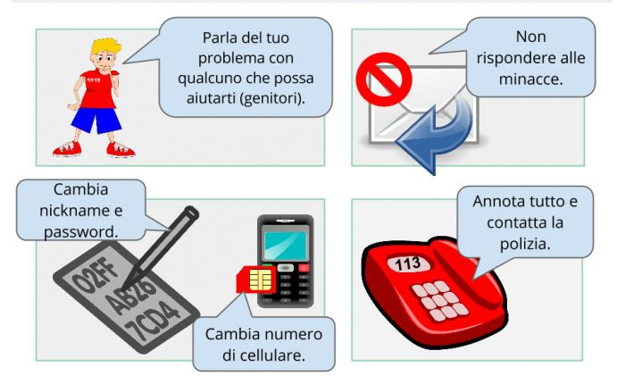
HOW TO DEFEND FROM CYBERBULLYING
The victim hardly ever talks to anyone about what he suffers, but if you are bully’s target you have to:
Report everything to others, without fear
Ignore the bully
Try to have self-confidence
Denounce to the police
Block the user
Talk about your problems with someone who can help you
Don’t respond to threats
Change your nickname and password
Write everything and contact the police
Change telephone number

Slide 7
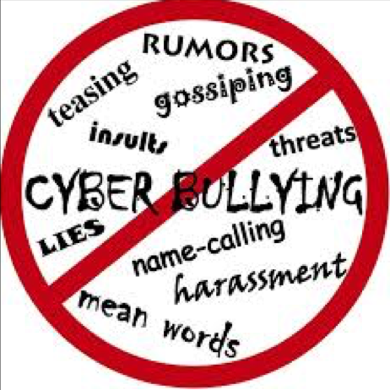
STOP CYBERBULLYING
To stop cyberbullying there are many associations like:
A.I.C.S. (Italian association cyberbullying and sexting)
CNAC (National Centre Anti-Cyberbullying)
PSY
….
Moreover there is a World Day against Cyberbullying and it is celebrated on 7 th February.

Slide 8
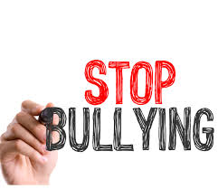
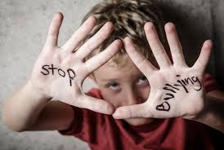
«WE HAVE LEARNED TO FLY THE AIR LIKE BIRDS AND SWIM THE SEA LIKE FISH, BUT WE HAVEN’T LEARNED THE SIMPLE ART OF LIVING TOGETHER AS BROTHERS» MARTIN Luther KING
A word can become a caress or a punch
Made by: Martina Solaro
Chiara Vaiasicca

