Slide 1
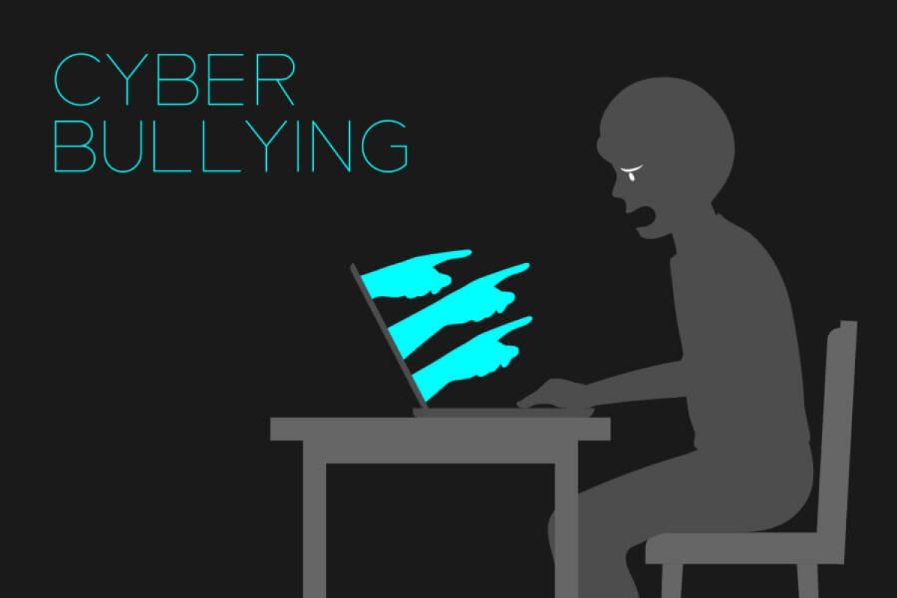

Slide 2
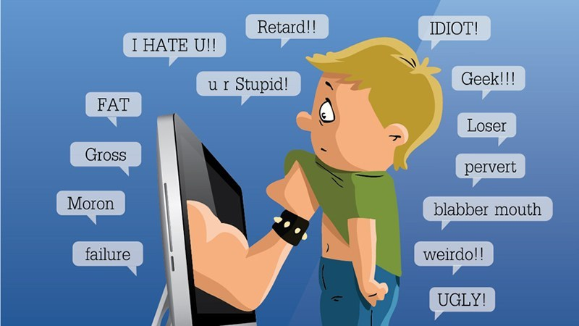

WHAT IS?
Cyberbullying is a very current phenomenon and consists of mistreating and offending people on the Internet who do not know how to defend themselves.
It is achieved through the continuous attack on the victim, of offensive content, through chats, social networks and e-mails.

Slide 3
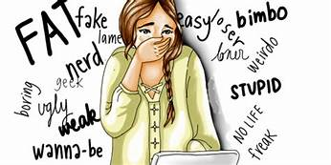
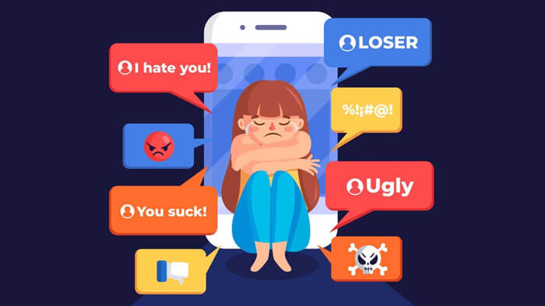
WHO IS THE CYBERBULLY?
So who is the cyberbully?
Normally it is a person between the ages
of 10 and 16,
(sometimes even up to 18), who uses the net to give vent to his bullying on the internet because in "real life" he does not have the courage to do so, without realizing the severity of their actions.

Slide 4
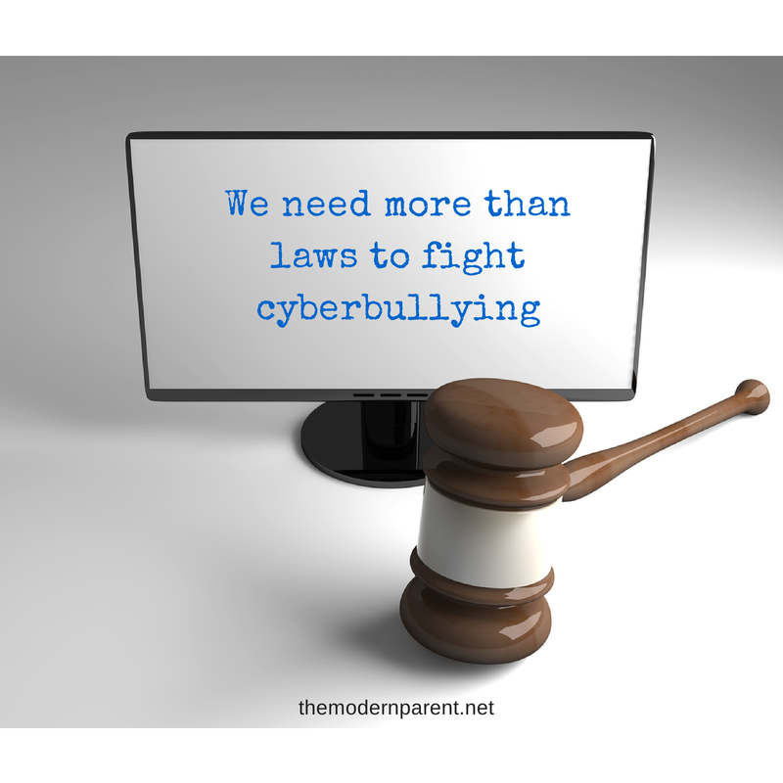
LAWS IN FAVOR OF VICTIMS
Fortunately, there is now a law that provides some tools to help victims of this phenomenon.
For example:
• blocking of websites where cyberbullying occurs;
• the complaint to the Privacy Guarantor;
• report cyberbullying to parents;
Furthermore, the law specifies that each of these tools can also be used by children of at least fourteen years.

