Slide 1
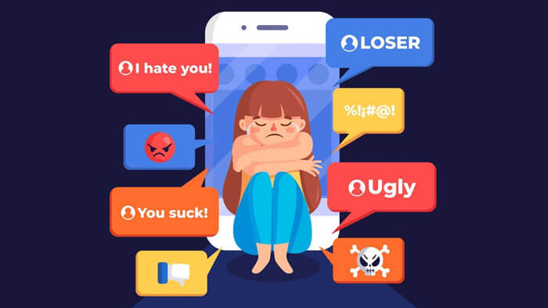
Cyberbulling?
It’s no secret that everything has a dark side and when talking about our dear friend technology, it’s cyberbullying.

Slide 2

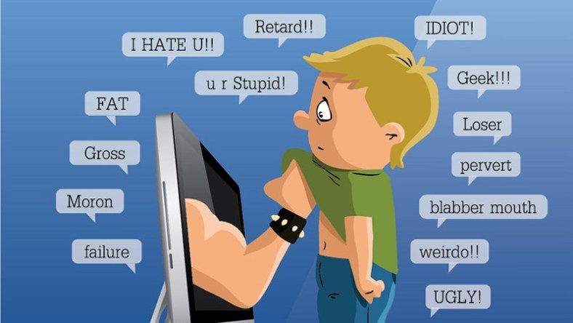
This phenomenon takes place on social media, messaging platforms, gaming platforms…
It consists of a form of bullying or harassment using electronic means, also known as online bullying.
Harmful bullying behavior can include posting rumors, threats, sexual remarks, a victims' personal information, or pejorative labels. All of this because of pictures, comments and data we share with billions of stangers.

Slide 3
Many types of cyberbullying
Many traumas caused
Exclusion - the act of leaving someone out deliberately
Harassment - constant pattern of hurtful or threatening online messages
Outing -refers to the act of openly revealing personal information about someone without their consent
Flaming -constitutes of posting about or directly sending insults and profanity to their target.
Humiliation
Isolation
Depression and Anxiety
Low Self-Esteem
Self-Harm
Suicidal Thoughts

Slide 4
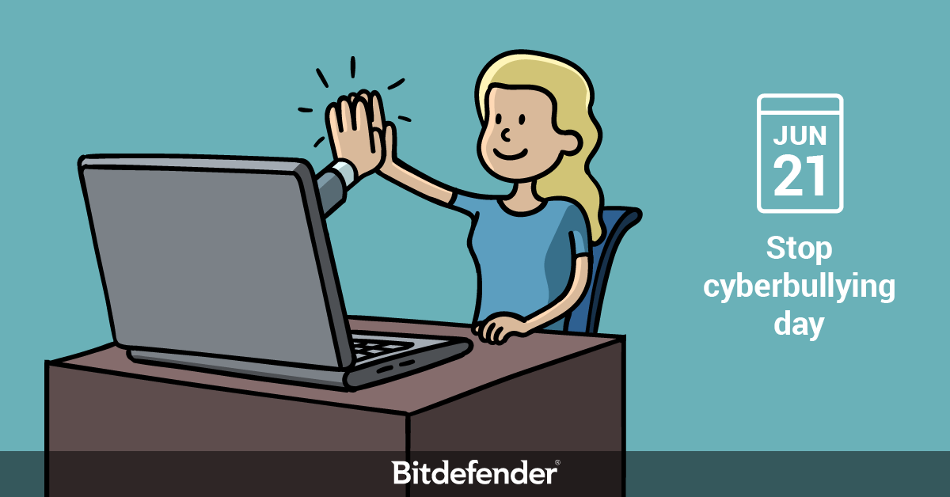
How can we fight cyberbullying?
First you need to pay more attention to what you share online. In case of bullying you must warn anyone who can help: friends, family, teachers, many schools arrange meetings with psychologists to help the victims overstep fear and shame and convince them to take the scariest step but the most important: the complaint.
Cultrera Federica e Leone Maria Chiara IV BL

