Slide 1
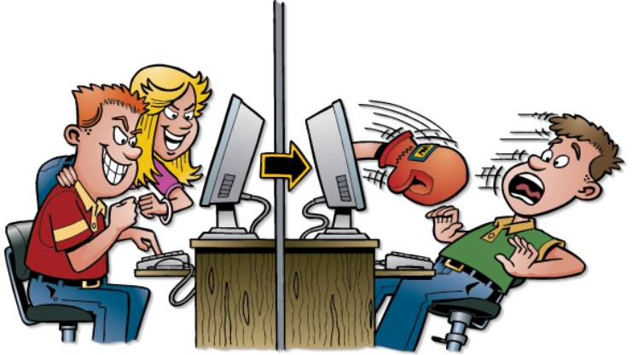
Cyberbulling
LO CICERO ELENA
ALECCI CHIARA 1°BL

Slide 2
Cyberbulling is a from of bullyng conducted through electric tools with internet, and has as its protagonists the bullies who torment the victims but, precisely, in intertnet. This phenomenon, comes to steal the identity of others by building fake profiles aimed at damaging the victim's reputation.

Slide 3
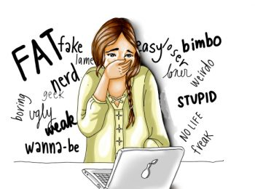
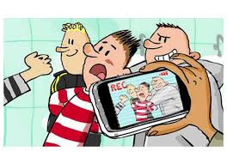
BULLYNG
STOP

