Slide 1
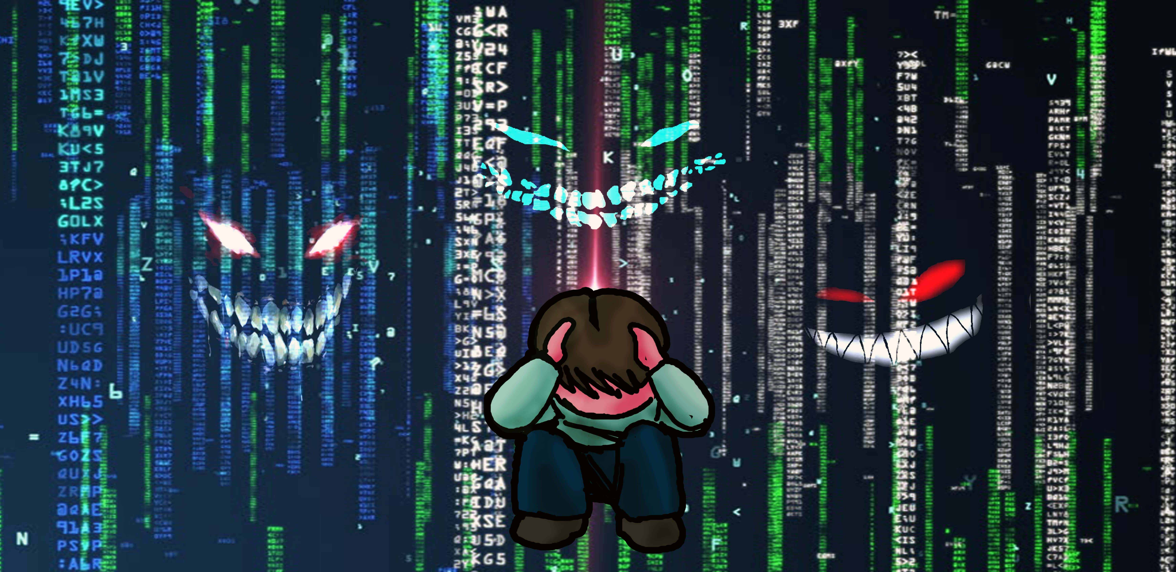
Cyber-bullying
A new serious problem…
Work done by: Giulia Farhat
Gaya Giurdanella

Slide 2
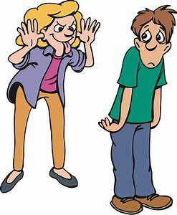
What’s bullying?
So basically what’s bullying? Bullying is a widespread phenomenon among young people and not only. Bullies use various ways to torture people, physically and psychologically.
Victims are targeted for stupid reasons,
like their social class or race.
Other forms of bullying can be social
exclusion or gossiping.

Slide 3


what are schools doing?
So many schools do so many things to prevent bullying, like special anti-bullying days.
An example may be the day of the pink shirt.
In Canada happened that a boy was bullied
because he was wearing a pink t-shirt, and so
they founded this special day.

Slide 4

what do psychologists think?
According to psychologists, anti-bullying days are not effective. You have to understand why bullies bully. There's a particular reason why these guys target others, and many times is due to a psychological fact.
It also happens that all the other kids know who the victim is but they don't do anything about it (they may be scared of the bully, or they just avoid getting involved) and may even use the special day to skip school.

Slide 5
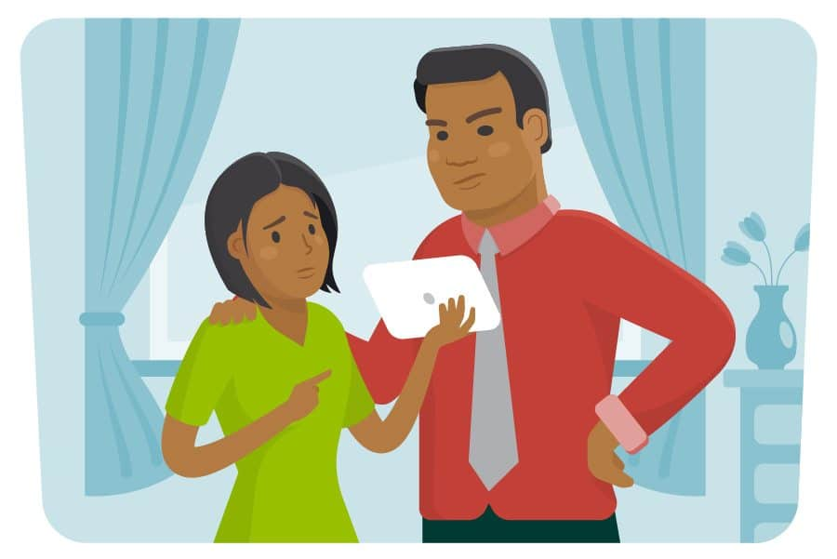
Adult can’t be victims of cyber bullying, right?
Absolutely wrong, adults can also be victims, at work or online. Online bullying has a name, cyber bullying. Many times co-workers make fun of a person (often someone who is new in the field), some also change their names on social media to avoid being found.

Slide 6


what happens to the victim?
The victim as we already know already suffers a lot. Can begin to suffer from low self-esteem or depression caused by all the insults received by bullies. We also have extreme cases where the victim commits suicide…

