Slide 1

BULLYING
Francesco Ferrante
Ludovica Castro
IVAL
A.S. 2020-2021

Slide 2
What’s bullying ?
Who is the bully ?
Who is the victim ?
What’s the keyword for bullying?
The other types of bullying
Example of bullying in sport
Example of bullying in cinema
Example of bullying in music

Slide 3
THE END

Slide 4
The term bullying is used to designate a set of behaviours in which someone repeatedly does or says thinks to have power over another person or dominate it.
The original term “bullying” includes both the behaviours of the bully and those of the victim, racing the relationship at the centre of the attention.
Often it is not given much importance because it is confused with normal conflicts between peers while bullying is characterized by some factors:
Intention to do evil and lack of compassion
Intensity and duration
Power of the bully
Vulnerability of the victim
Lack of support

Slide 5



Slide 6
Bully is a person who need to feel powerful and in control making someone miserable and isolated.
He avoid adults; has friends and lacks guilt for being cruel.
Bully shows no regret, concern or worry for the victim; he just plains enjoy picking on someone else. He actually gains an exciting rush from having power over someone and is apparently motivated by the “pleasure” he derive from his actions.
Thare are 2 types of bully:
Well connected to their peers, have social power, are overly concerned about their popularity and like to dominate or be in charge of others.
More isolated from peers, may be depressed or anxious, have low self esteem, not so involved in school, is easily pressured by peers and does not identify with the emotions or feelings of others.

Slide 7
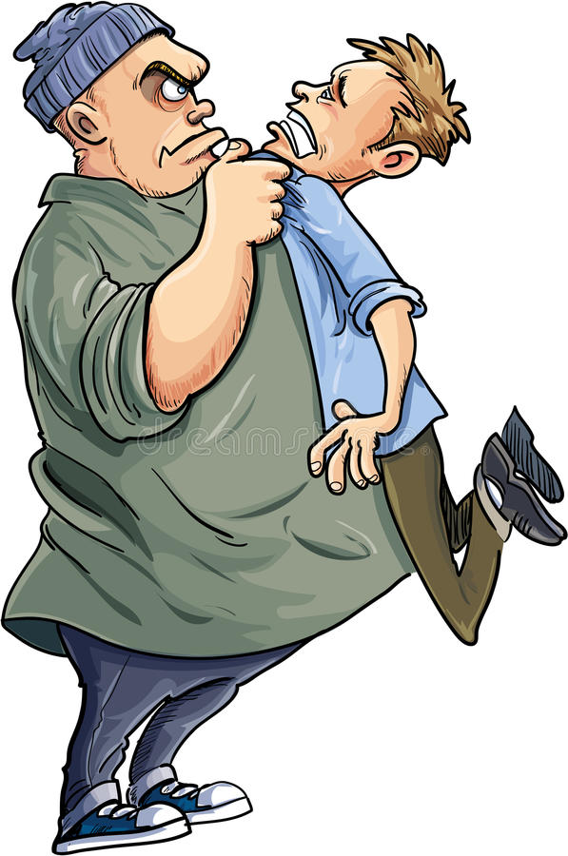
«Children are not born bullies but are taught to be bullies».
-Matt Bomer

Slide 8
A typical victim is a person who is usually shy and consequetly lacks on social skill and is isolated and alone with few friends and that's why it's very easy to pick on. when intimidated it looks and acts afraid.
There are two types of victims:
the passive one, which conveys a feeling of inability to react and therefore is subdued; also it is very difficult for him to establish himself in a group of friends.
the other type of victim is the provocative one, which has an anxious and aggressive character therefore transmits tension and irritation

Slide 9
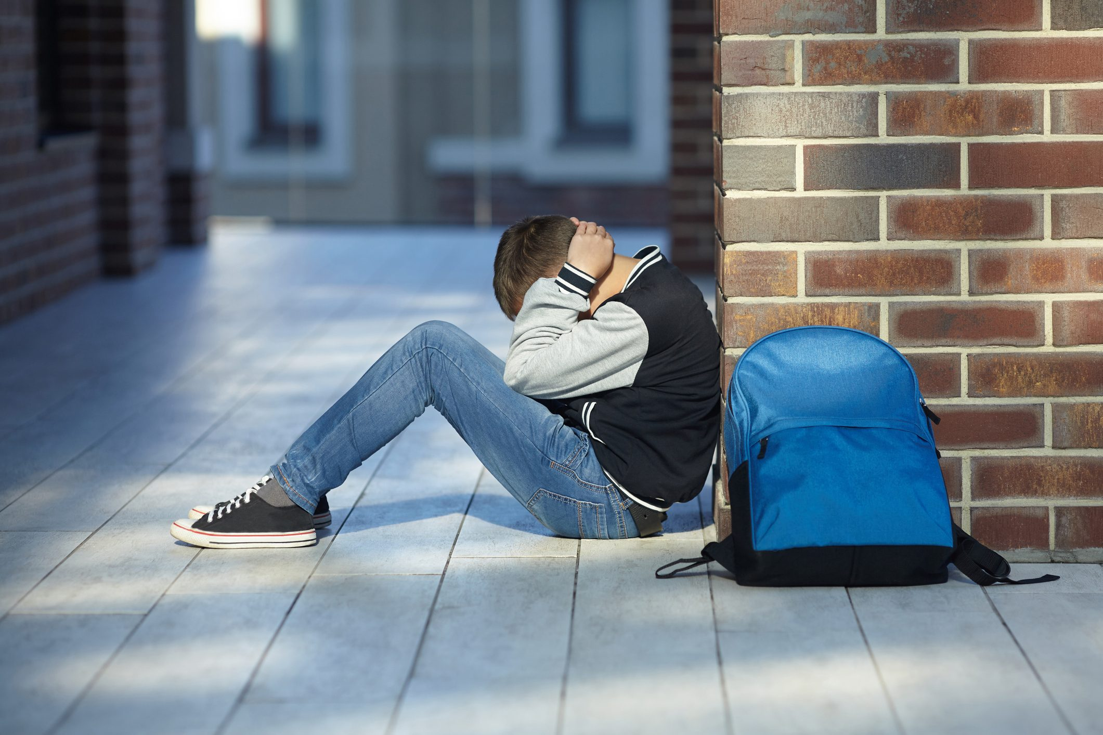

“They used to swear at me like "you suck" "you’re a loser" and then they threw me on the floor and started kicking me. I barely got up and went to the teachers, but they didn’t say or do anything.
I felt pain and anger distributed in my body.
I also wanted to fight back, but I already knew I’d never make it. Not alone, because the strength of a group might have helped me, but I was alone. And alone I could not fight”
-Andrew, a victim of bullying

Slide 10
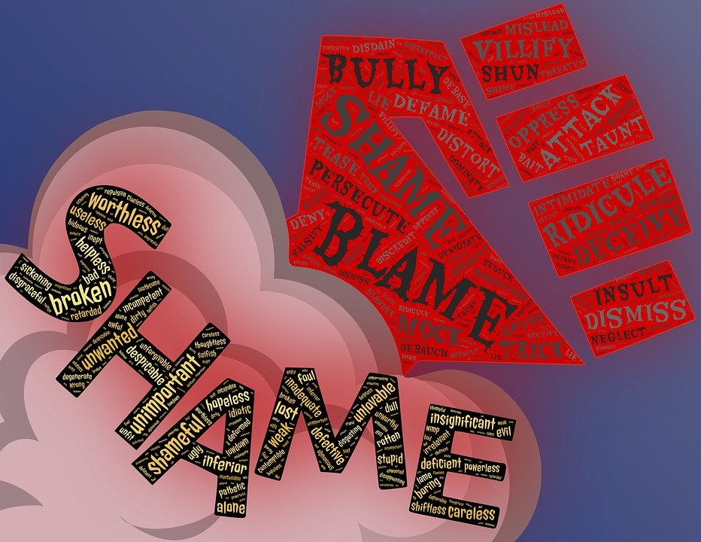
The bullying’s key word is fragility. In fact the extreme fragility of both people obstructed :
the choice of bully to talk about his problems with a conselor or vent his anger, frustration or even hate through a different activity.
The choice of victim to go refuge in herself along with her pain; it’s a clearly wrong attitude because if you stay closed in on yourself you get to the limit of endurance and in the most serious cases you get to make extreme gestures like suicide.

Slide 11
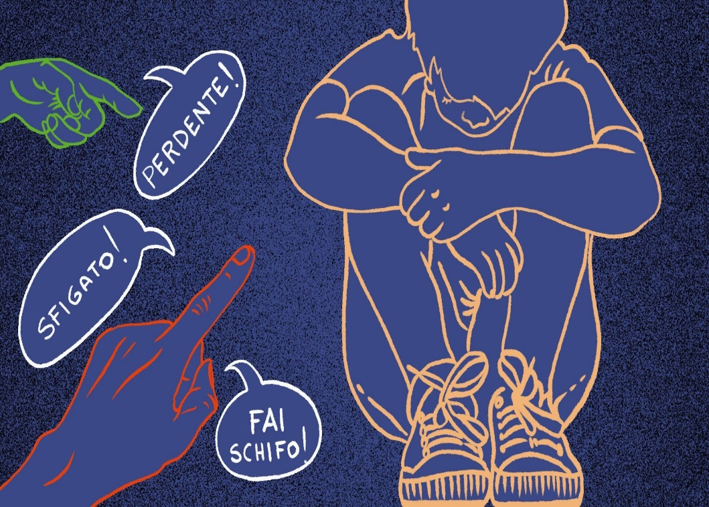
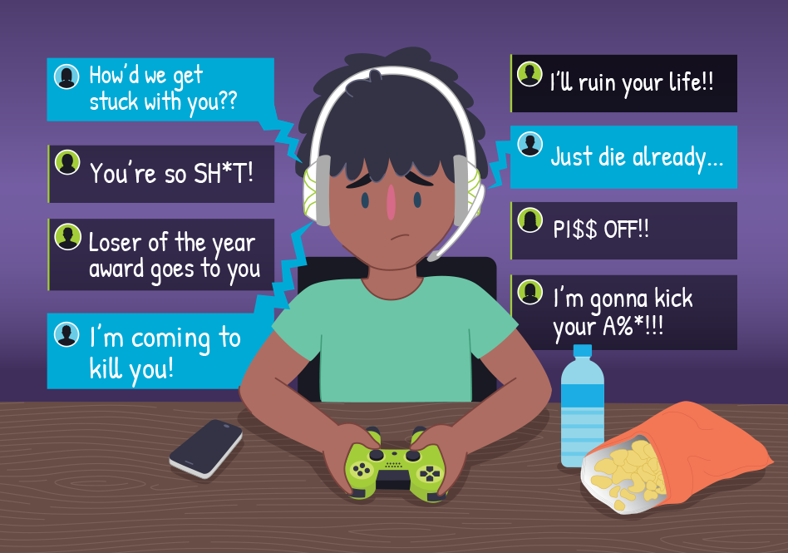
The other two types of bullying
Verbal Bullying
Cyberbullying

Slide 12
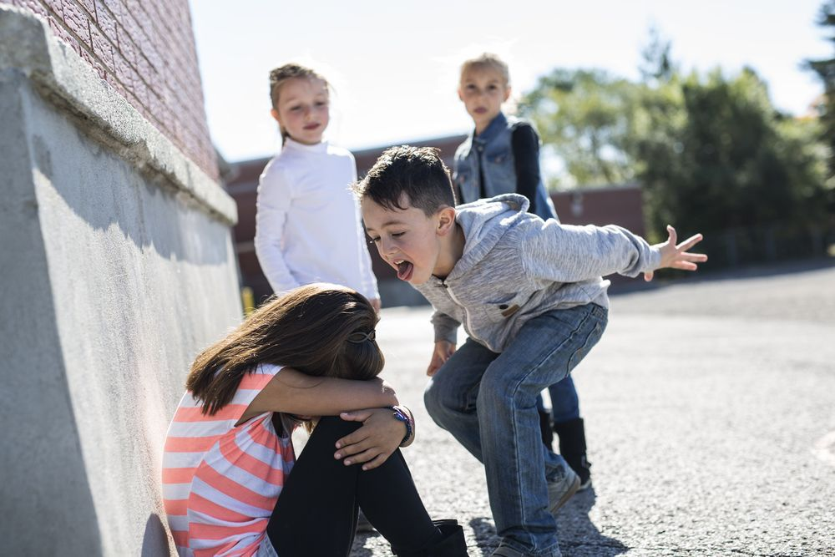
The definition of verbal bullying is when an individual uses verbal language like insults, teasing, etc to gain power over his or her peers.

Slide 13

Cyberbullying is bullying that takes place over digital devices like cell phones, computers, and tablets. Cyberbullying can occur through SMS, Text, and apps, or online in social media, forums, or gaming where people can view, participate in, or share content. Cyberbullying includes sending, posting, or sharing negative, harmful, false, or mean content about someone else.

Slide 14
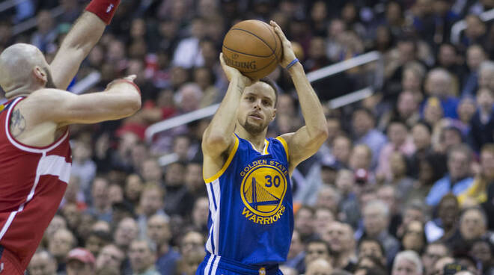
STEPHEN CURRY
Stephen Curry was teased by his teammates at Queensway Christian College, Toronto and also by the coach because of his slender physique and low height. "You’re too short to play basketball," his previous coaches told him and as a result was not identified as a possible NBA talent.
Today Stephen Curry plays as a point guard in the Golden State Warriors and holds the title of best shooter of all time with 2653 shots from three.

Slide 15

SELENA GOMEZ
During an interview, the infamous actress, to the question "What do you think about the new tv series "Thirteen reasons why?" who talks about a girl being bullied, who before committing suicide turns 13 videos into tapes that will give people who are the reason for her suicide, This is a clear message for all the boys who are bullied, for all the bullies who destroy the serenity of the victims". He also recounts his experience as a victim when he attended the world’s largest high school or Dis.

Slide 16
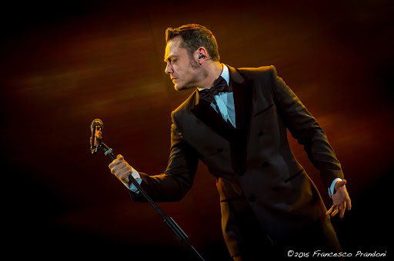
TIZIANO FERRO
Tiziano Ferro says in an interview that he was bullied when he was in high school because of his fitness.
Today is one of the most appreciated singers of the Italian music scene and not only.
"Bullismo? Non l'ho risolto al liceo. Quel che è successo è stato abbracciare il mio dolore, il mio senso di inadeguatezza e farlo diventare arte".

