Slide 1
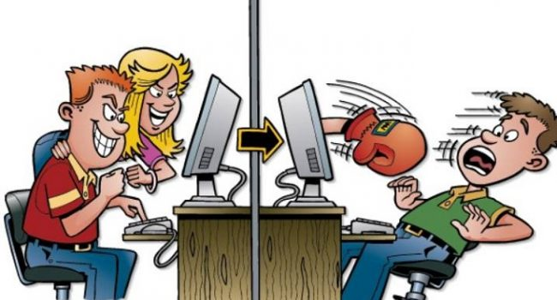
CYBERBULLYING
MADe by
Riccardo iozzia
Stefano russo
Salvo carastro
2bl

Slide 2
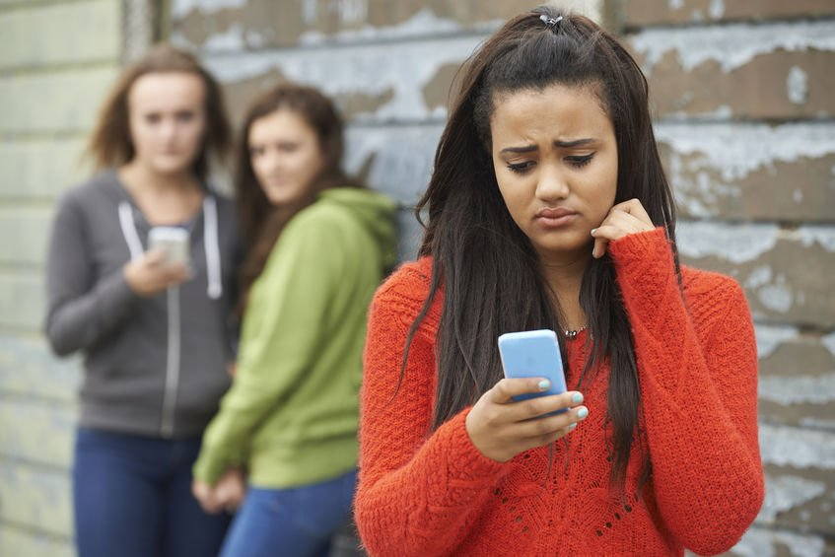
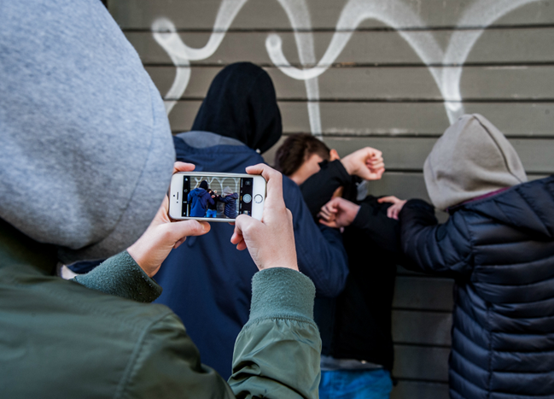
Cyber bully intimidates, threatens and insults people through text, email and chat

Slide 3


The cyber bully can only behave in this way in group chats and social networks

Slide 4
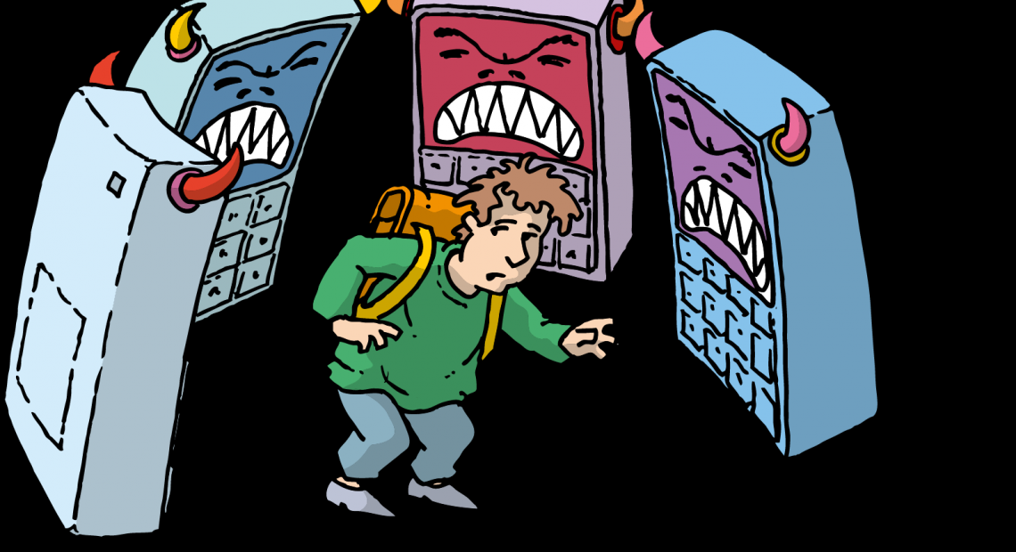
TYPES OF CYBERBULLYING ARE
-FLAMING
-HARASSMENT
-CYBERSTALKING
-DENIGRATION

Slide 5
FLAMING
Flaming is the insult on social network in the comments in youtube, instagram,facebook

Slide 6
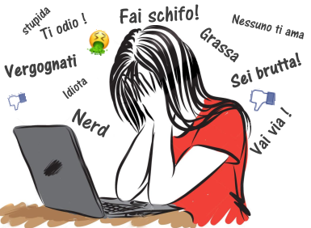
HARASSMENT
Harassment are insult,spam by call,sms, email

Slide 7
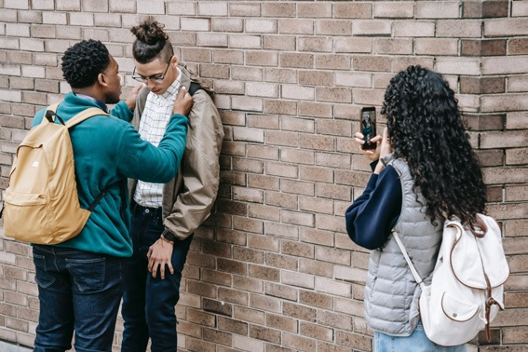
CYBERSTALKING
Cyberstalking use for intimidate and harass the victim

Slide 8
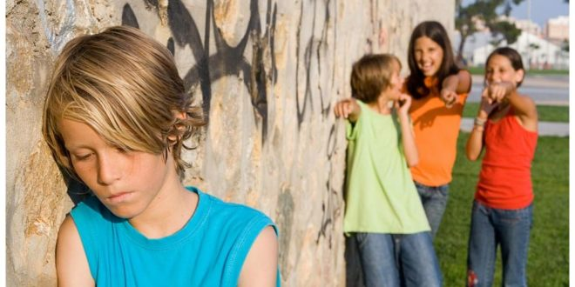
DENIGRATION
Denigration is to exclude people by chat and games

Slide 9
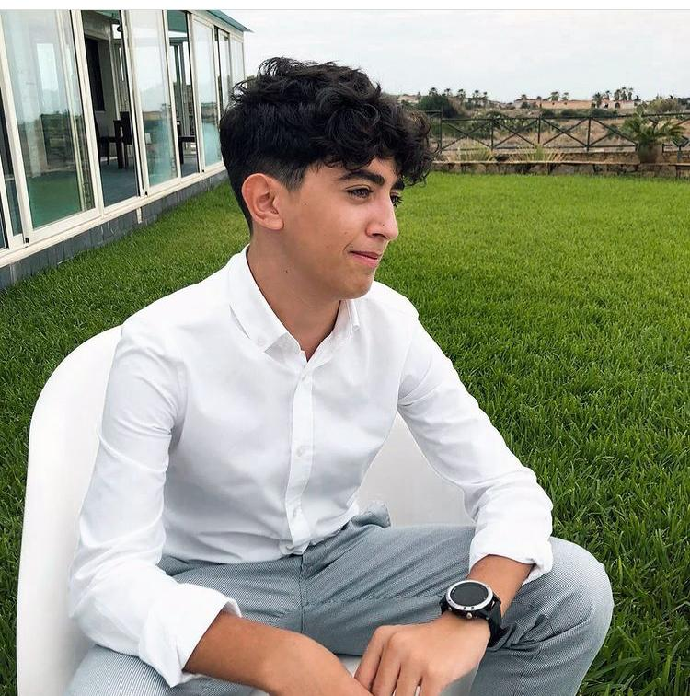
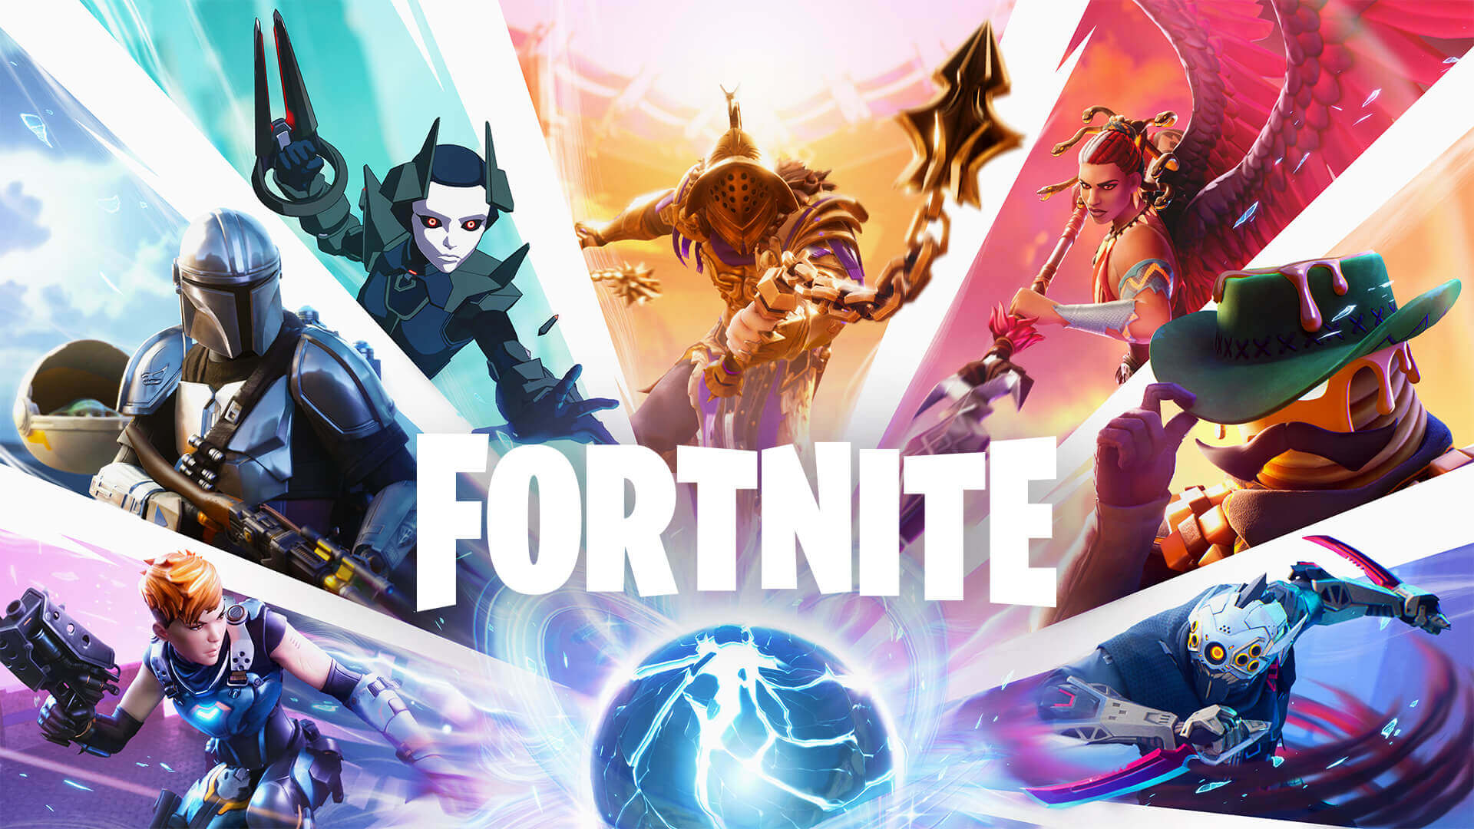
Riccardo’s experience
When i was 12 years old, i was a victim of cyberbullying because i played in a video game with my friends and a guy threatened me because i was stronger than him in the game.
The next day i went at school and i talked with teacher about that and this guy apologized to me

