Slide 1
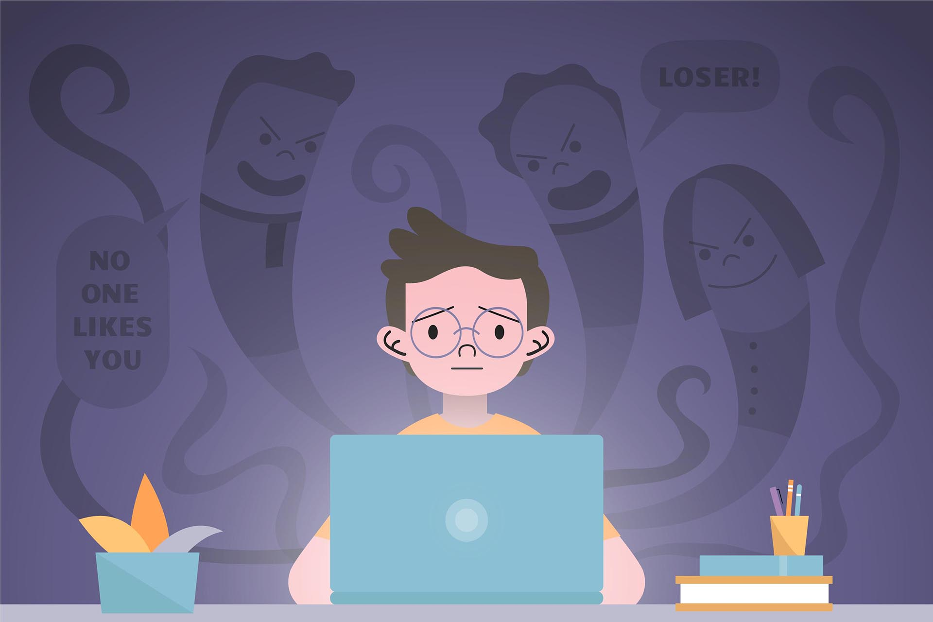
CYBERBULLYING

Slide 2

Cyberbullying is a form
of bullying that occurs
via the internet.

Slide 3


Cyberbulliyng is widespread
especially among minor.
Cyberbullying widespread
among minors is called
Cyberbullying, while
Cyberhrassment is that
between adults or between
an adult and a minor.

Slide 4
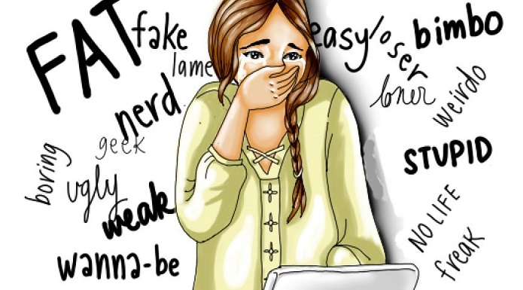
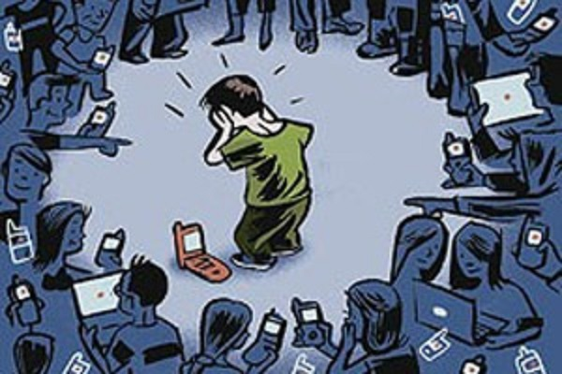
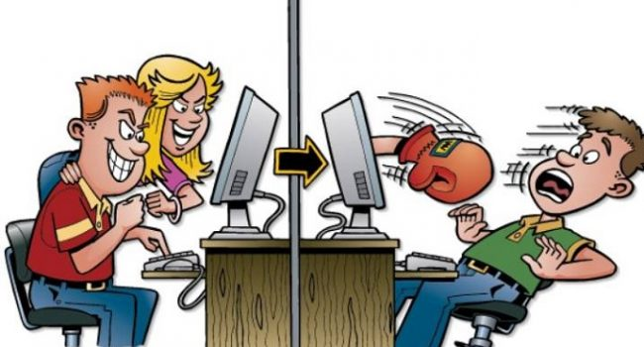
There are various types of cyberbullying:
Harassment: repeated sending of
insulting messages aimed at hurting
someone.
Cyberstalking: repeated and threatening
harassment and denigration aimed at instilling
fear.
Doxing: public dissemination of personal
And sensitive data via the internet.

Slide 5

Cyberbullying today can be defeated by reporting it to the postal police or even just talking about it with someone close to us and not pretending that everyone is okay. Many teenagers have lost their lives due to the offenses they suffered.

