Slide 1
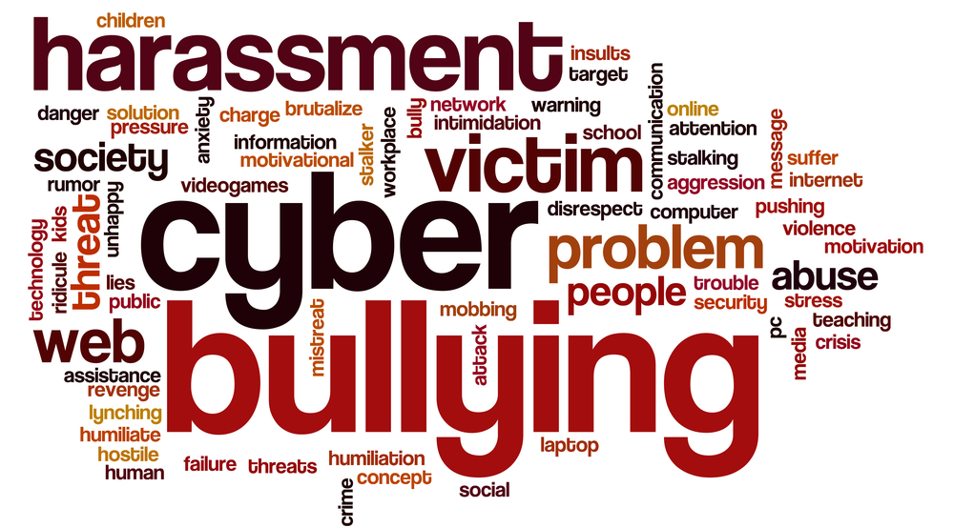

Slide 2
EVERYTHING YOU NEED TO KNOW ABOUT CYBERBULLYING
WHAT DOES THE WORD CYBERBULLYING MEAN?
KEY WORDS AND EFFECTS
WHAT IS CYBERBULLYING?
HOW DOES IT DIFFER FROM OTHER FORMS OF BULLYING?
-PREVENTING CYBERBULLYING

Slide 3
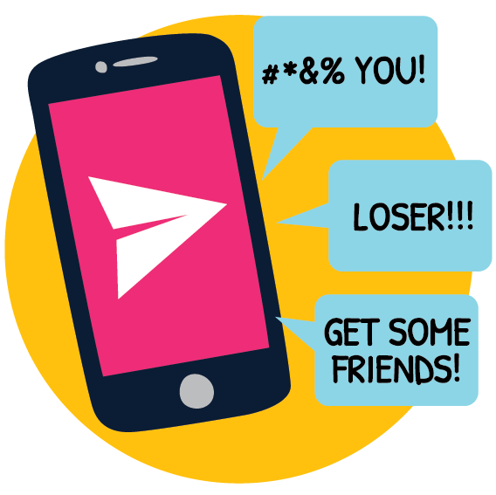
DEFINITION OF CYBERBULLYING
A frequently used definition of cyberbullying is "an aggressive, intentional act or behavior that is carried out by a group or an individual, using electronic forms of contact, repeatedly and over time against a victim who cannot easily defend him or herself.

Slide 4
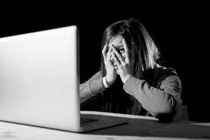
WHAT IS CYBERBULLYING:
Cyberbullying is bullying that occurs on digital devices such as mobile phones, computers and tablets. Cyberbullying includes posting, posting or sharing negative, harmful, fake or mean content on someone else.
Victims of cyberbullying may not know the identity of their bully, or why the bully is targeting them, based on the online nature of the interaction.

Slide 5
KEY WORDS
What makes cyberbullying so hurtful?
It’s public – lots of people can see itIt spreads quicklyIt can be hard to escapeThe bully can be anonymousRemoving it can be a difficult process
Torment
Target
Humiliate
Gossip
Demostration
Awareness
Stand up for
Self esteem
Anxiety

Slide 6

DIFFERENCE BETWEEN BULLYING AND CYBERBULLYING
While bullies are students, classmates or institute friends known to the victim, cyberbullies can be anonymous, pretend to be anonymous and solicit the inclusion of other anonymous 'friends', so that the person is often not even aware of the identity of those with whom they are interacting

Slide 7
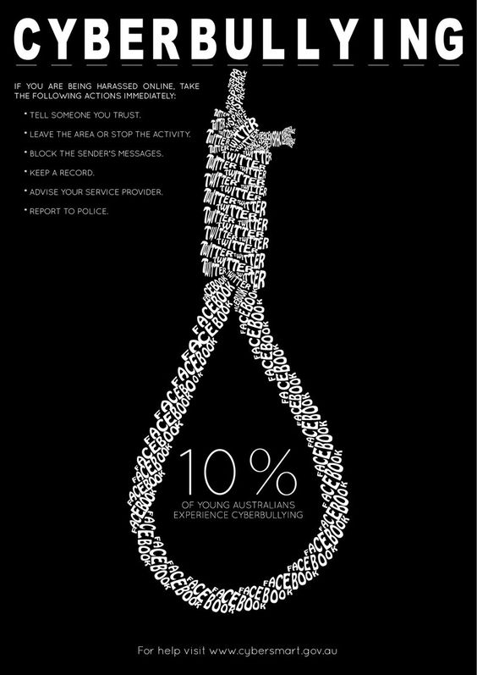
PREVENTION
It’s important to respond if you see others being cyberbullied You can help to stop cyberbullying. Here’s what you can do:
Get someone to help you report it.
Don’t forward or share it .
Don’t take part in it.
Leave the group or conversation.
Say something kind or positive to the person being cyberbullied If it’s safe, take a stand against it and ask the bully to stop.
Let the bully know that what they’re doing is NOT ok.
Talk to the person being cyberbullied privately and ask if they’re ok and if they need help

