Slide 1
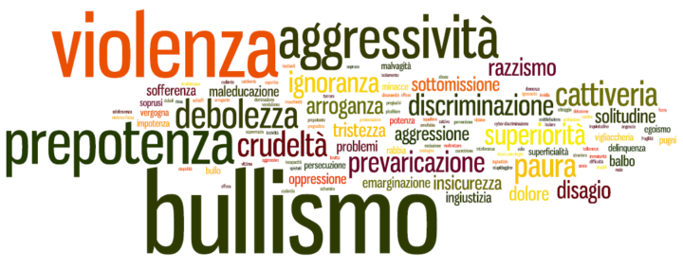
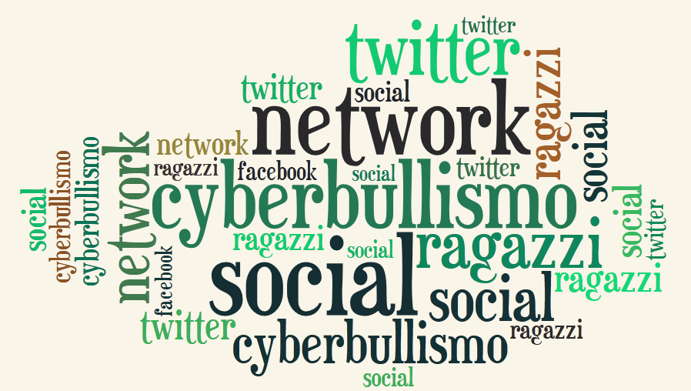
CYBERBULLYING
WHAT IS IT AND WHAT ARE ITS CONSEQUENCES?

Slide 2
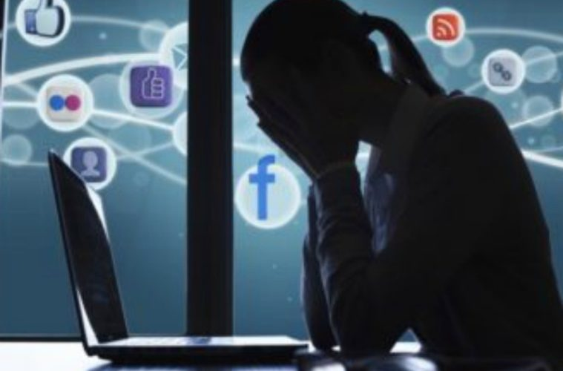
WHAT IS CYBERBULLYING?
Cyberbullying is a new generation, a kind of online bullying. The internet has opened up new possibilities for all of us. The other side of the coin, however, is represented by the risks associated with the improper use of this tool, as in the case of cyberbullying. The one carried out online is also an intentional aggressive act, conducted by an individual or group of individuals, but it makes use of various forms of electronic contact, i.e. different methods offered by new media, especially social networks (Facebook, Twitter, Instagram ...) , chats, phone calls and messages. It also has its own characteristics that make it more pervasive and unstoppable. If, in fact, bullying was traditionally understood as a form of abuse, single or group, which implied the direct relationship between bully and victim, in cyberbullying the boundaries are much wider because they travel through the internet.

Slide 3
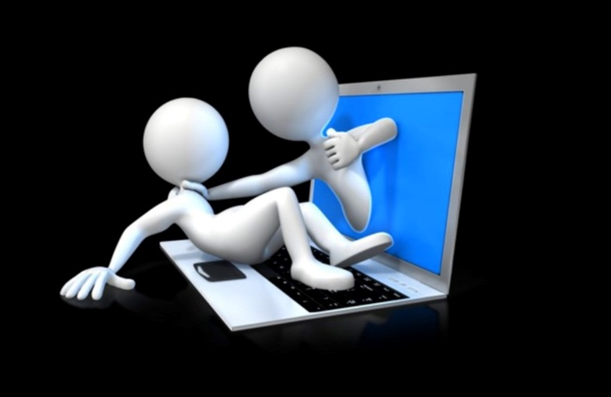
CYBERBULLYING: HOW IT CAN BE DIVIDED
FLAMING: violent and vulgar messages with the aim of provoking verbal "battles" online.
HARASSMENT: repeated sending of offensive, rude and insulting messages.
DENIGRATION: gossiping about someone online. Sending or posting cruel gossip about a person to damage their reputation or friendships.
IMPERSONATION: violating someone's private account, pretending to be that person and sending messages to give a bad image of the person, creating problems or dangers.
EXPOSURE: posting private and / or embarrassing information about another person.
CYBERSTALKING: repeated and threatening harassment and denigration aimed at arousing fear.

Slide 4
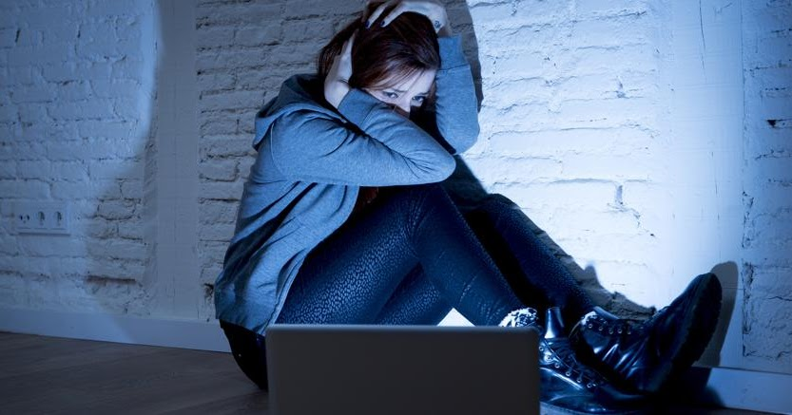
CONSEQUENCES OF CYBERBULLYING
The consequences of cyberbullying manifest themselves in the victim's real life.
They manifest themselves in a psychological way, that is, with sudden mood changes, emotional disorders, physical health problems, nervousness, anxiety, people suffering from cyberbullying withdraw into themselves and do not communicate with the rest of the world. They fall into a kind of depression and their self-esteem and confidence is zero.
As in bullying, in the most desperate cases they even decide to take their own life.

Slide 5
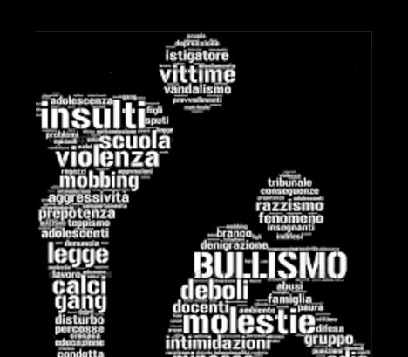
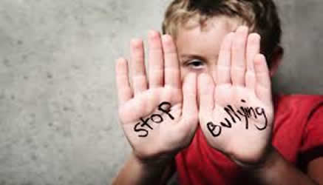
DEFENSE FROM CYBERBULLYING
The defense against cyberbullying acts only through not hiding what happens, reporting the matter first to parents, teachers if in the school context and, subsequently, to the Postal Police.
Following a complaint, the Police can undertake research actions to trace the person or people responsible, which is absolutely possible, thus putting an end to the violence.
Those responsible for bullying and cyberbullying can be indicted and judged pursuant to the Decree Law of 14 August 2013, n.93. If the facts take place in the school environment, severe disciplinary measures can be taken.

Slide 6
THE END
TRINGALI GIORGIA
SCICOLONE LUDOVICA

