Slide 1


CYBER-BULLYING
Cyber-bullying is the term to indicate a continuous, repeated and offensive attack through the tools of the network: in fact, it’s a phenomenon that has arisen in recent years among children and especially adolescents and which is found, for example, through the Internet, mobile phones and also computer.
Therefore, electronic bullying includes all forms of bullying through emails, text messages, websites, images or videos published on the network and social networks. Furthermore, the bully's goal is always the same: to harass the victim, threaten her and make fun of her.

Slide 2


CONSEQUENCES OF CYBER-BULLYING
In essence, this cyber-bullying manifests itself in various ways, but basically, as we have already said, via the Internet and telephones mobile phones. Unfortunately no research has been conducted on understanding the consequences of cyber-bullying, as opposed to what it happened with traditional bullying, the consequences of which are evident for teenagers.
However, according to the most recent studies, the damage to cyber-bullying is similar to that of traditional bullies and victims. The victims very often develop low self-esteem, depression, anxiety, fears, relationship problems and in the most serious cases even suicidal thoughts.

Slide 3

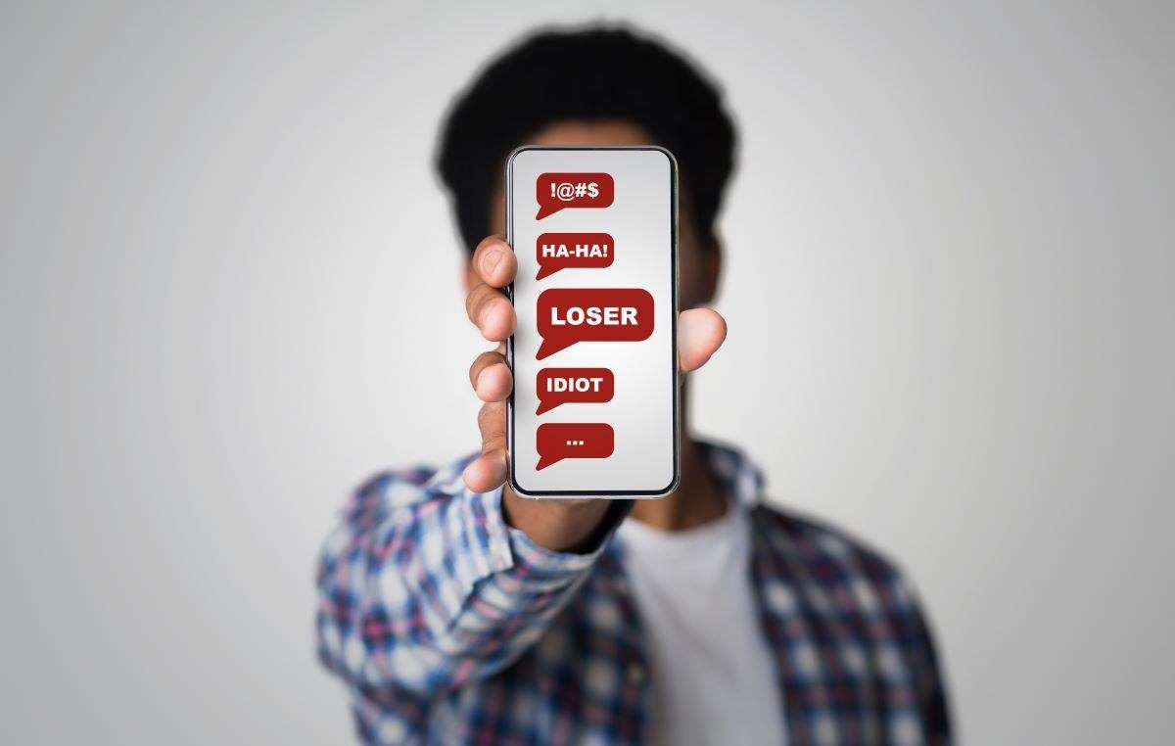

SOLUTIONS OF CYBER-BULLYING
In conclusion, it is important to teach young people some basic rules to prevent this phenomenon and use the Internet secure way: never give personal information, such as name, address, phone number, age, names of friends to someone you don't know personally or anyone you know on the web; never respond to a message that makes you feel confused or uncomfortable.

