Slide 1
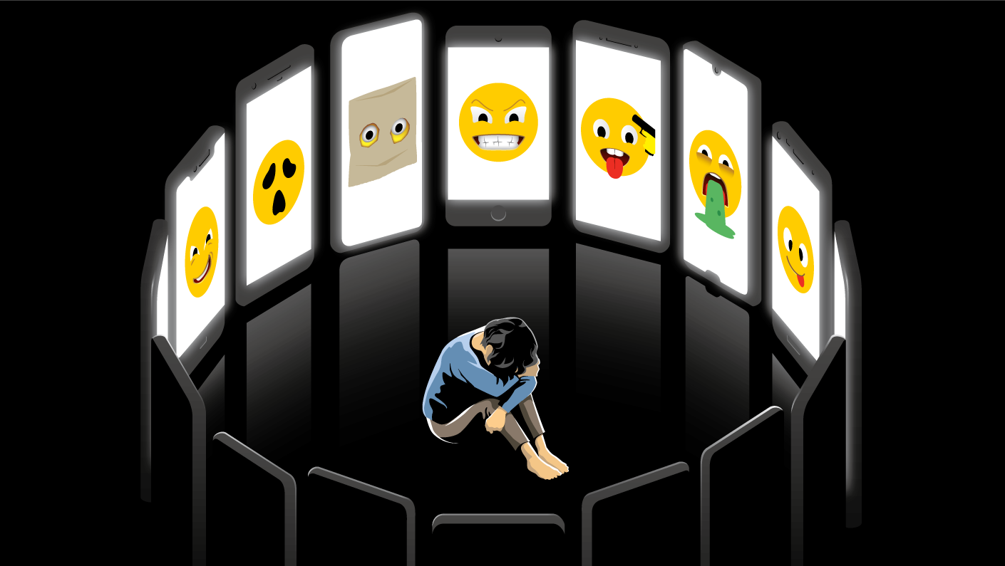
CYBER-BULLYING

Slide 2
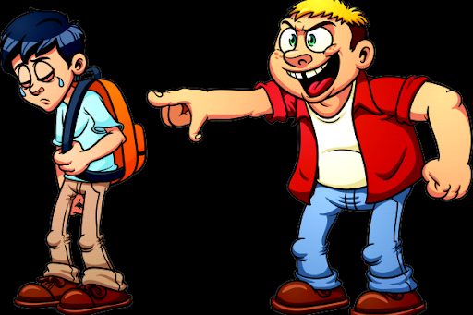
BULLYING
Bullying is the use of force, to abuse, aggressively dominate or intimidate.
There are many different types of bullying that can be experienced by children and adults alike, some are obvious to spot while others can be more subtle. The different types of bullying that we look at below are some of the ways that bullying could be happening.
Physical bullying, physical bullying includes hitting, kicking, tripping, pinching and pushing or damaging property.
Verbal bullying, verbal bulling includes name calling, insults, teasing, intimidation, homophobic or racist remarks, or verbal abuse.
Social bullying, social bullying, sometimes referred to as covert bullying, is often harder to recognise and can be carried out behind the bullied person’s back. It is designed to harm someone’s social reputation and / or cause humiliation.
Cyber bullying, the activity of using the internet to harm or to frighten another person, especially by sending them unpleasent messages...

Slide 3
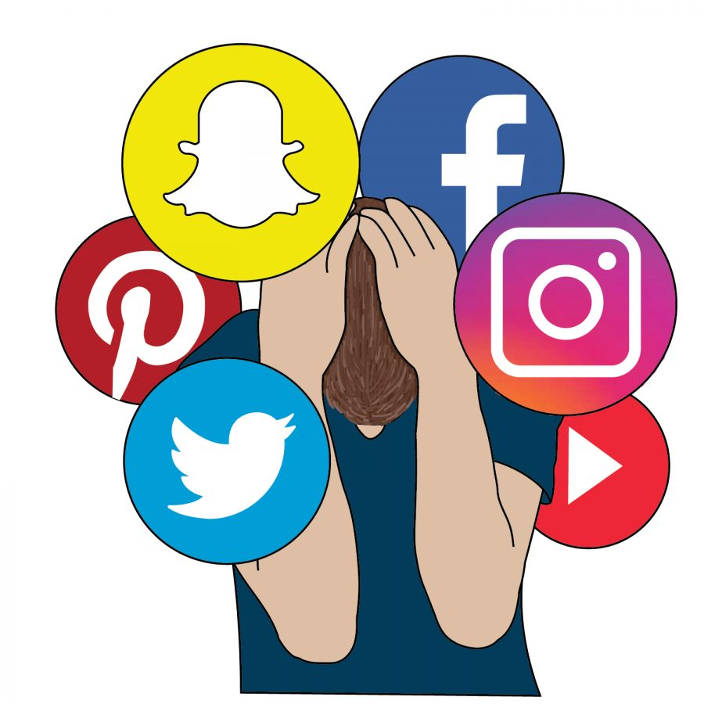
…CYBER-BULLYING
Not surprisingly, cyberbullying is a significant stressor in a young person's life. In fact, research shows that 32% of kids who are targets of cyberbullying report experiencing at least one symptom of stress.
In addition to feeling distressed, they also may feel embarrassed, hurt, and even fear for their safety. They may even blame themselves for the cyberbullying.
So, if you notice a change in your child's mood, don't hesitate to reach out to their healthcare provider for support.

Slide 4
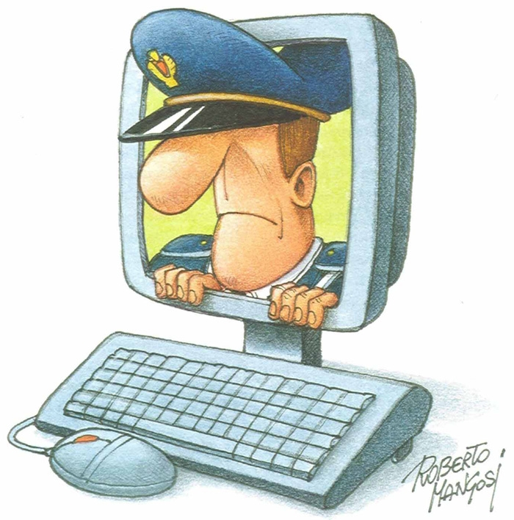
The defense:
The defense against cyberbullying acts only through not hiding what happens, first reporting to parents, if it happens at school it’s important to tell the fact to the teacher and subsequently, to the postal police.
Thanks to the complaints, the police can do research to trace the guilty, putting an end to the violence.
Those responsable for cyberbullying acts can be judged persuant to Law Decree n.93 of 14 August 2013. If the facts take place in the school environment, severe desciplinary measures can be taken.

Slide 5
ELENA CALAMARO
CAROLA CACCIAGUERRA
&

