Slide 1
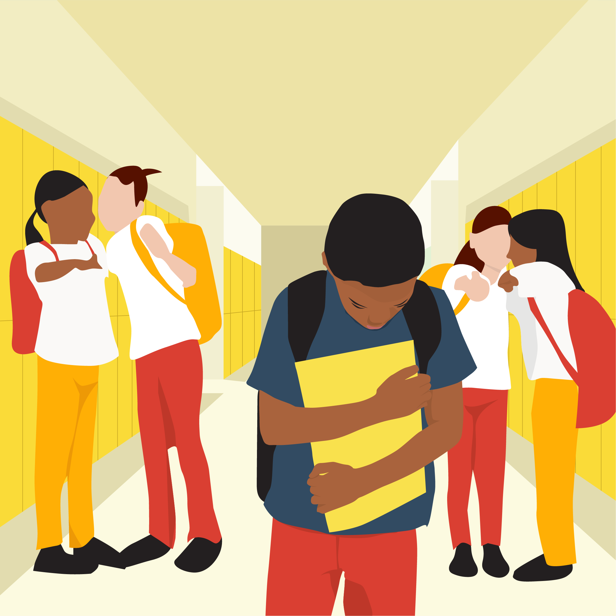
Bullying
Alessia Grandi

Slide 2
WHAT IS BULLYING?
There is no legal definition of bullying. But it is usually defined as repeated behaviour which is intended to hurt someone either emotionally or physically, and is often aimed at certain people because of their race, religion, gender or sexual orientation or any other aspect such as appearance or disability.

Slide 3
1) How many forms of bullying exist?
Bullying can take many forms.
2) What is cyberbullying?
Cyberbullying is bullying that takes place over digital devices like cell phones, computers, and tablets. Cyberbullying can occur through SMS, Text, and apps, or online in social media.
3) Laws and sanctions
All states have laws requiring schools to respond to bullying. And many states now includes cyberbullying too.

Slide 4

Can we prevent bullying?
How can we prevent bullying?
HELP, COMMUNICATION,
LISTEN,
ENCOURAGE.
Stop bullying is possible?

Slide 5
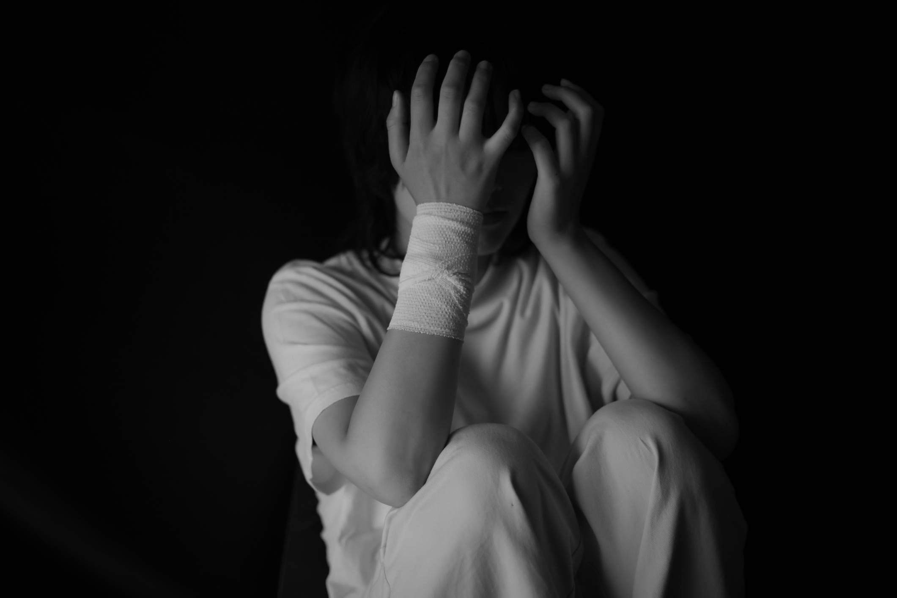
Effects
Kids Who are Bullied and Kids Who Bully Others
Bullying can affect everyone—those who are bullied, those who bully, and those who witness bullying.
Is there a relationship between bullying and sucide?

