Slide 1


Bullying
Cristina Bassi
Giulia Blandino
IIIAL
A.S. 2020/2021
What is bullying?
Types of bullying
How to help
How bullying changes with age

Slide 2
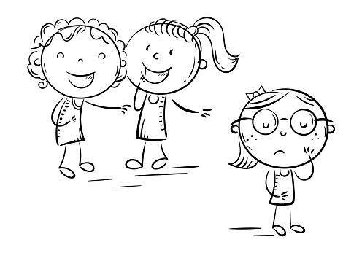
What is bullying?
“The term bullying designates
a set of behaviours in which someone
repeatedly does or says things in order to have power over another person
or to dominate them.”
It includes both the behaviours of the "persecutor" and those of the "victim", placing the relationship at the centre of attention.
Factors characterizing bullying:
Intention to harm and lack of compassion
Intensity and duration
Power of the bully
Vulnerability of the victim
Lack of support
Often it is underrated and confused with normal conflicts between peers.

Slide 3
Types of bullying
There are four types of bullying:
Verbal bullying is saying or writing mean things.
It includes:
  Teasing
  Name-calling
  Inappropriate sexual comments
  Taunting
  Threatening to cause harm
Physical bullying involves hurting a person’s body or possessions. It includes:
  Hitting/kicking/pinching
  Spitting
  Tripping/pushing
  Taking or breaking someone’s things
  Making mean or rude hand gestures
Social bullying, sometimes referred to as relational bullying, involves hurting someone’s reputation or relationships. It includes:
  Leaving someone out on purpose
  Telling other children not to be friends with someone
  Spreading rumors about someone
  Embarrassing someone in public
  Cyberbullying is bullying with the use of digital technologies on social media, messaging platforms, gaming platforms and mobile phones. It is aimed at scaring, angering or shaming those who are targeted. It includes:
  Spreading lies / posting embarrassing photos
  Sending hurtful messages or threats via messaging platforms
  Impersonating someone and sending mean messages to others on their behalf.

Slide 4
How to help
The victim:
LISTEN EMPATHICALLY, PUT YOURSELF IN HIS CLOTHES.
If the victim confides, it is important that his story is heard in all details facets.
ATTENTION TO YOUR REACTIONS CAN MAKE IT CLOSE MORE.
You must not have exaggerated reactions, neither anger, nor alarmist.
You must transmit security and confidence.
DON'T ATTACK BUT DEFEND YOURSELF.
It is important to tell the victim immediately not to react to the provocations
of the abusers because what the bully wants to achieve is a reaction from him.
DO NOT ERASE THE TRACKS OF CYBERBULLYING, THEY ARE AN IMPORTANT DOCUMENT. Don’t delete the traces on social networks or chats and inform someone about
everything that happens to intervene immediately and avoid something more serious.
TEACH THE VICTIM NOT TO LOSE TRUST IN HIMSELF AND IN OTHERS.
You have to be especially careful because when he is targeted,
he lose confidence in himself, he no longer believes in his abilities, he loses vitality.
It is also essential to recreate support and reinforcement
so as not to make him feel completely lost and alone.

Slide 5
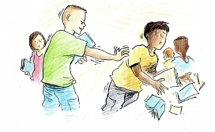

How to help
The bully:
LET’S REORGANIZE HIS LIFE.
Behind the bully there’s a great emotional fragility, after all he is a weak boy or girl.
You must support him, make him grow. Don't criminalize him.
LET’S MAKE HIM APOLOGIZE.
When an unpleasant event happens, help him to reconstruct the facts,
accompany him to a meeting organized in which the victim and her parents are also present.
IDENTIFY THE REASONS THAT LED HIM TO SEEK NOTORIETY.
There is often great frustrations behind these behaviours.
Let you not be fooled by the strength shown by the bully:
let you help him understand the state of mind of the victim
and don’t be afraid to express your criticism.

Slide 6
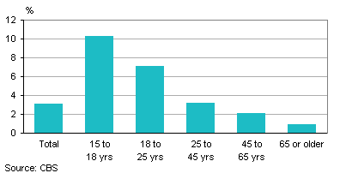
How bullying changes with age
Children
Teens
Baby – bullying: carried out by very young children.
More common in primary schools, even though often underestimated.
Still little known: for the child it can be difficult to face such a situation and it is thought that such a small child can assume certain attitudes.
Not the right tools to avoid it and educate children.
Recognize the first signs and not to make certain attitudes become normal by the bully.
The most critical period: between 11 and 13.
A higher level of psychological verbal violence was recorded among girls.
Often these violent attitudes are caused by the changes that every teenager lives: physical changes, thoughts, own values or desire for independence.
Adults
Found anywhere: office, university or public places.
Physical bullying: the most dangerous for the consequences on the victim;
Passive bullying: the victims are subjugated and treated with kindness;
Role bullying: in the workplace;
Verbal bullying; adult cyberbullying.
Generally it includes: violation of private property, vulgar and provocative attitudes towards girls or harassments.

