Slide 1

In 2021 bullying continues to be a rather present social scourge, especially among young people

Slide 2
Often, those who are bullied suffer so much that they take their own lives

Slide 3

AGBproduction
presents

Slide 4

BULLYING IN SOCIETY
A POWER POINT BY:
FRANCESCO BELLOMO
ALBERTO PITRUZZELLO
GIUSEPPE PRATO

Slide 5

WHAT IS BULLYING?
There is no legal definition of bullying. But it is usually defined as repeated behaviour which is intended to hurt someone either emotionally or physically.

Slide 6

THE CAUSES OF BULLYING
Bullying is often aimed at certain people because of their race, religion, gender or sexual orientation or any other aspect such as appereance or disability
s

Slide 7
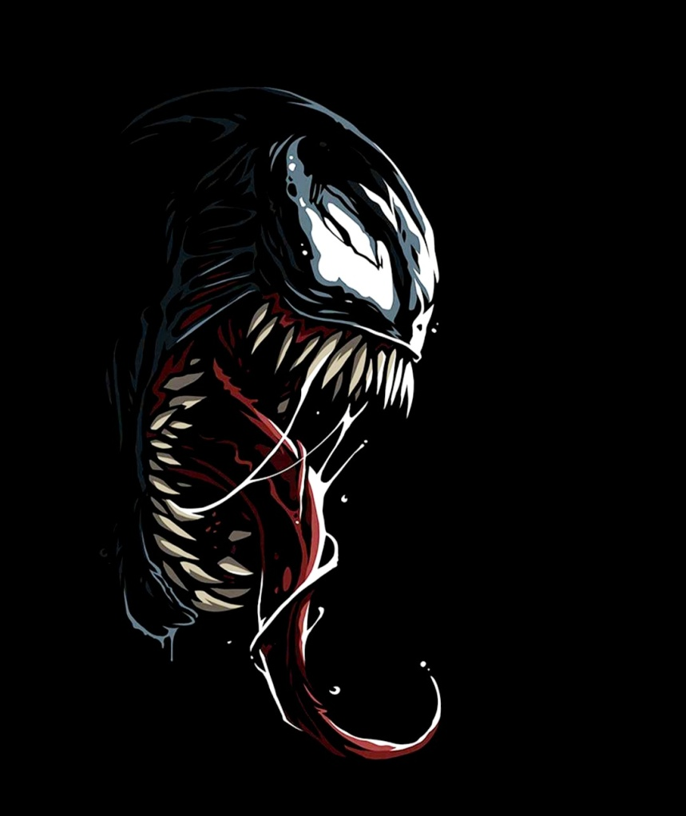
WHERE DOES BULLYING OCCUR?
Bullying tends to happen most of the time in school and around schools, especially in those areas where there is little or no adult supervision. Some studies indicate that bullying is most prevalent during the elementary school years, while others show an increase and peak during early adolescence.

Slide 8

PINK SHIRT DAY
Pink Shirt Day is an antibullying campaign that celebrates diversity and creates environments where all people can feel safe, valued and respected. Each year, schools, organisations and individuals join the movement to fight against bullying by wearing a pink shirt. It originated in Canada, and is now celebrated on various dates around the world

Slide 9
TYPES OF BULLYING
SCHOOL BULLYING
CYBERBULLYING
VERBAL BULLYING
PHYSICAL BULLYING

Slide 10
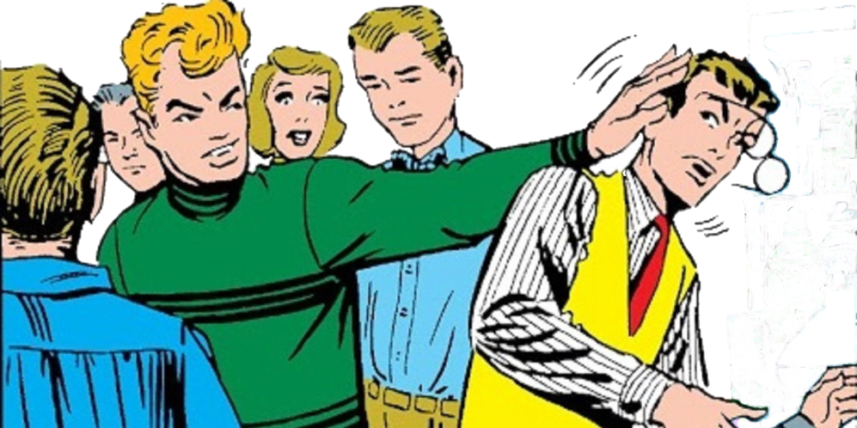
SCHOOL BULLYING
GO BACK
School bullying is bullying that occurs inside schools. Bullies are often physically stronger and taller than the victims who are most of the time shy, smaller and very weak physically

Slide 11
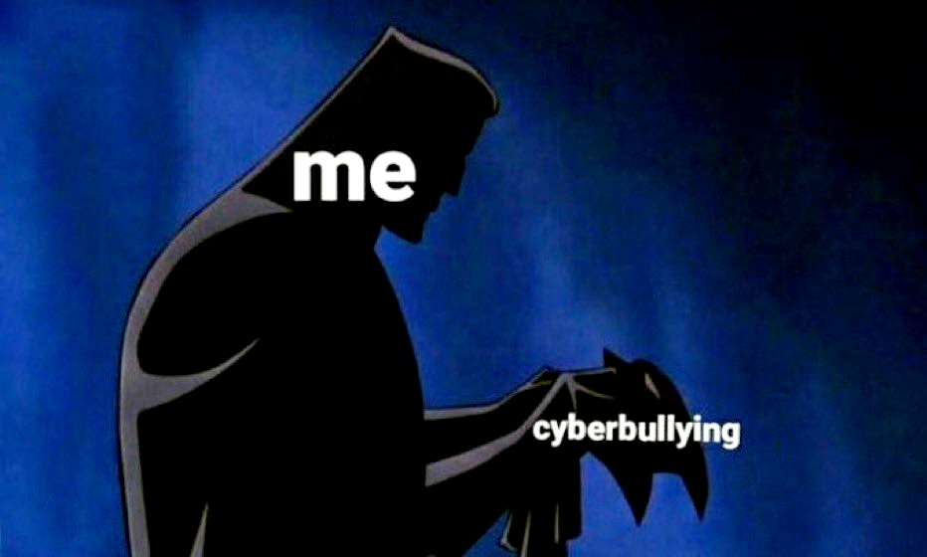
CYBERBULLYING
GO BACK
Cyberbullying is bullying that takes place over digital devices like phones, computers and tablets. It occurs most of the time on social media like Facebook or Instagram. Cyberbullying includes sending, posting, or sharing negative, false, mean content or private information about someone else

Slide 12
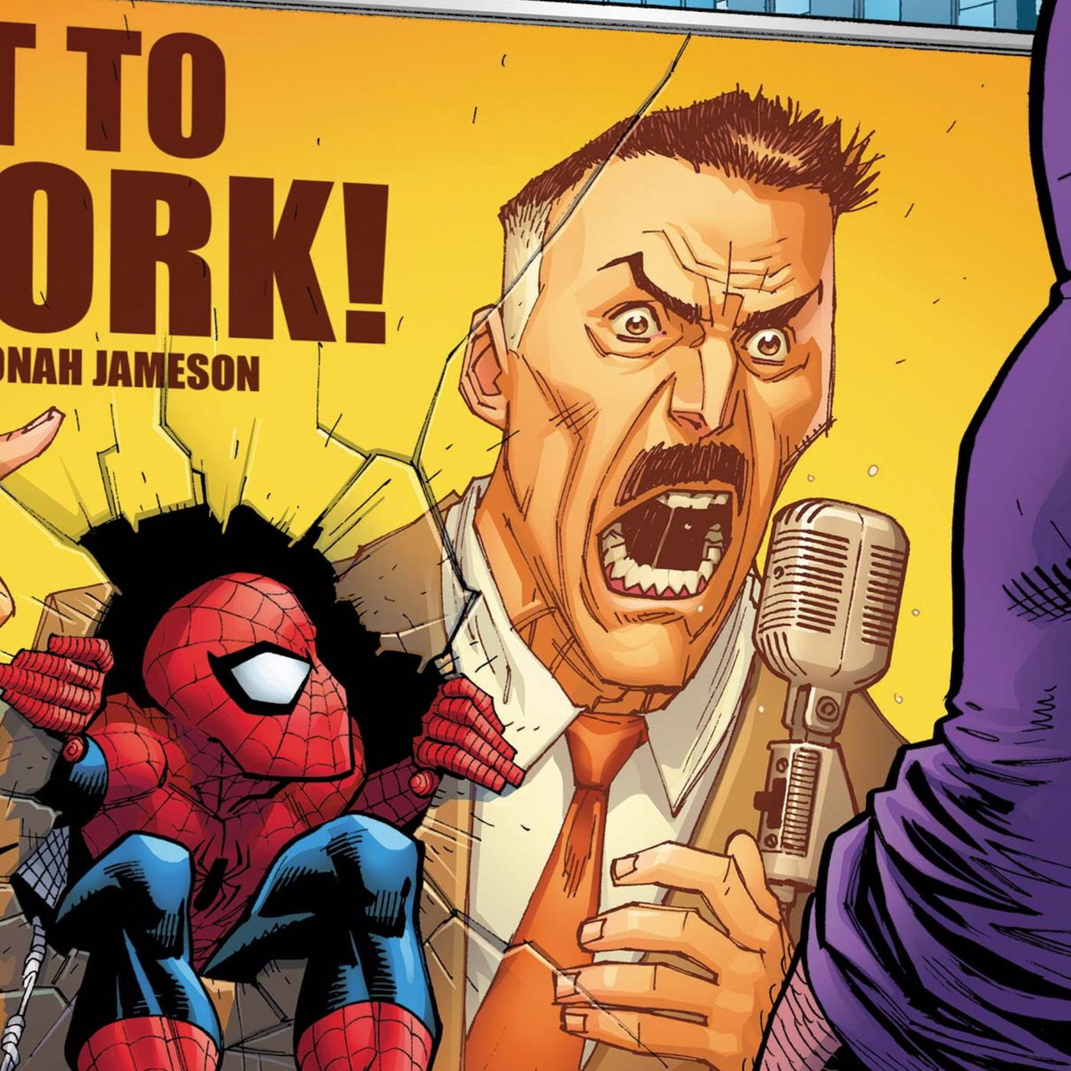
VERBAL BULLYING
GO BACK
Verbal bullying involves mainly insults, taunts, name calling, and other types of verbal abuse.
Verbal bullying is not limited to children but also adults. It can start only by teasing or a slight insult but this can quickly escalate intro verbal violence that causes serious harm to its victim.

Slide 13
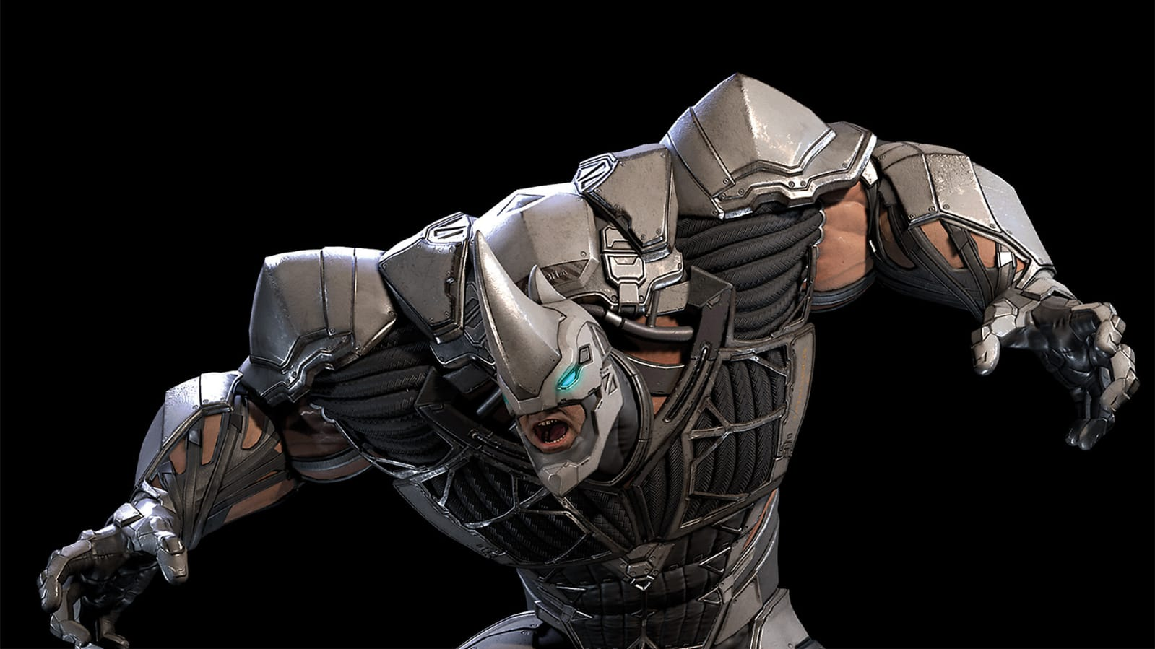
PHYSICAL BULLYING
Physical bullying is the use of physical actions to intimidate and gain control over a target. Physical bullying includes: hitting, kicking, pinching and damaging personal things

