Slide 1

CYBERBULLING
Elena Papillo, Carla Riso and Oliwia Jarocha
2AL

Slide 2
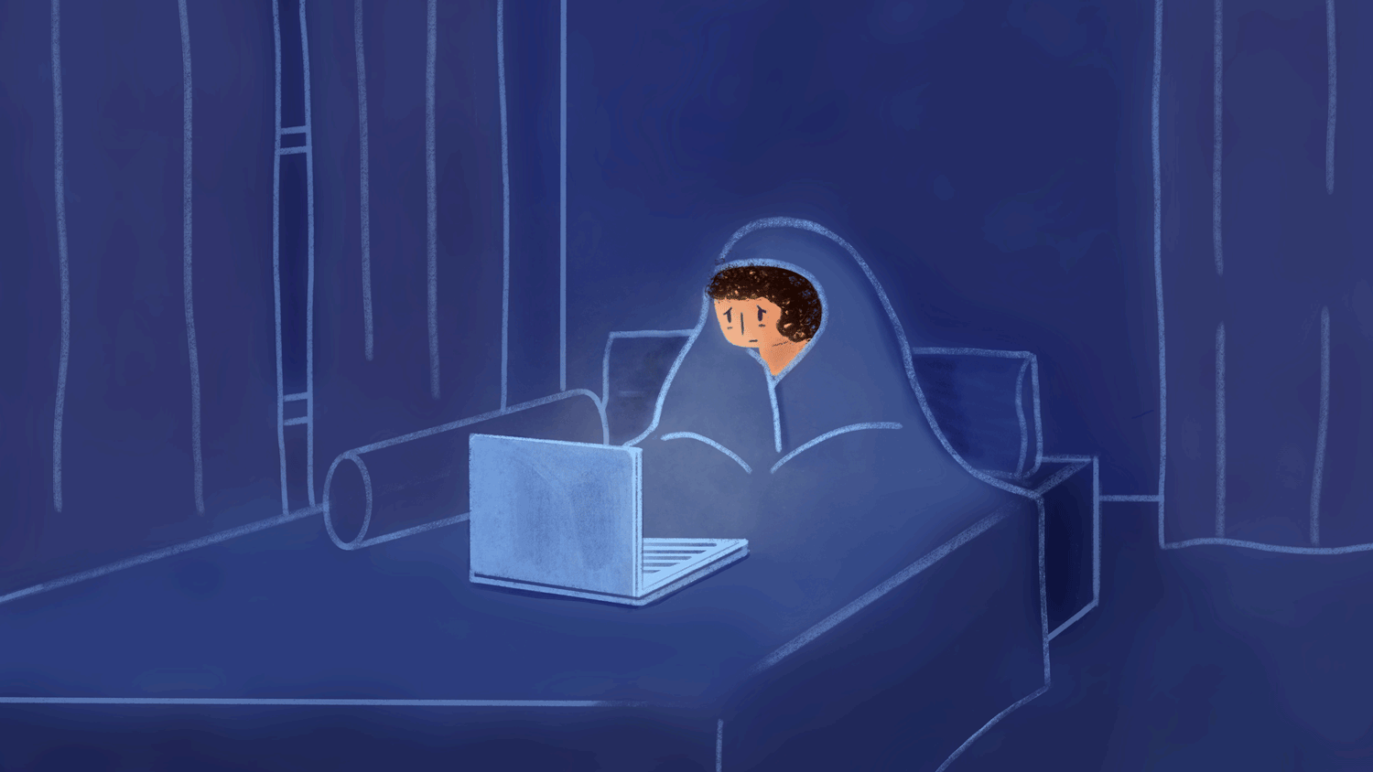
WHAT IS CYBERBULLING?
Cyberbullying is bullying that takes place over digital devices like cell phones, computers, and tablets. Cyberbullying can occur through SMS, Text, and apps, or online in social media, forums, or gaming where people can view, participate in, or share content. Cyberbullying includes sending, posting, or sharing negative, false, or mean content about someone else. It can include sharing personal or private information about someone else causing embarrassment or humiliation.

Slide 3

The most common places where cyberbullying occurs are:
Social Media, such as Facebook, Instagram, Snapchat, and Tik Tok
Text messaging and messaging apps on mobile or tablet devices
Instant messaging, direct messaging, and online chatting over the internet
Online forums, chat rooms, and message boards, such as Reddit
Email
Online gaming communities

Slide 4

BULLYING
Bullying affects lots of people and can happen anywhere: at school, travelling to and from school, in sporting teams, in friendship or family groups or in the workplace.
There is no legal definition of bullying. But it is usually defined as repeated behaviour which is intended to hurt someone either emotionally or physically, and is often aimed at certain people because of their race, religion, gender or sexual orientation or any other aspect such as appearance or disability.

Slide 5

Bullying can take many forms including:
Bullying can take many forms including:
physical assault
social bullying
threatening behaviour
name calling
cyberbullying

Slide 6
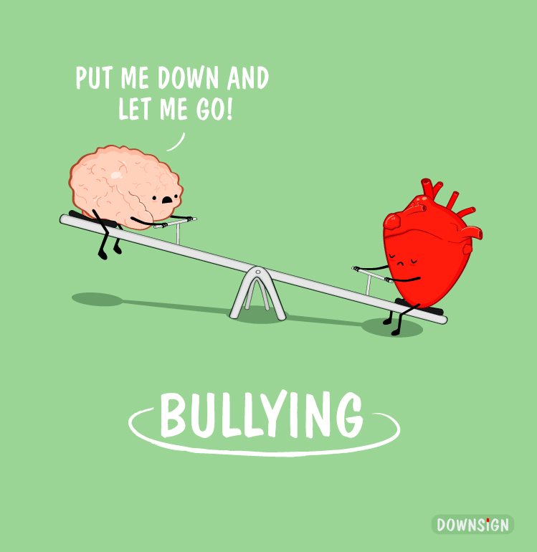
How to deal with bullying at school
If you are being bullied at school, tell a friend, tell a teacher and tell your parents. It can be hard to do this so if you don't feel you can do it in person it might be easier to write a note to your parents explaining how you feel, or perhaps confide in someone outside the immediate family, like a grandparent, aunt, uncle or cousin and ask them to help you tell your parents what's going on.

