Slide 1
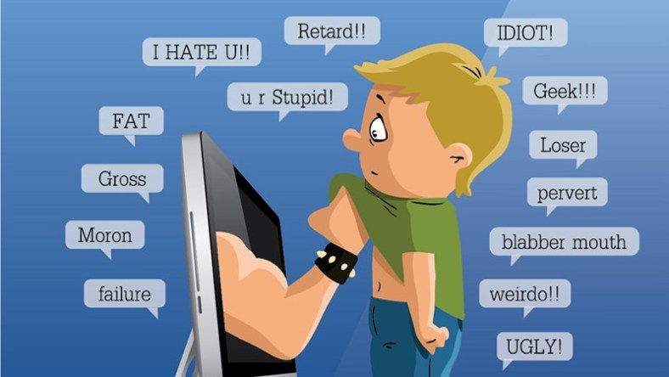
CYBERBULLYING
SAIA DANIELE
BALLOTTA RICCARDO
SANTORO GAETANO

Slide 2
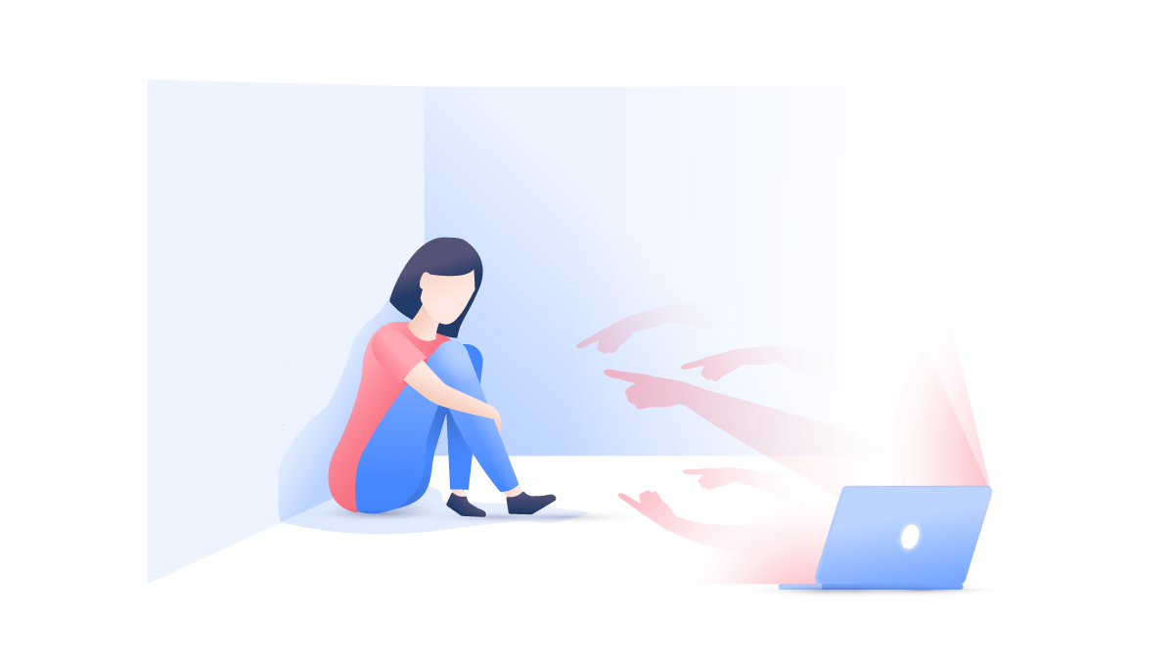
‘’Cyber bullying’’ is when a child or teen is tormented, threatened, harassed, humiliated, embarrassed or otherwise targeted by another child or teen using internet, interactive or digital technologies or cell phones.
It has to have a minor on both sides, or at least have been instigated by a minor against another minor.
What is Cyberbullying

Slide 3
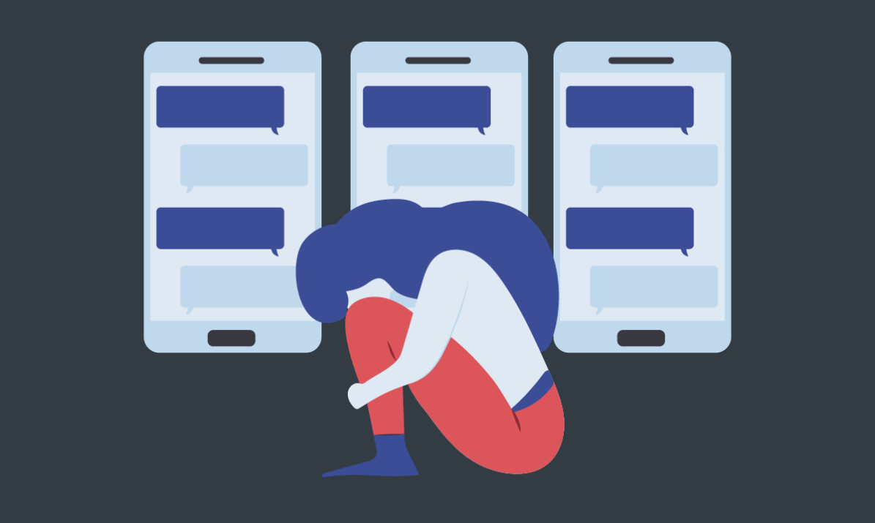
There are two kinds of
Cyber Bullying :
-Direct Attacks. Messages sent directly to the victim.
-Cyber Bullying by Proxy. Using someone else to cyber bully a victim, this proxy may know they are cyber bullying and they may not.

Slide 4
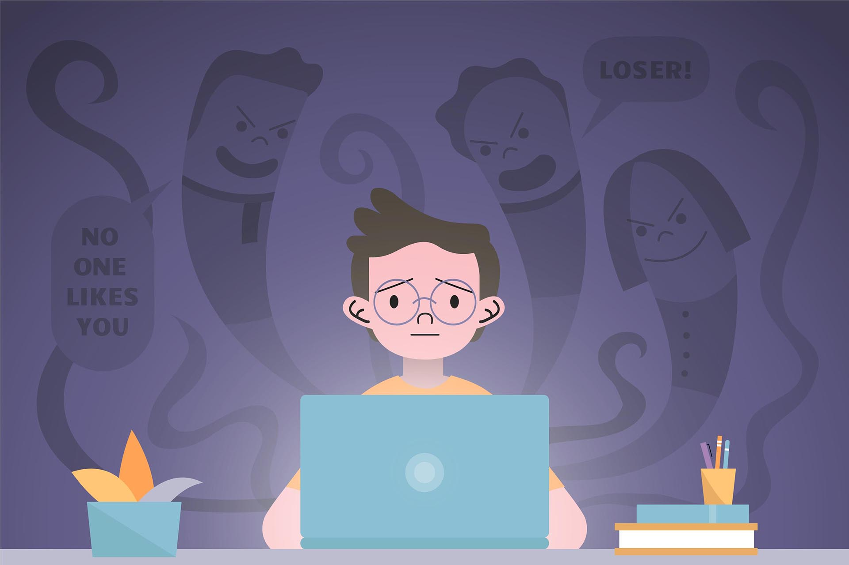
Direct Attacks
-Instant Messaging
-Text Messaging
-Blogs
-Websites
-Emailing Pictures
-Stealing Passwords
-Internet Polling-Hot or not!
-Hacking or sending spyware

Slide 5
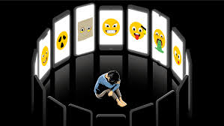
By Proxy
-Someone else does the dirty work for the main cyber bully.
-Bullies may hack into the victim’s account or steal their password.
They may set up a new account pretending to be the victim.
-Friends get angry with the victim.
-This form of cyber bullying is very dangerous because many people are involved, not just the bully and the victim.

Slide 6

Prevention
- Education of students is the best way to teach children about the seriousness of cyber bullying.
- Schools can take action with discipline for IN-SCHOOL situations only.
- Teach students techniques for calming down so they do not react with anger and revenge using technology.

